Slide 1
Eavor Loop & the Deep Geothermal Frontier
State of the Art, Depth Limits & 150–180 °C Resources
2025-07-03

Slide 2
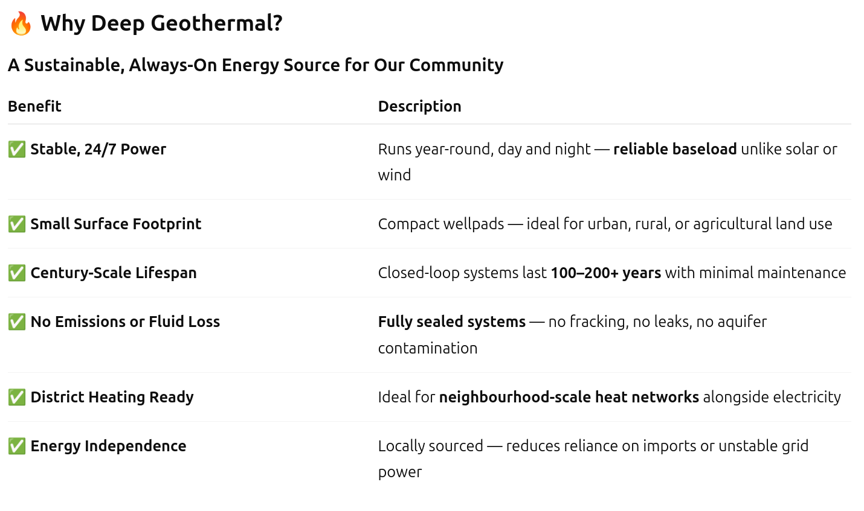

Slide 3
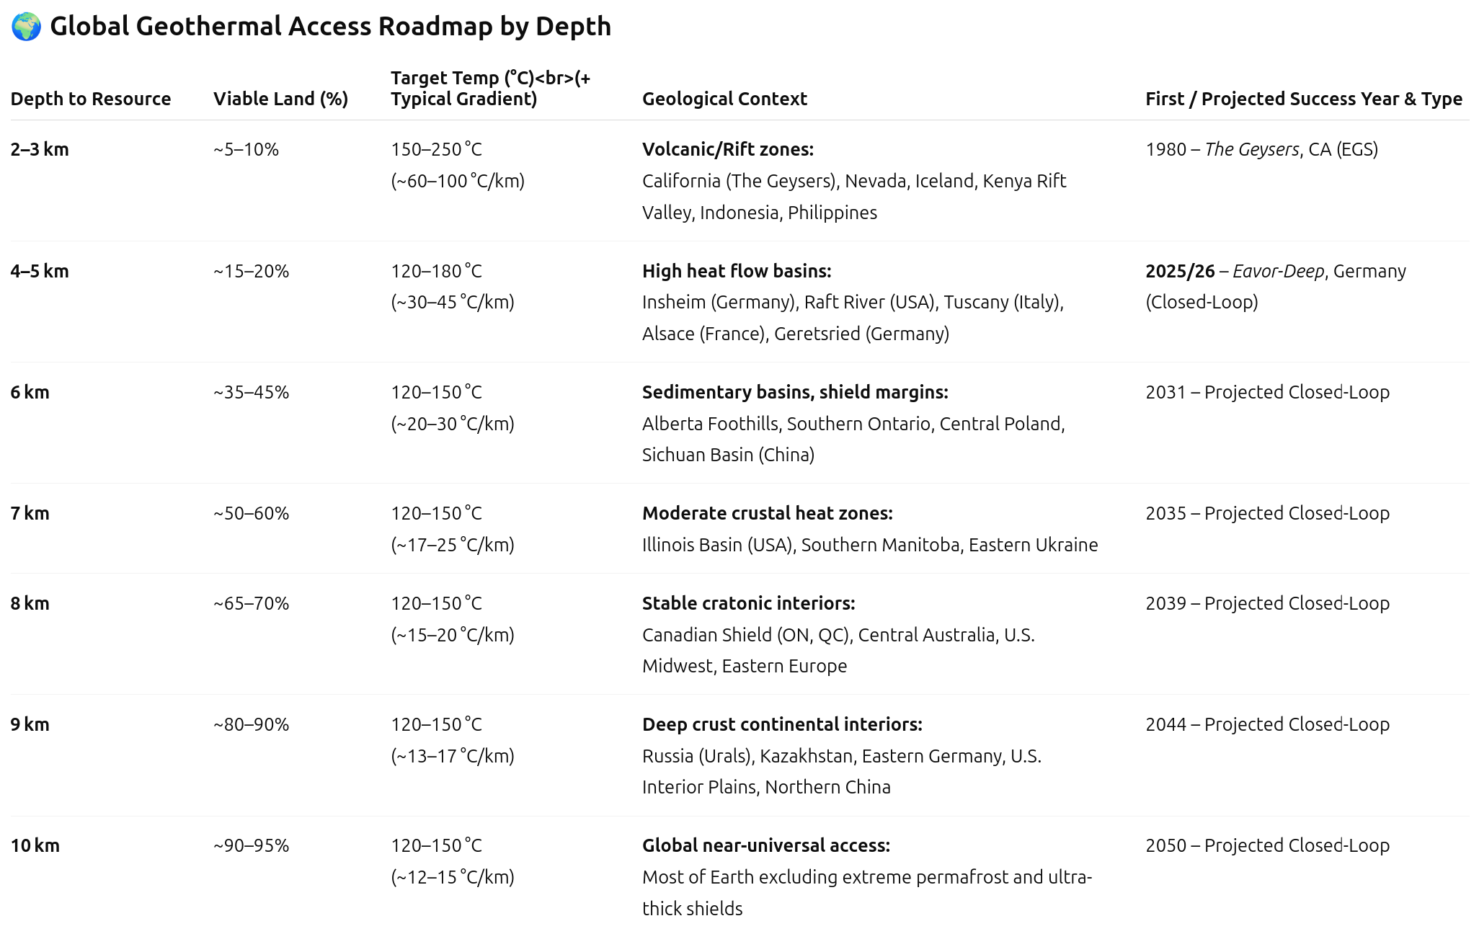

Slide 4
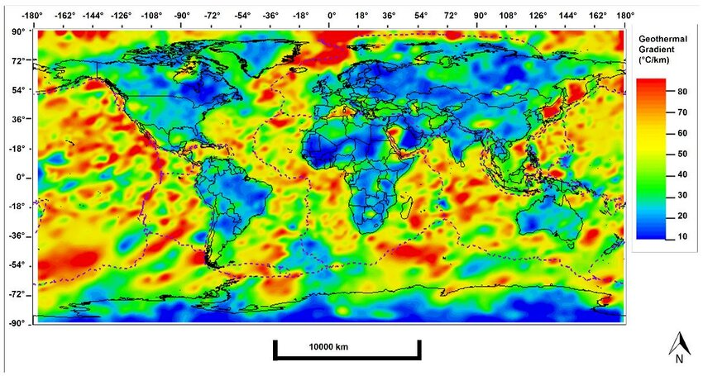
Global Geothermal Gradient Map (by Carlos Vargas)

Slide 5
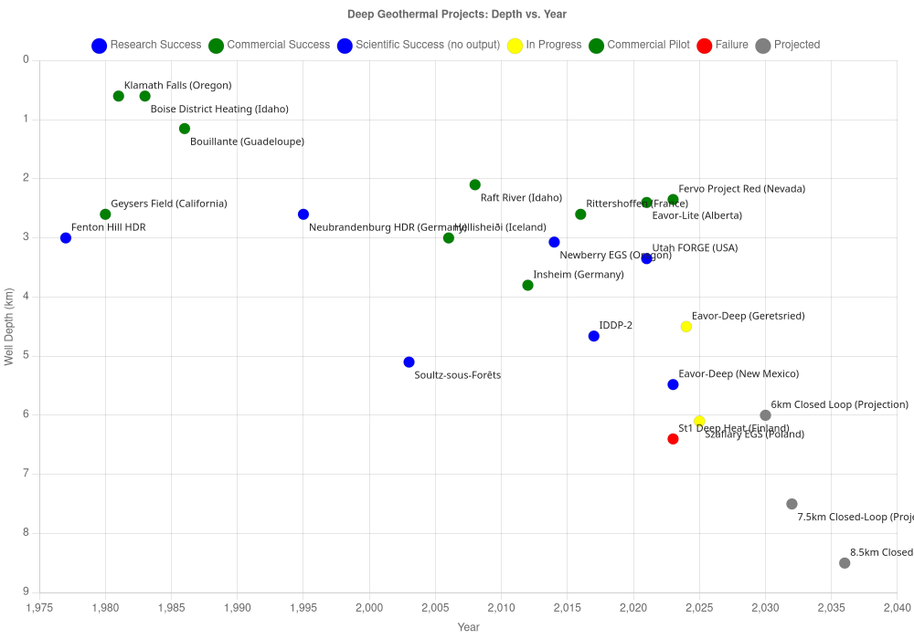
Historical Depth Milestones

Slide 6
🧯 Why EGS Fails Below 4 km
❌ EGS Needs Proppant to Work
EGS relies on fracturing deep rock to create fluid pathways.
Proppant (like sand or ceramic beads) keeps fractures open.
But at depths >3.5–4 km, pressures exceed 100 MPa:
All known proppants crush or deform
Fractures seal shut, stopping flow
Result: Flow drops within months without costly re-fracturing.

Slide 7
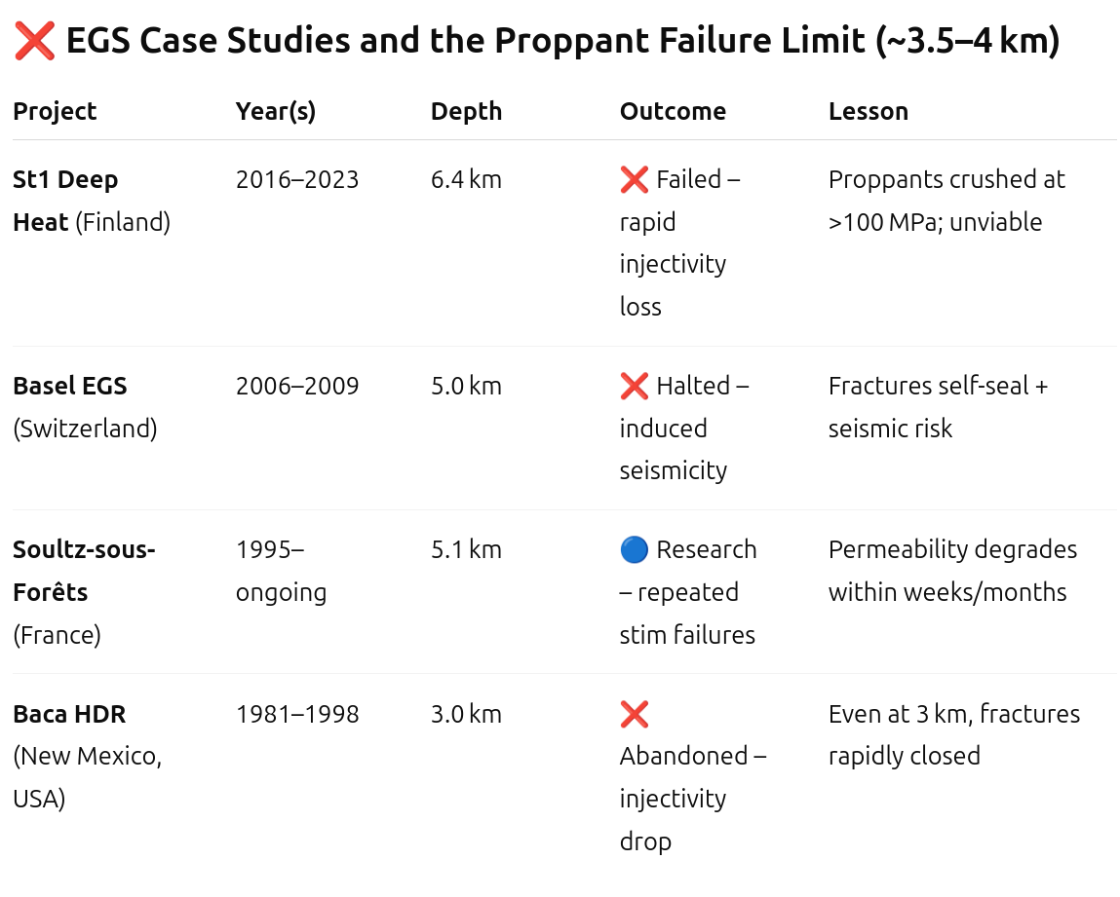
Failed Deep EGS Projects

Slide 8
✅ Closed-Loop Systems Are the Solution
No fracking, no proppant, no fluid loss
Can operate reliably beyond 6–8 km
Eavor-Deep NM proved tech at 5.5 km, 250+ °C
Ideal for Ontario: target 7–8.5 km for 150–180 °C
🧠 Bottom Line:
Closed-loop geothermal is the only realistic deep geothermal solution below 4 km.

Slide 9
How the Eavor Loop Works
Closed‑loop U‑tube: two verticals joined by multilateral horizontals
Working fluid circulates in sealed wellbore—no produced brine
Natural thermosiphon delivers 150–180 °C to surface
No fracking ➜ minimal seismic & environmental risk

Slide 10
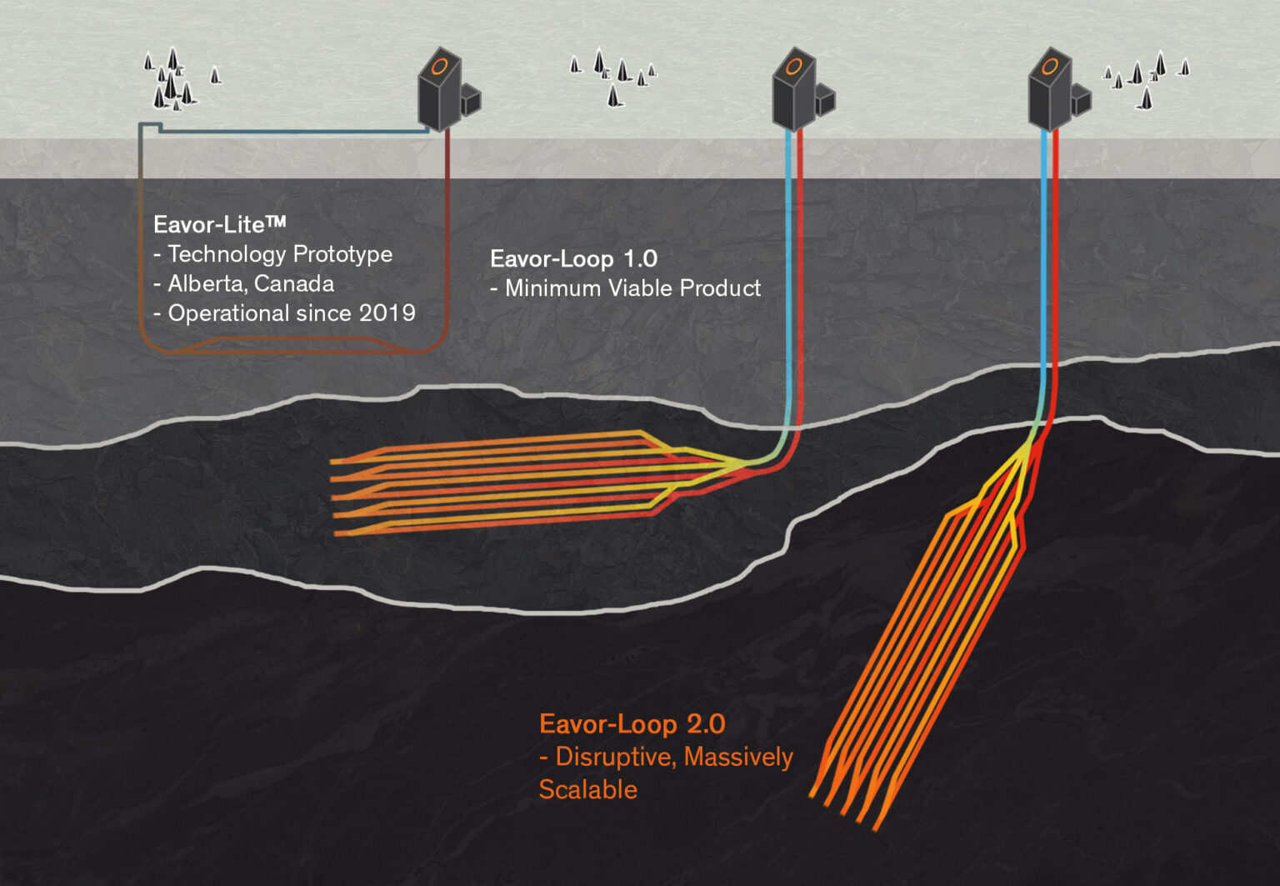
What are the different kinds of Eavor-Loops?

Slide 11
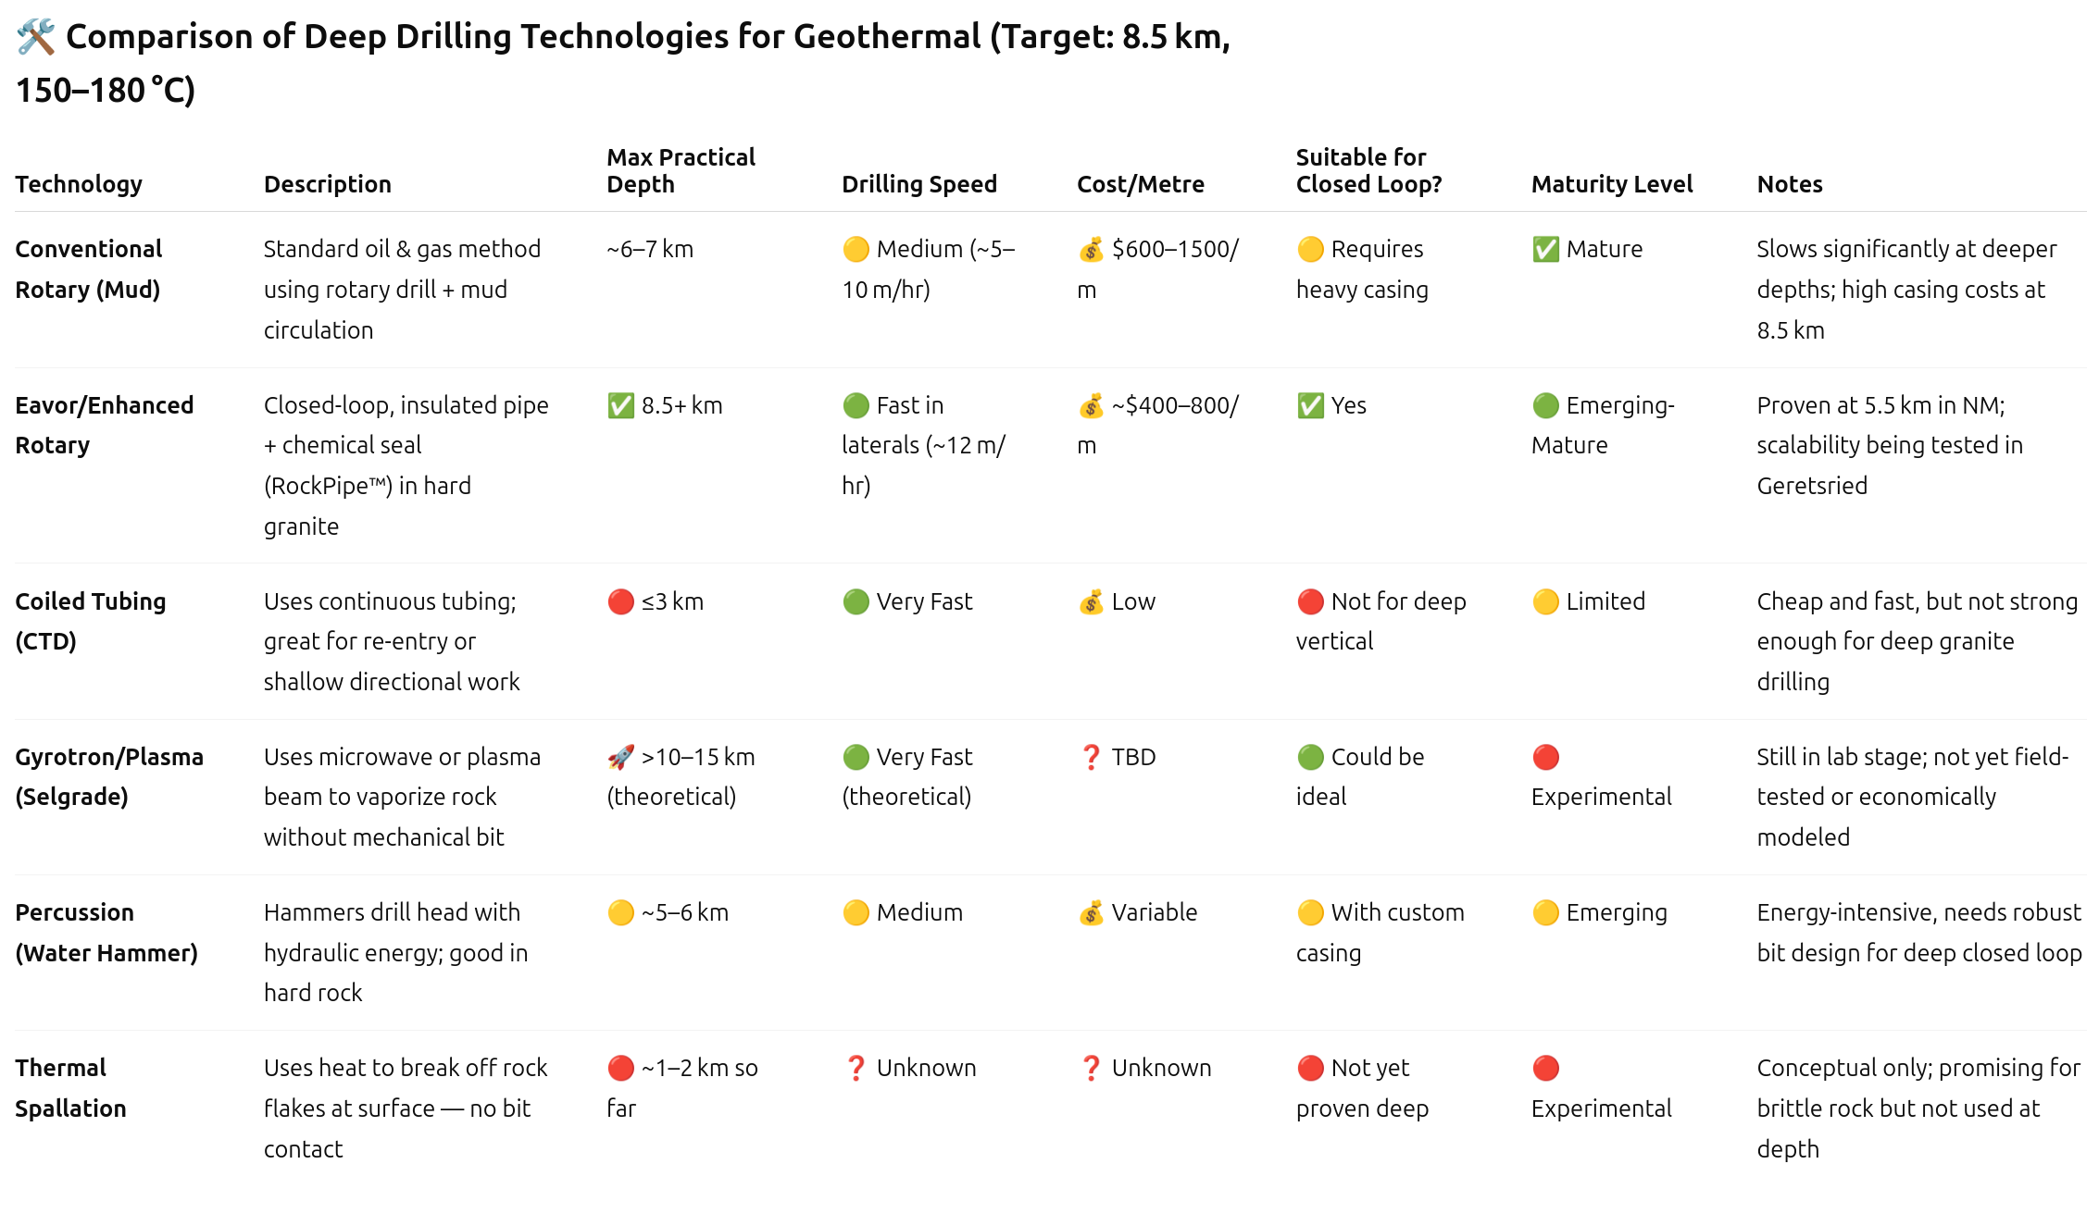

Slide 12
