Slide 1

Black Swans, White Swans and the Purple Transition
Simon P. Michaux
Associate Professor Mineral Processing & Geometallurgy

Slide 2
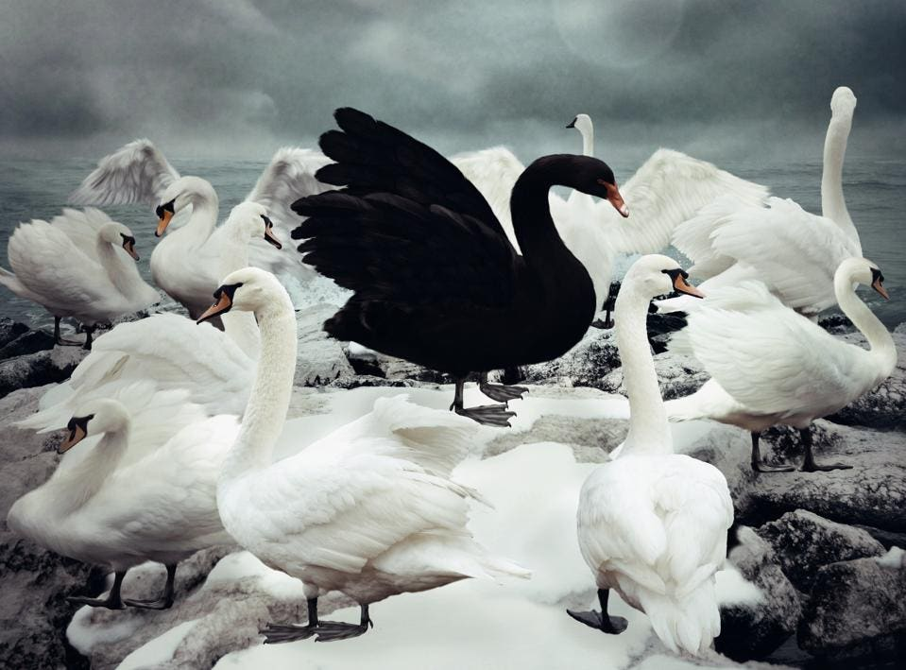
Summary
Mapping the Green Transition
4 buffer sizes to manage intermittency of solar and wind power supply
Quantity of metals needed
  Compared to global annual mining production 2019
  Compared to mineral reserves, resources and under sea resources
Make batteries of something other than lithium-ion chemistry
The commodities industry has been misunderstood
Liquid fuel fission using thorium as the fuel
Ammonia fueled ICE
The Purple Transition

Slide 5
Table 43. Total metal quantity required to phase out fossil fuels, by different buffer for stationary power storage capacity
6 hours (Larson et al 2021)
Larson, E., Greig, C., Jenkins, J., Mayfield, E., Pascale, A., Zhang, C., Drossman, J. Williams, R., Pacala, S., Socolow, R., Baik, E.J., Birdsey, R., Duke, R., Jones, R., Haley, B., Leslie, E., Paustian, K., and Swan, A., (2021): Net Zero America: Potential Pathways, Infrastructure, and Impacts, Final Report Summary, Princeton University, Princeton, NJ, 29 October 2021, https://netzeroamerica.princeton.edu/?explorer=pathway&state=national&table=e-positive&limit=200
48 hours +10% (Steinke et al 2012)
Steinke F., Wolfrum Ph., and Hoffmann C. (2012): Grid vs. storage in a 100 % renewable Europe. Renewable Energy, 50 (2013), 826-832
28 days (Droste-Franke 2015)
Droste-Franke, B. (2015): Review of the need for storage capacity depending on the share of renewable energies (Chap. 6). In Electrochemical energy storage for renewable sources and grid balancing. Netherlands: Elsevier
12 weeks (Ruhnau & Qvist 2021)
Ruhnau, O., and Qvist, S., (2021): Storage requirements in a 100% renewable electricity system: Extreme events and inter-annual variability, ZBW – Leibniz Information Centre for Economics, Kiel, Hamburg, https://www.econstor.eu/bitstream/10419/236723/1/Ruhnau-and-Qvist-2021-Storage-requirements-in-a-100-renewable-electricity-system-EconStor.pdf

Slide 6
Mining production in 2019 (the last year of sensible data)
Remember,
this is for just the first generation of units.
They will wear out in 10 to 25 years, after which they will need to be replaced
(USGS Mineral Statistics 2023)

Slide 7
Reported Mineral Reserves + Estimated Resources + Undersea Resources
Copper
Nickel
Lithium
Cobalt
Vanadium
(USGS Mineral Statistics 2023, Hein et al. 2020)

Slide 8
Make batteries out of something else
Zinc
Fluoride
Sodium
Magnesium
Most of these things can be found in industrial waste
The valuable part becomes processing and refining into something useful
A Circular Economy action

Slide 9
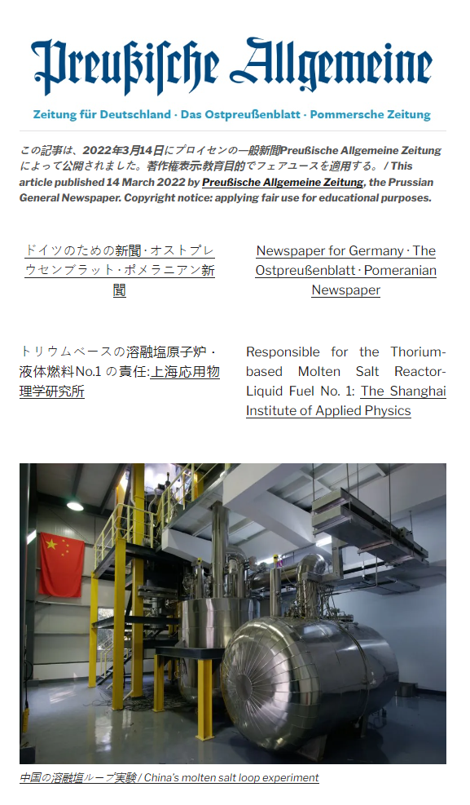

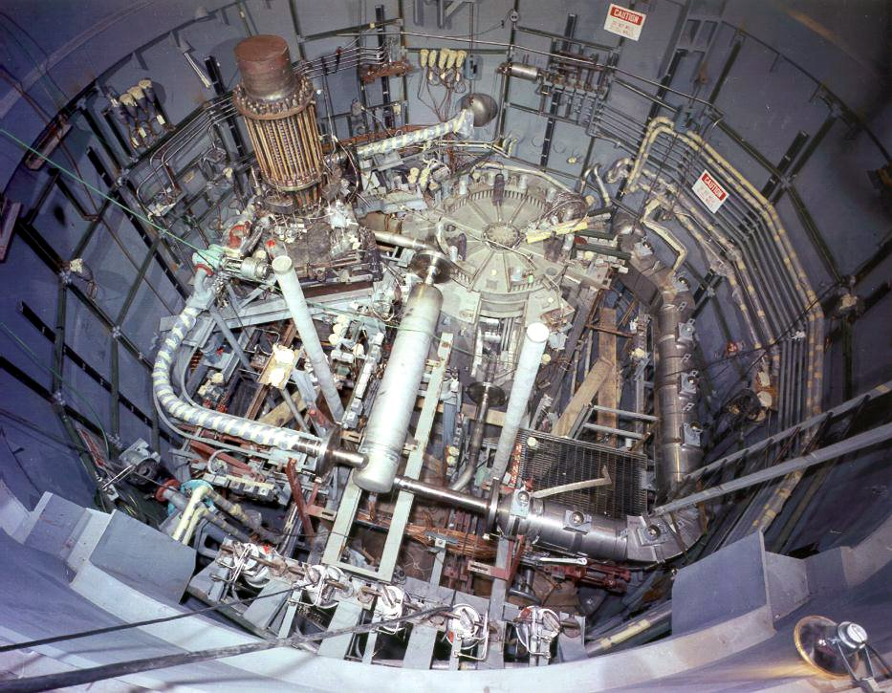
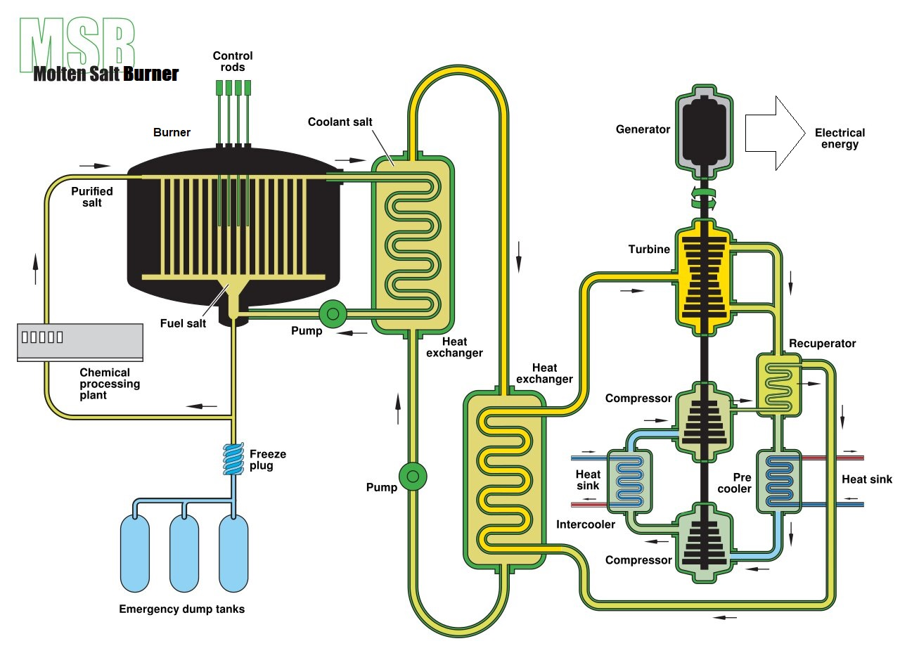
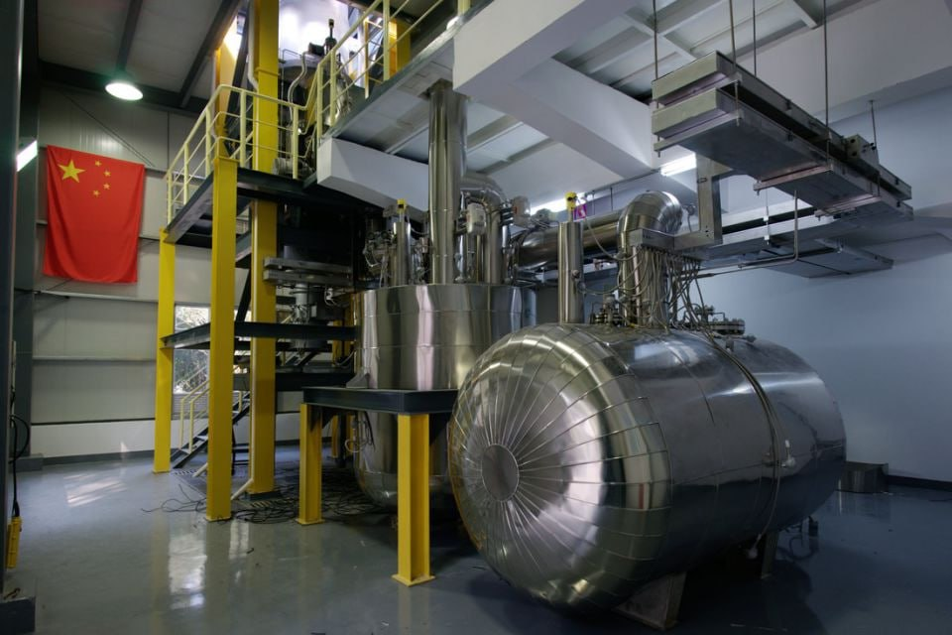
6000 hours power generation
The status report outcome of billions of dollars and several decades of research and development (100 billion $USD in 2023 adjusted for inflation)
The MSR used in the Oak Ridge Molten salt reactor (7.4 MW) commercial pilot 1969
Already done in China
https://thethoriumnetwork.com/2022/05/03/%e3%83%91%e3%83%bc%e3%83%95%e3%82%a7%e3%82%af%e3%83%88%e3%83%86%e3%82%af%e3%83%8e%e3%83%ad%e3%82%b8%e3%83%bc-%e3%83%90%e3%82%a4%e3%83%aa%e3%83%b3%e3%82%ac%e3%83%ab%e8%a8%98%e4%ba%8b-%e6%97%a5%e6%9c%ac/
ORNL (1972): The Development Status of Molten Salt Breeder Reactors, Report ORNL - 4812, Oakland Ridge Nuclear Laboratory, United States Atomic Energy Commission (AEC)
The LFTR (2 MW) used in Circa Whuhai, China in 2022 – now commercially selling power

Slide 10

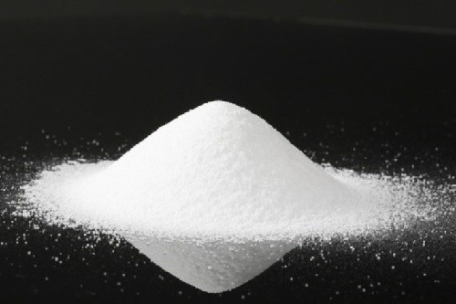


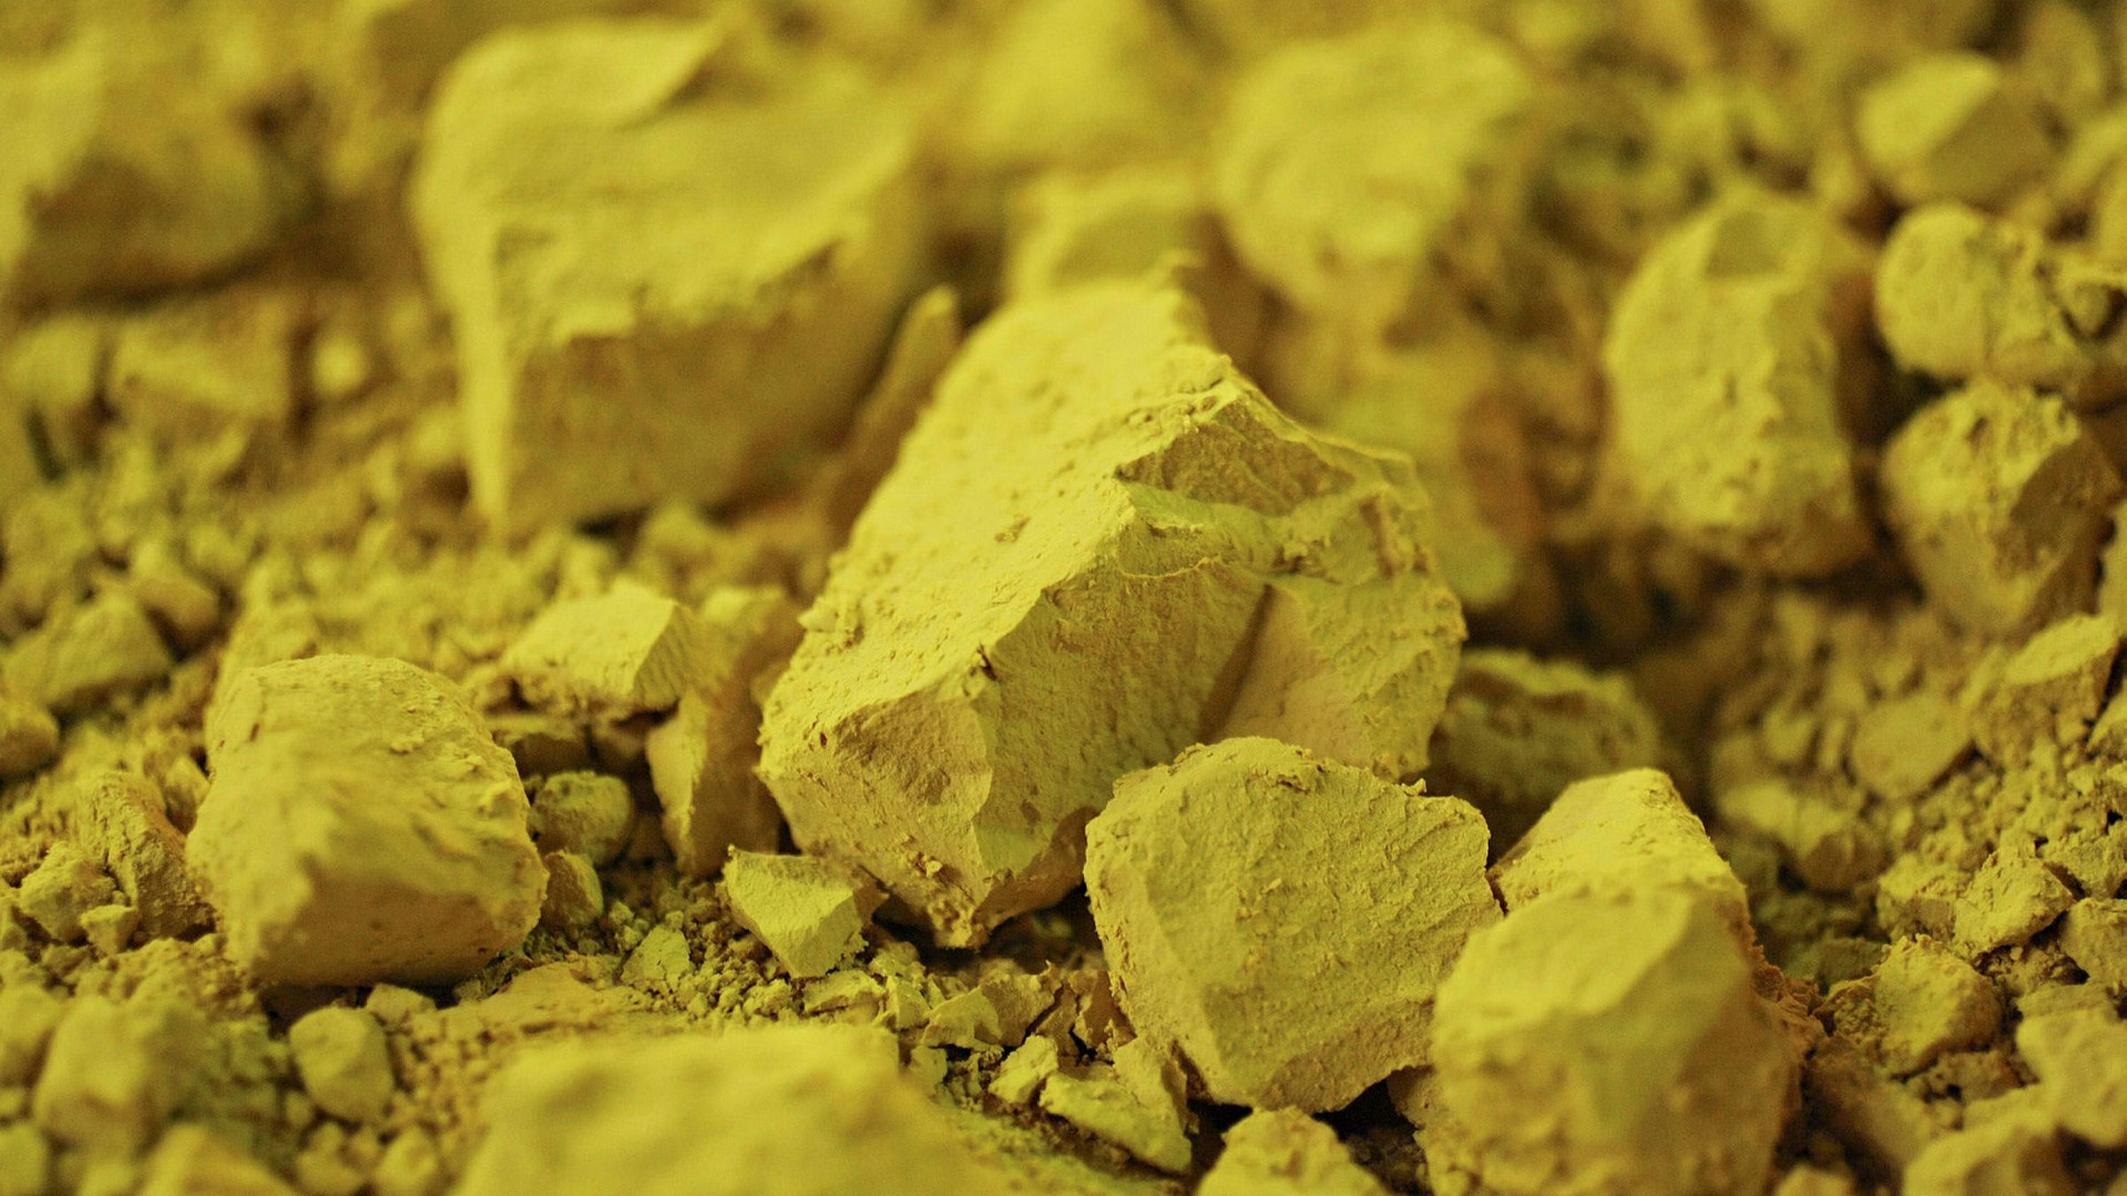
Liquid Fuel Thorium Molten Salt Reactor
Can also run with a U salt mix, and with some SNF
1-5% radioactive isotopes
10 000 GWh of electrical power is generated
(365 days)
53.84 kg of contaminated fuel (LLW). Mostly medical isotopes (Xe, Ce, Sr, Zr, I, etc.)
Stored for 300 years if not recycled
1.45 tonne of natural ThO₂ mined from approx. 280 tonne of monazite mineral sands (@0.5% grade Th)
1.34 tonne of ²³²Th in Thorium fluoride salt
Uranium Light Water Reactor
https://www.wise-uranium.org/nfcm.html
96% Waste fuel SNF
SNF (kg)
278.8 tonne of natural U₃O₈ mined from approx. 123 Mt of ore (@0.5% grade)
Conversion of U₃O₈ to UF₆ (347.9 tonne)
Nuclear fuel UO₂ assembly fabrication
(32.9 tonne)
with 4.9% ²³⁵U
10 000 GWh of electrical power is generated
(365 days)
Enrichment of UF₆ ²³⁵U @ 4.09% (43.3 tonne)
THE THORIUM NETWORK

Slide 11
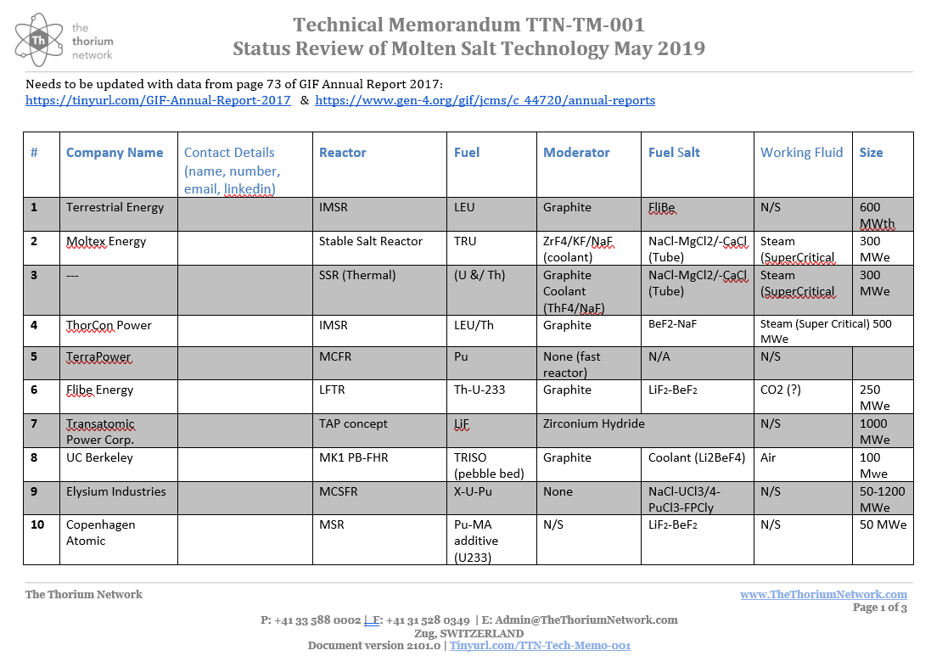

Slide 12
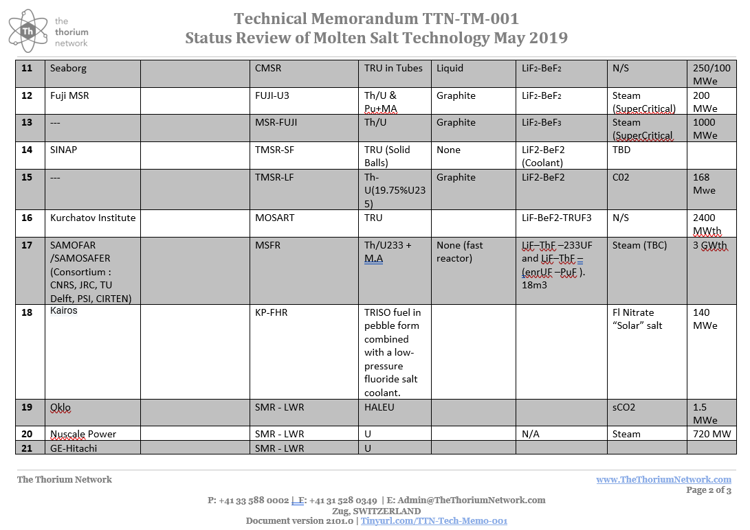

Slide 13
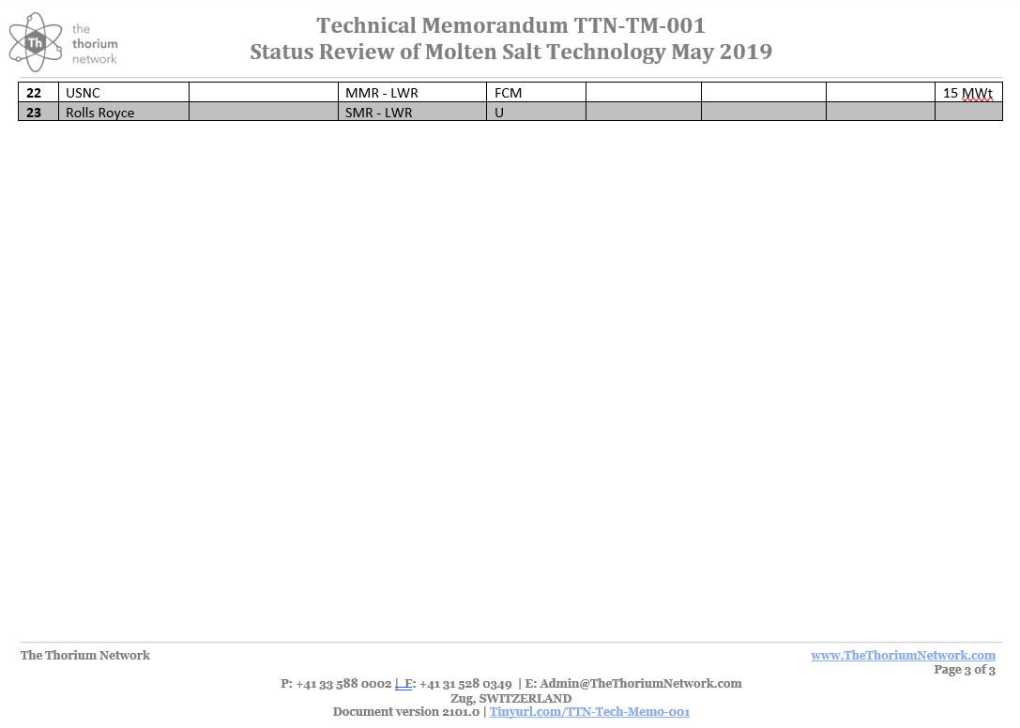

Slide 14
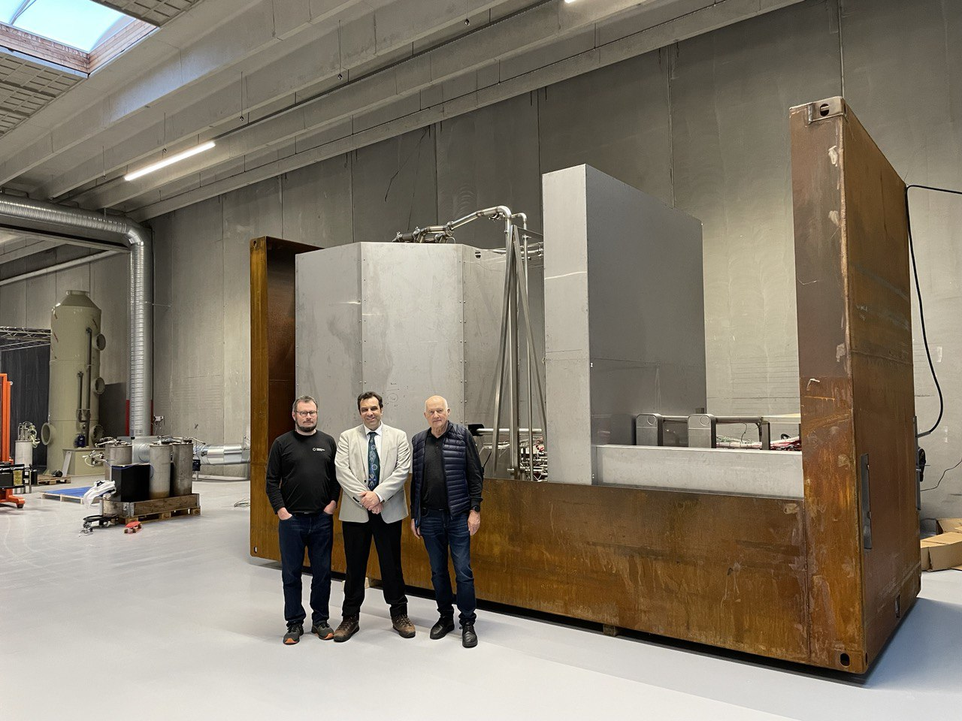
Copenhagen Atomics
Each commercial rector is planned to be able to produce 100 MW of thermal heat, or 40 MW of electricity
Each reactor is the size of a 40 foot shipping container
Electricity will be sold at a projected 2 cents/kWh
1g of thorium or uranium produces 24 MWh of thermal energy.
  A plant producing 1 GW electricity needs 800kg of Th₂₃₂ metal in salt form each year.
First test of complete system to generate electricity in late 2025 to 2026
Commercial reactors will be available for sale in 2028 (at this stage)
Test rig with a full sized reactor to pilot test the water circuit
https://www.copenhagenatomics.com/

Slide 15
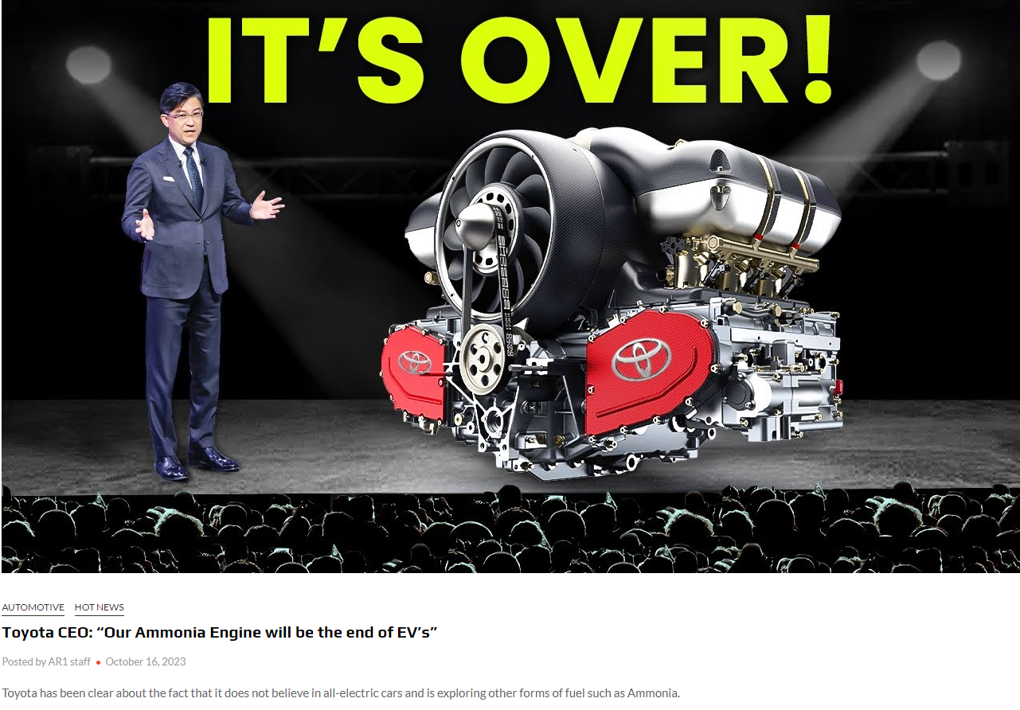
Ammonia Fueled ICE – passenger vehicles to ships
The EV Black Swan is here
The sourcing of raw materials for manufacture drove this decision
The battery market will now crash (opinion)
https://www.autoracing1.com/pl/413299/toyota-ceo-our-ammonia-engine-will-be-the-end-of-evs/

Slide 16
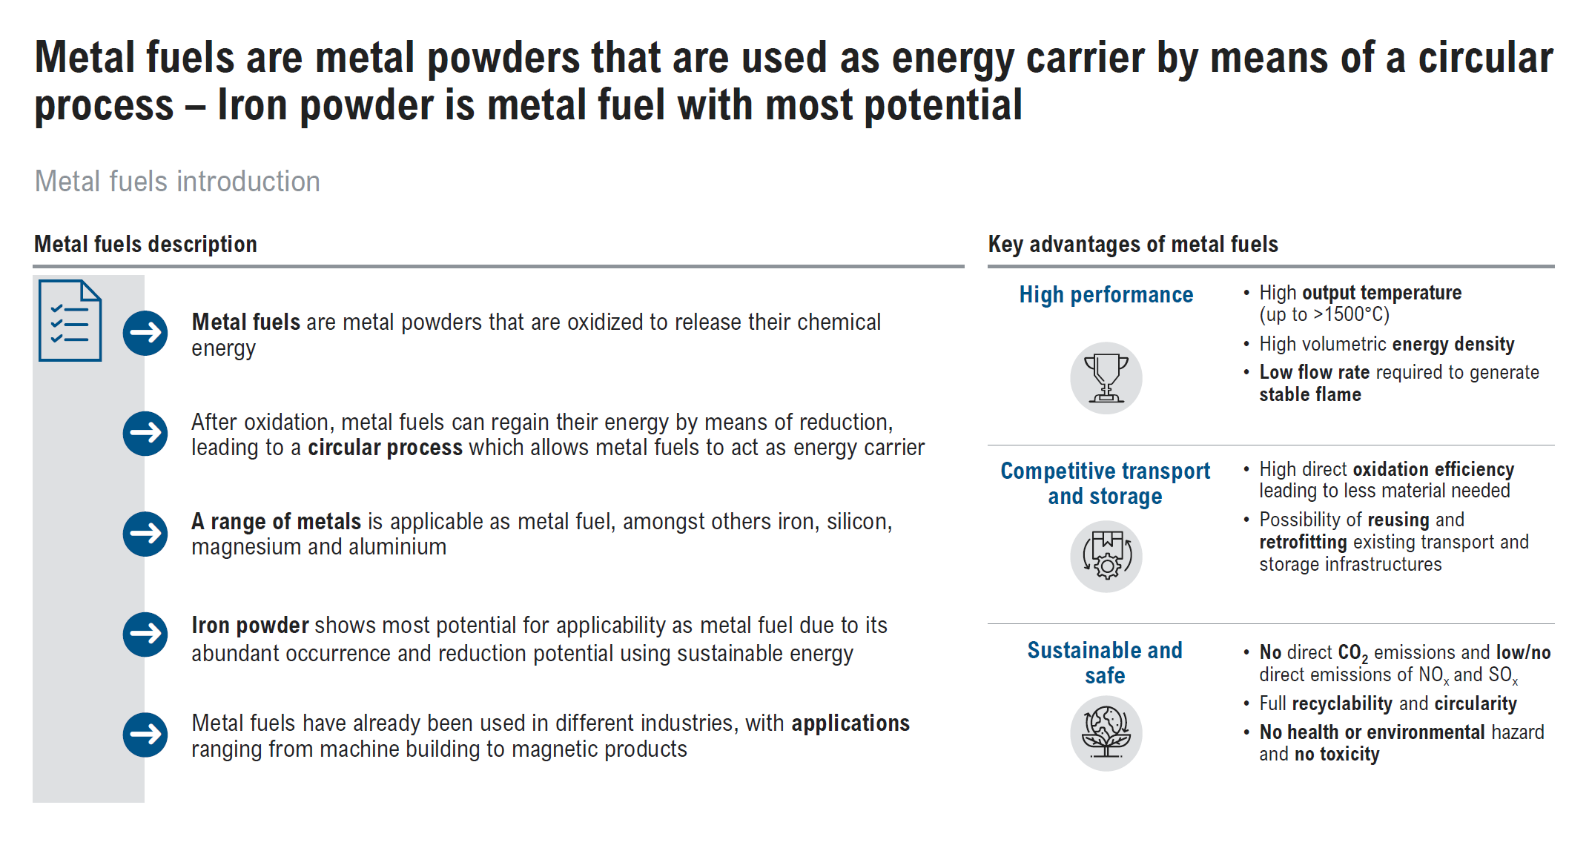
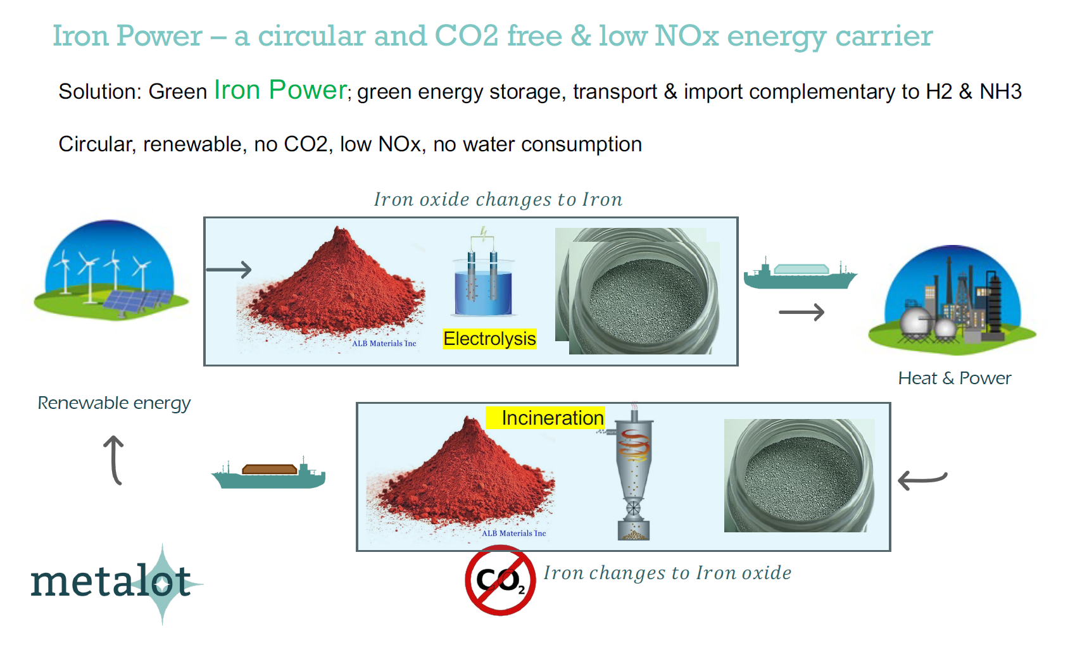

Slide 18
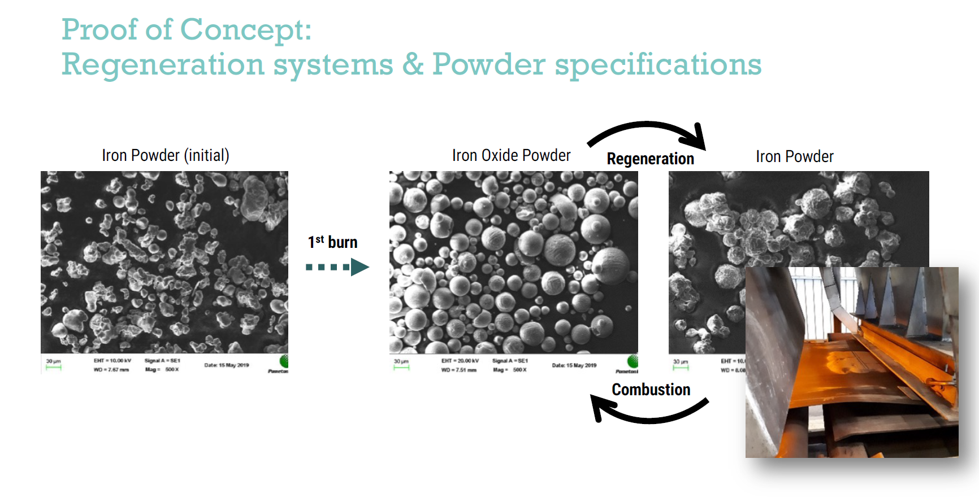

Slide 19
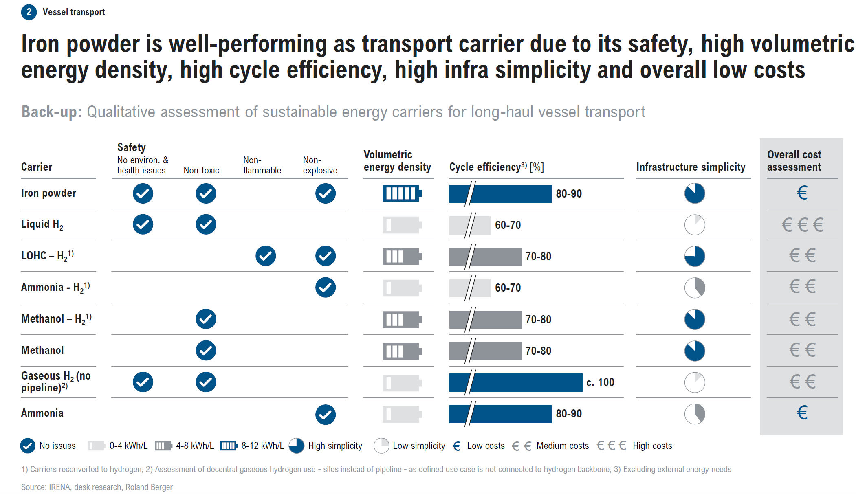

Slide 20
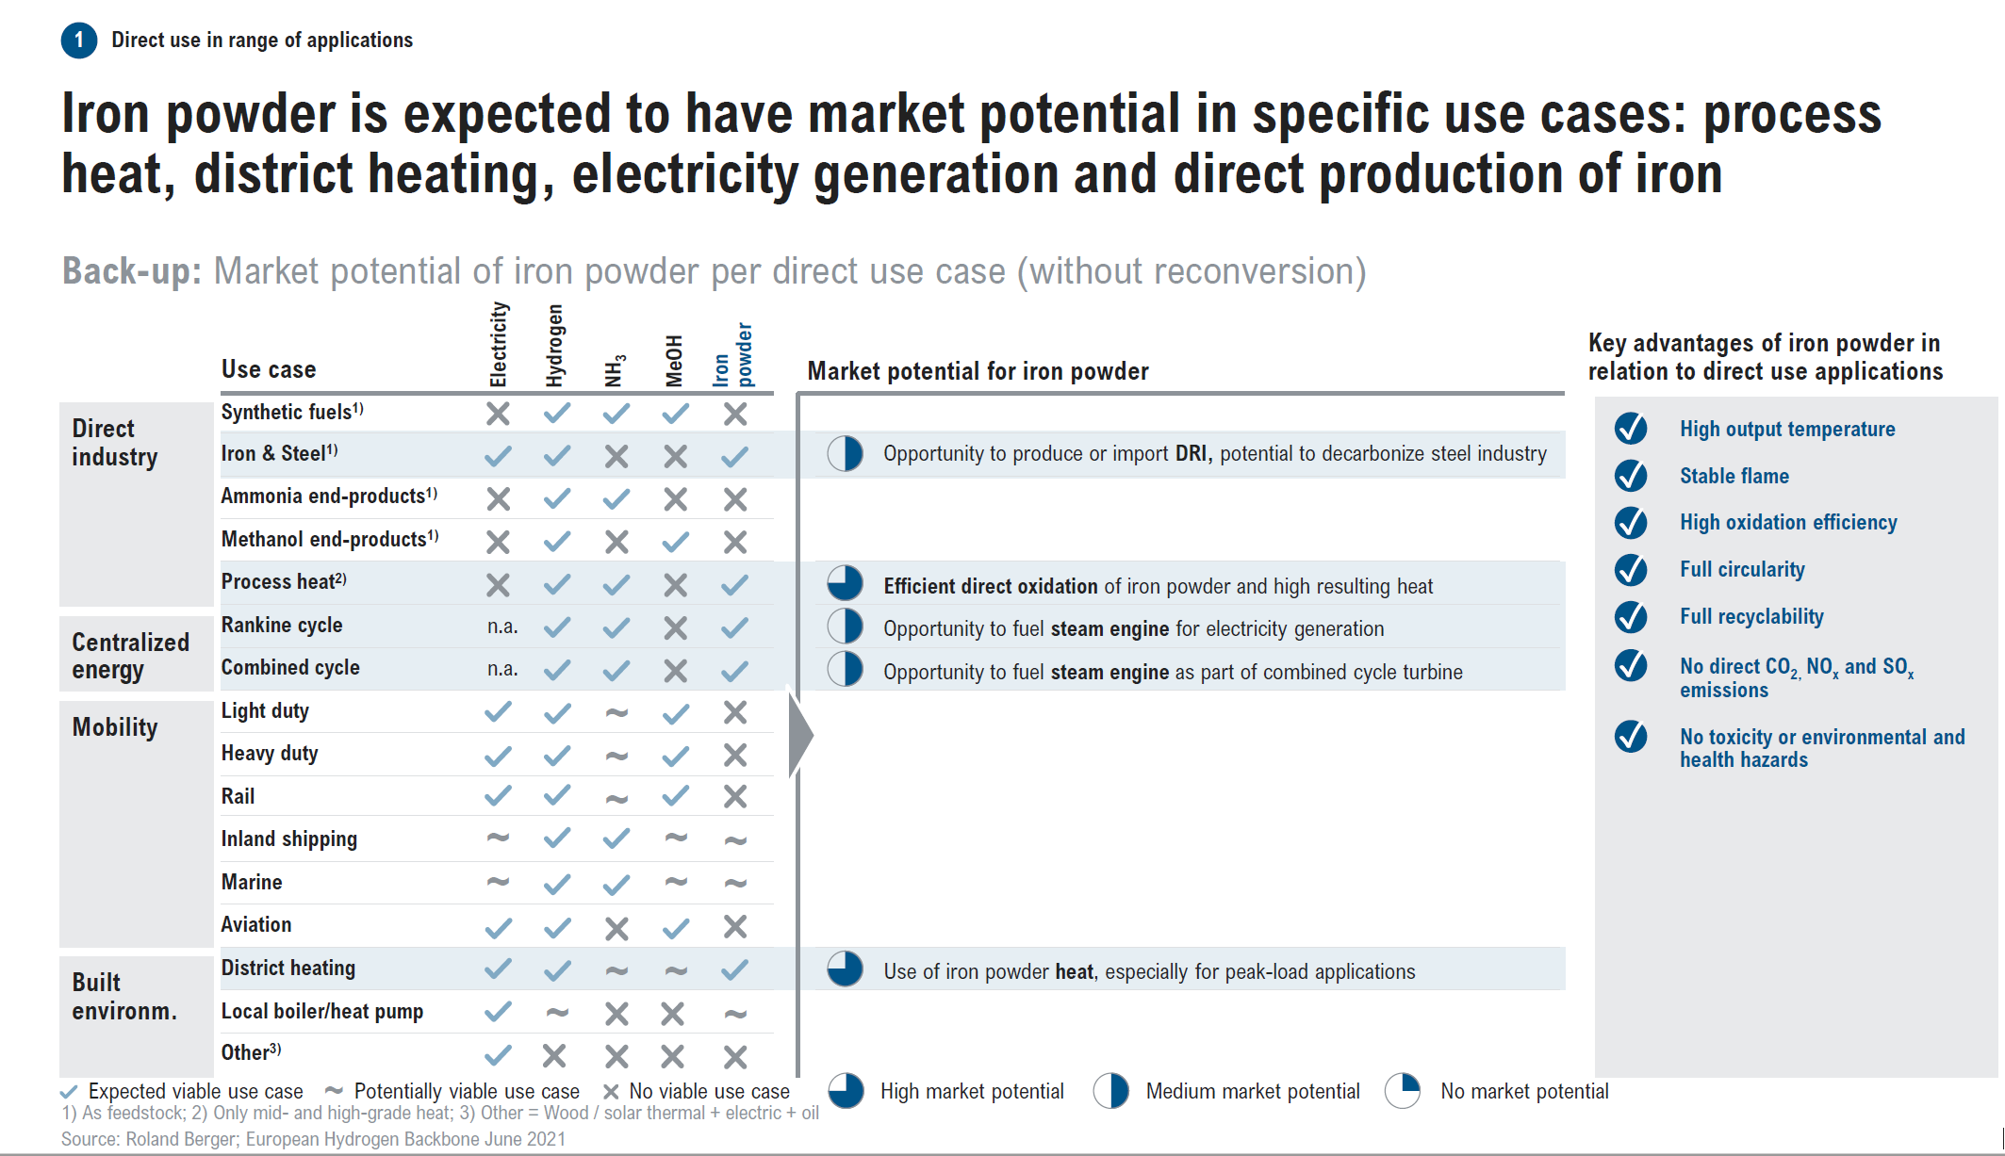

Slide 21


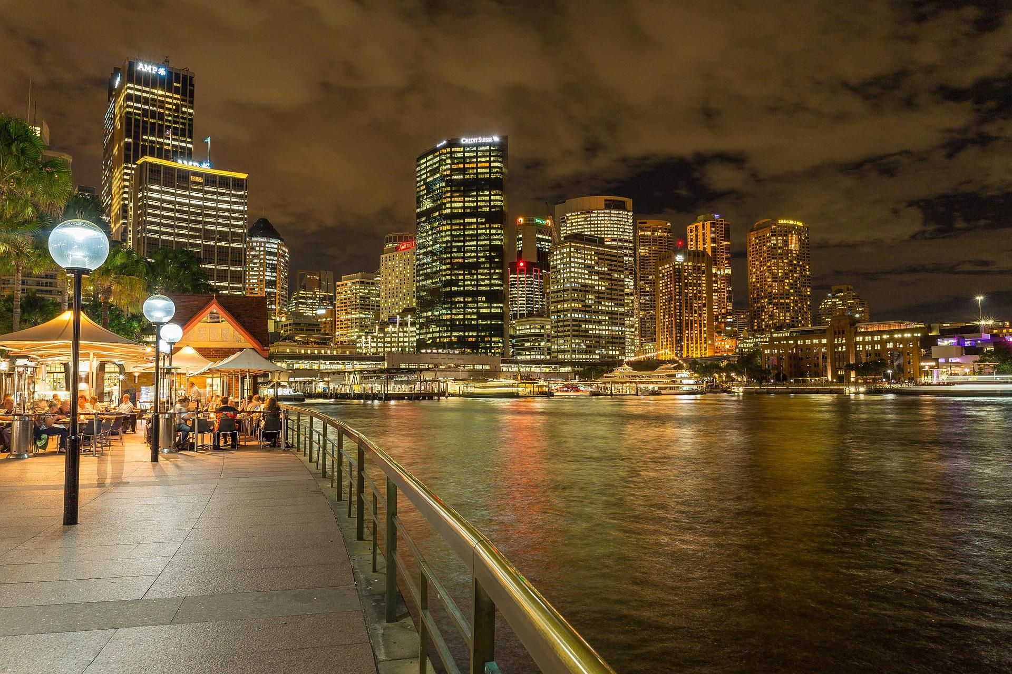
The commodities sector has been misunderstood
Our relationship between all 4 aspects & the planetary environment is changing
This is how our system is really structured
Technology
Human Society
Finance & Economics
Minerals
Sometimes about technology
Energy
Any new system will have to have a similar structure
Economics
Each one of these aspects cannot be considered without the other three
All of these aspects and human society functions by harvesting feedstock from the planetary environment

Slide 22
Generation
Application
ICE
Petroleum
To be phased out
Buffer to manage intermittency
Solar
Wind
Electric Vehicles
Batteries
Hydro
Oil
Transport
Biofuels
Limited supply of biomass
Natural limitations to expansion
Geothermal
Gas
Electricity
Biowaste
Coal
Manufacture
Hydrogen Fuel Cell
Limitations in storage and transport of H₂
Wave
Can’t expand fast enough
Nuclear
U (LWR)
Heat
ICE
Ammonia
Exhaust gas?
Can we produce the ammonia from seawater?
Liquid Fuel Fission Th MSR

Slide 23
The Purple Transition
Generation
Application
Transport
Liquid Fuel Fission Th MSR (560⁰C)
ICE
Ammonia
Electricity
Manufacture
Heat
Combustion of iron oxide powder to produce high temperatures (1800⁰C)

Slide 24
Simon P. Michaux
Associate Professor Geometallurgy
Circular Economy Solutions
simon.michaux@gtk.fi
gtk.fi
Kiitos & Thank you

