Slide 1
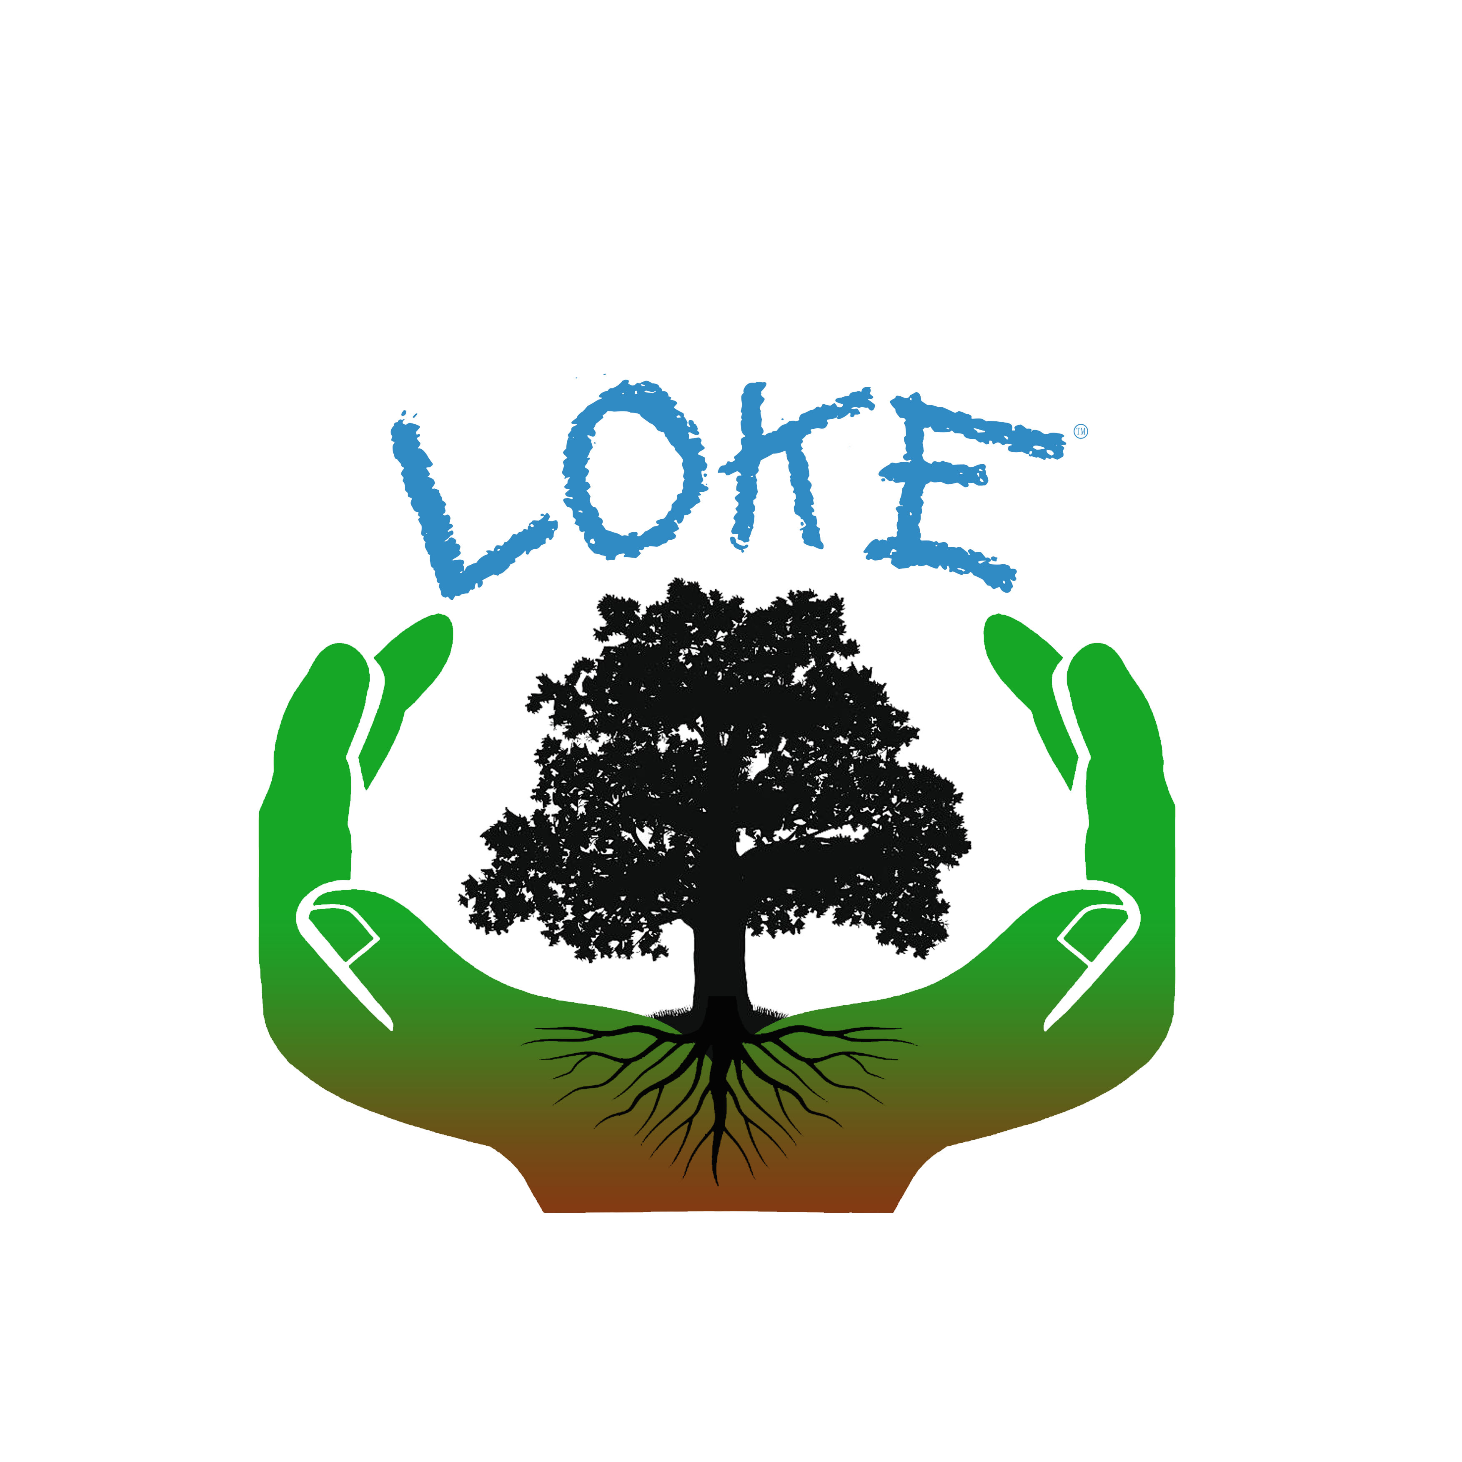

Slide 2
Why?
LOKE is the sound of loc -- alisation.
To help local people create security locally, through building localisation.
To become more independent from fossil fuels and more dependent on local habitat and land.

Slide 4
Mission
To sequester land. Reintroduce natural habitat, create a closed loop system with no waste, though permaculture, regenerative farming and togetherness.

Slide 5
l How to sequester land
Talk to local councils.
Talk to local land owners.
Crowd fund in an attempt to sequester land.
Find wasted artificial natural cosmetically developed land to develop into useful habitat.
Find artificial infrastructure that can be lifted and redeveloped into natural habitat and areas to grow food in.

Slide 6
l Education at the heart - Workshops on deep skills as followed
How to......
grow trees, plants and vegetables, planting and companion planting, brew beer, keeping bees in hives, collect and retain water, make bags and baskets from quick growing trees and shrubs, collect seeds and store them, regenerate soil, compost, design land with permaculture, preserve meat, fruit and vegetables, make herbal remedies, sewing and knitting, sharpening knives, recycle products, make charcoal, store the sun’s heat, recognise land geographics, coppice and making things from hazel and other natural trees and plants, conserve the habitat, surveying land and the biosphere, first aid.

Slide 7
l Hands on
- Local volunteers and partners
- Wandering walks
- Fund raising
- Integration of the people’s local governments with the people.

Slide 8
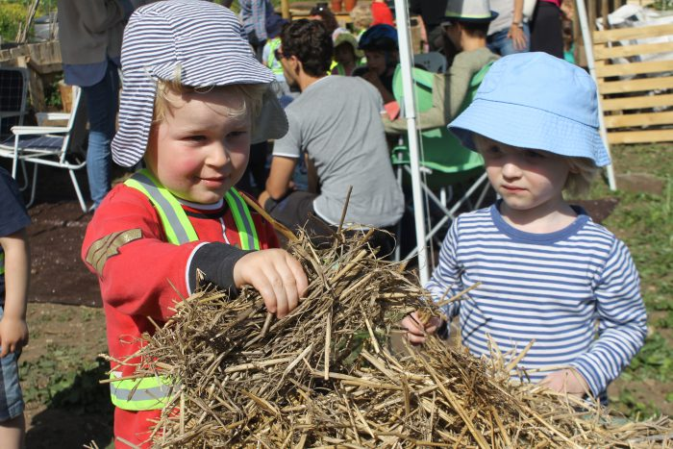
l Education at the heart Workshops on deep skills

Slide 9
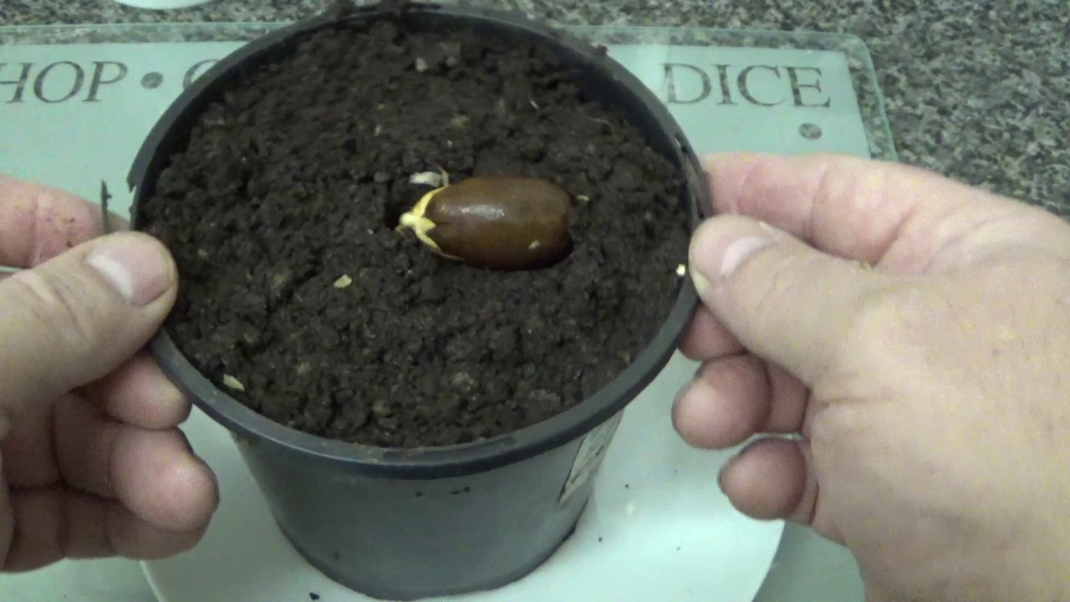
growing, trees and plants

Slide 10
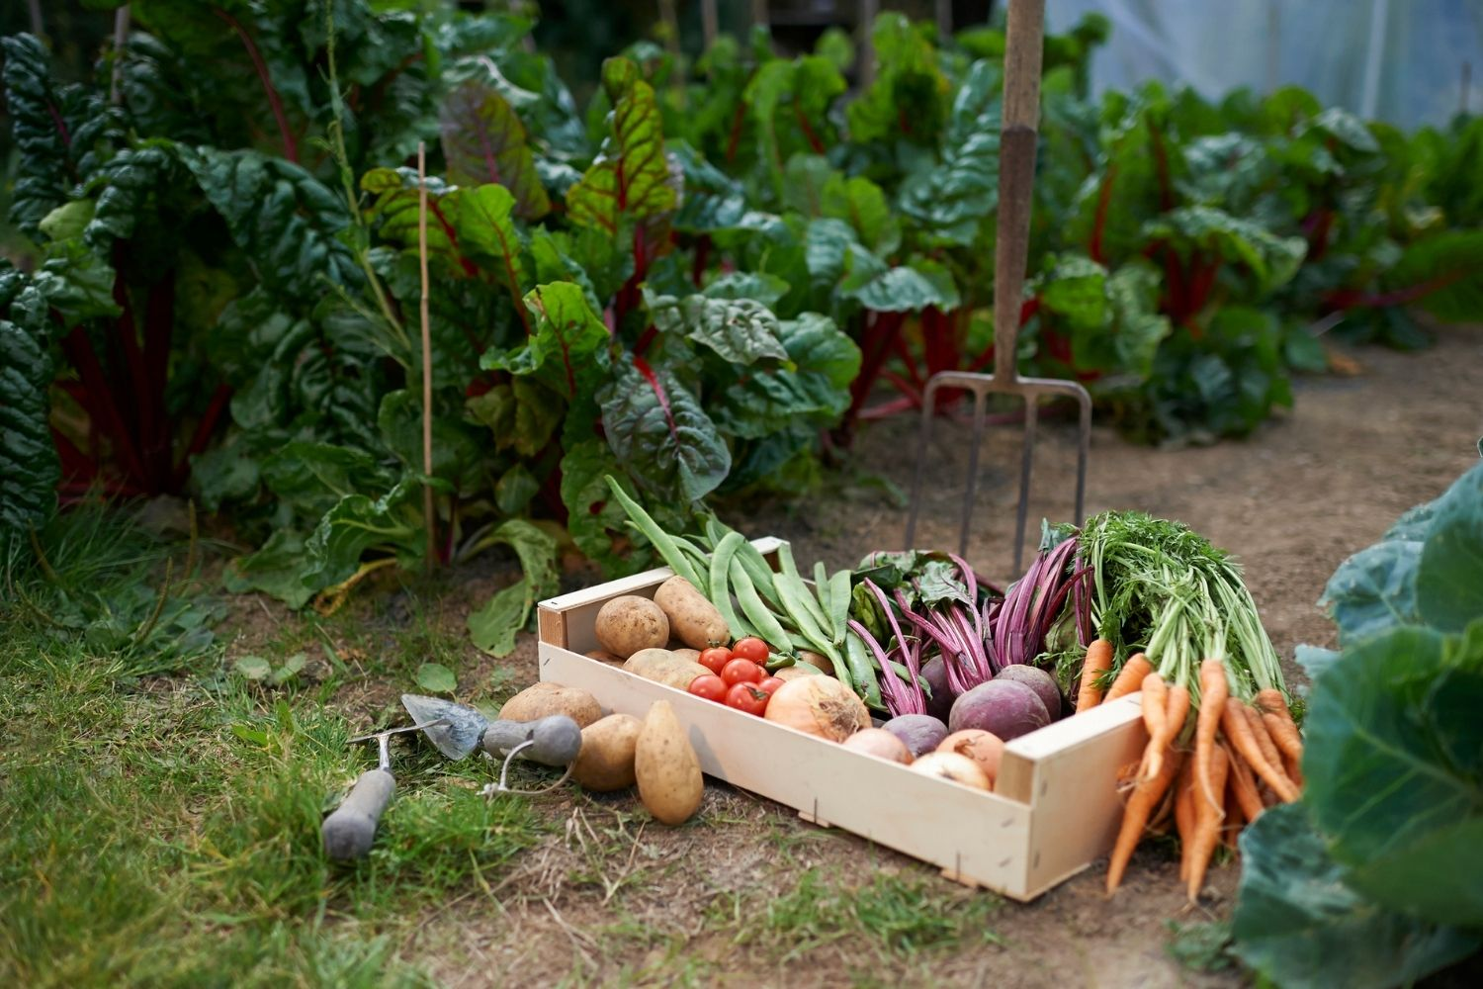
growing vegetables

Slide 11
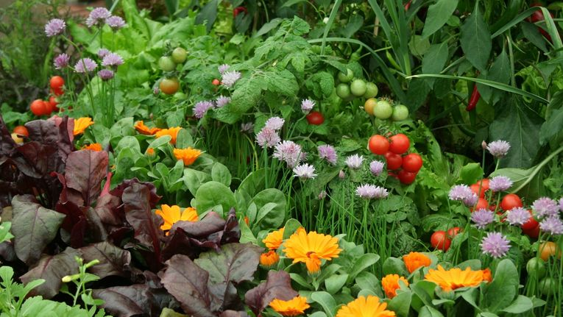
companion planting

Slide 12
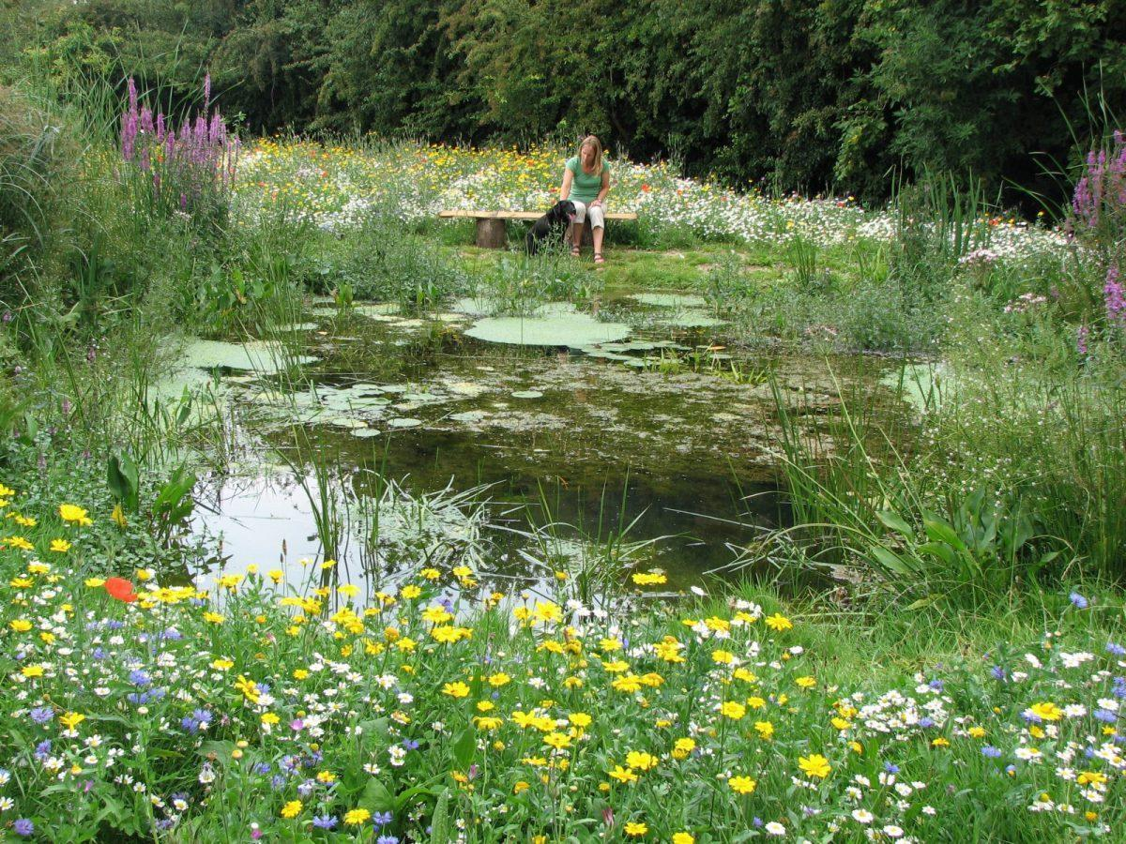
water retention

Slide 13
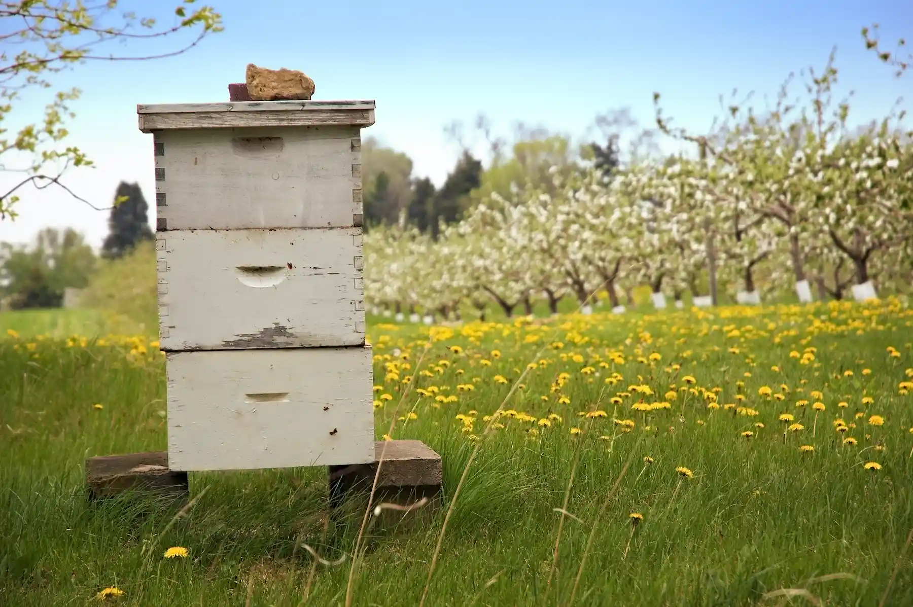
Bee keeping

Slide 14
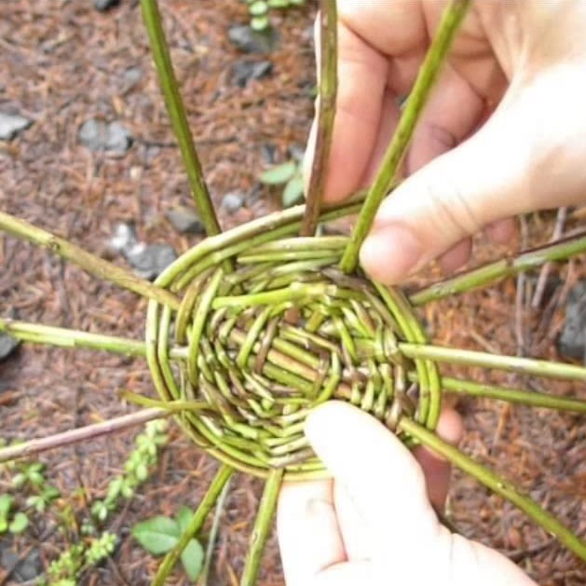
basket making

Slide 15
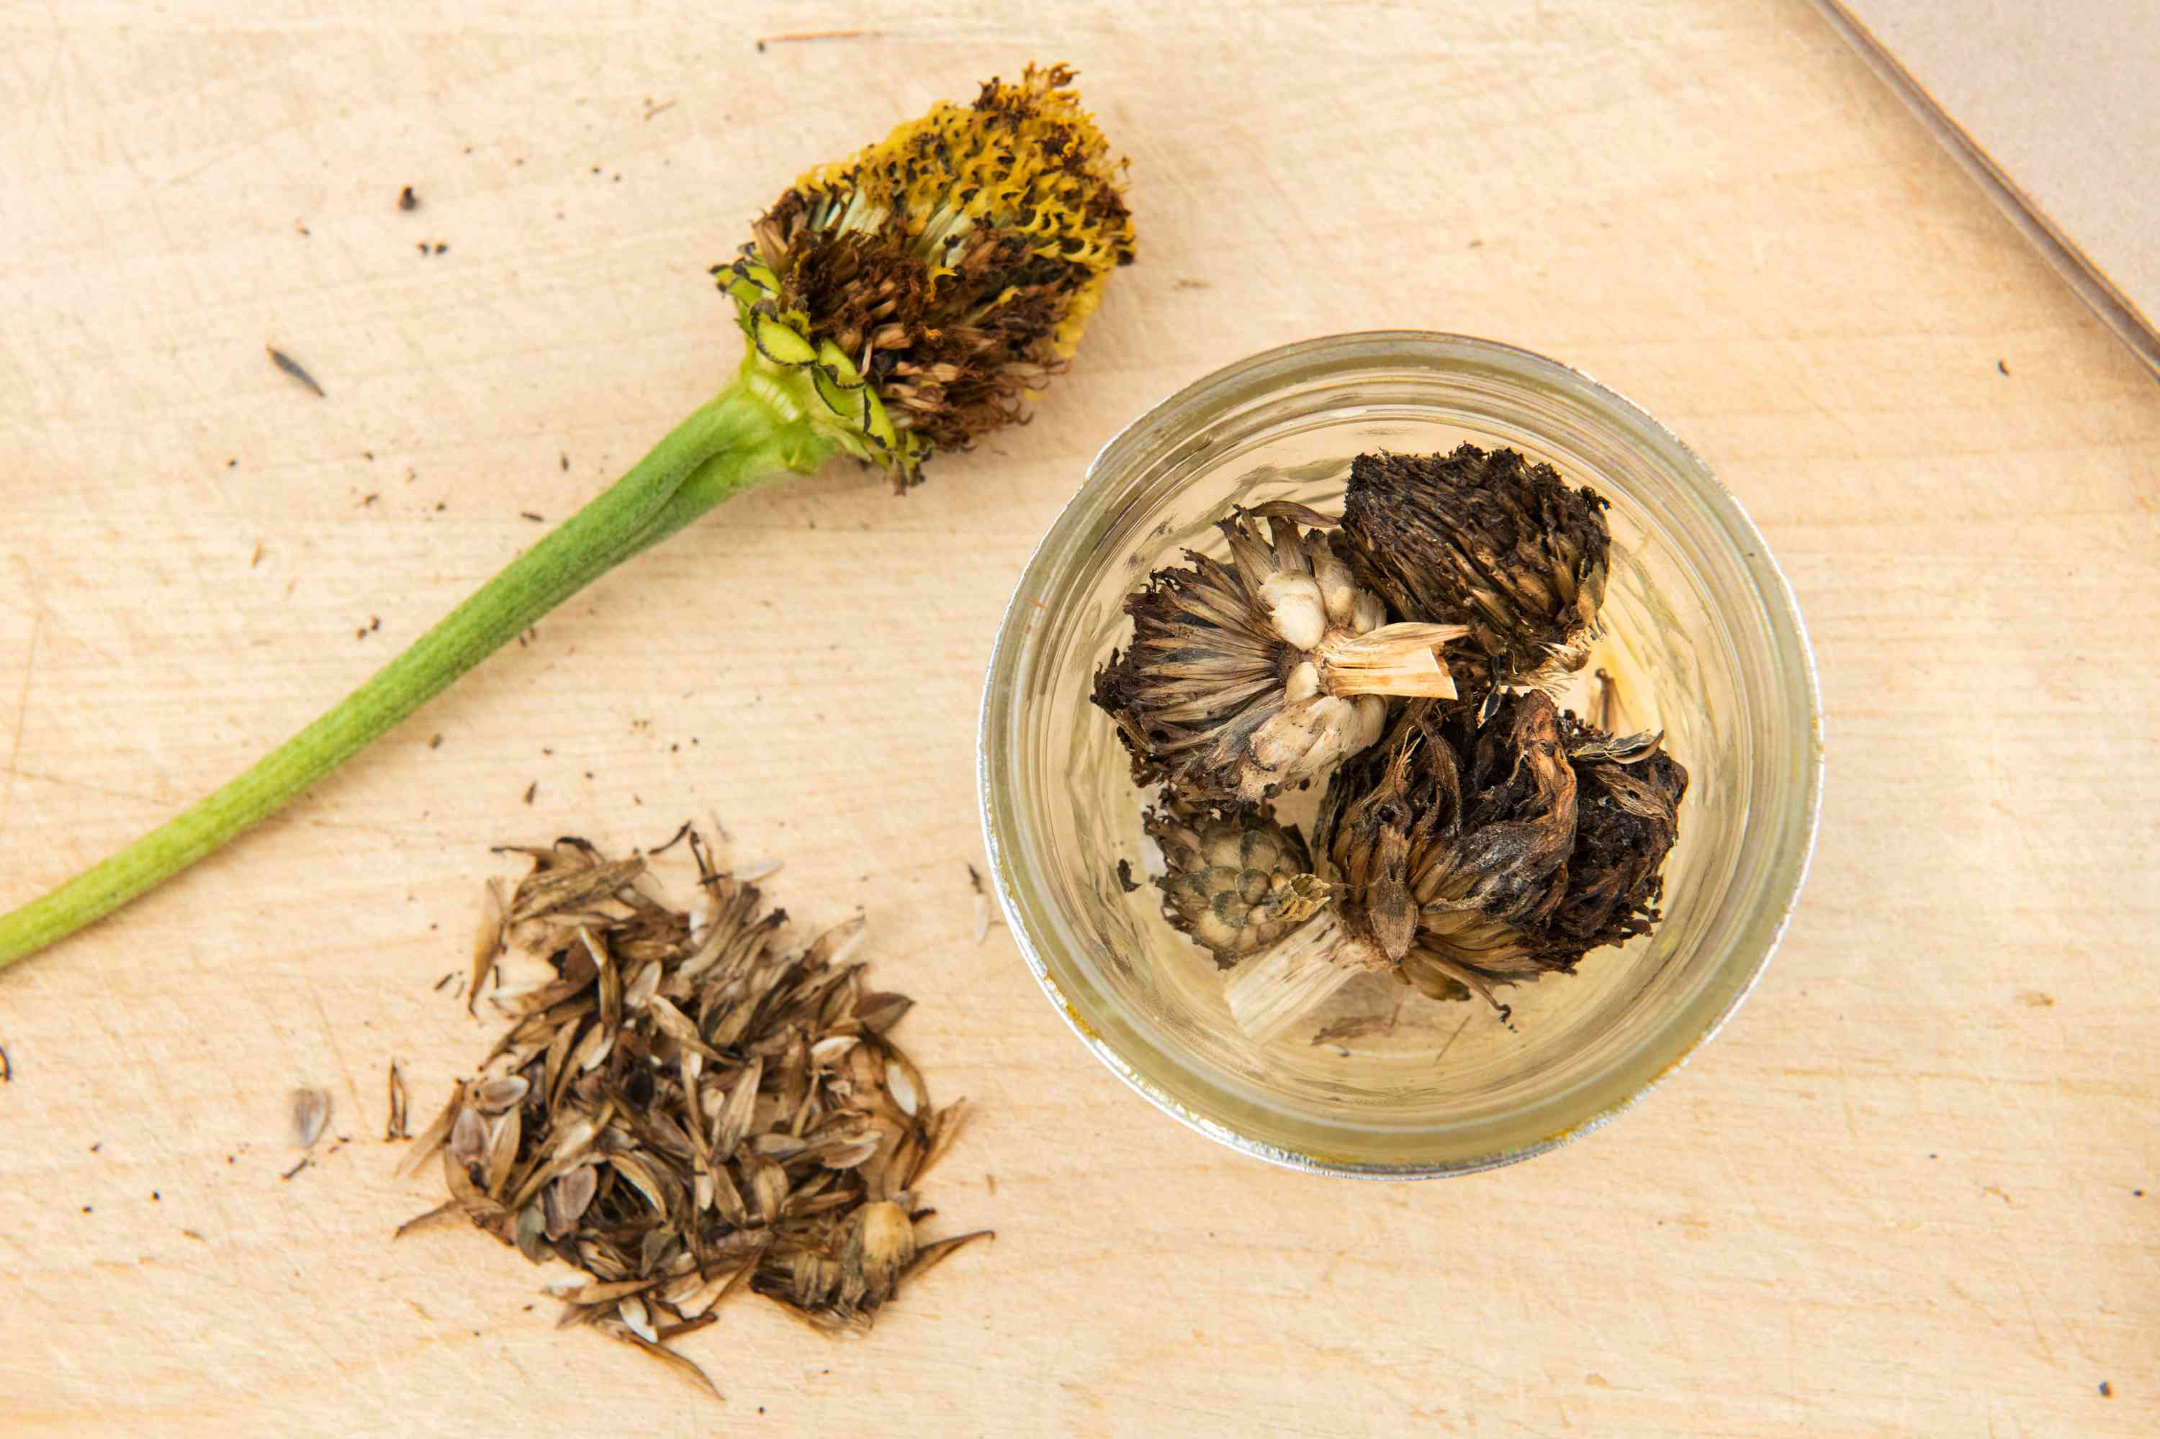
collecting seeds

Slide 16
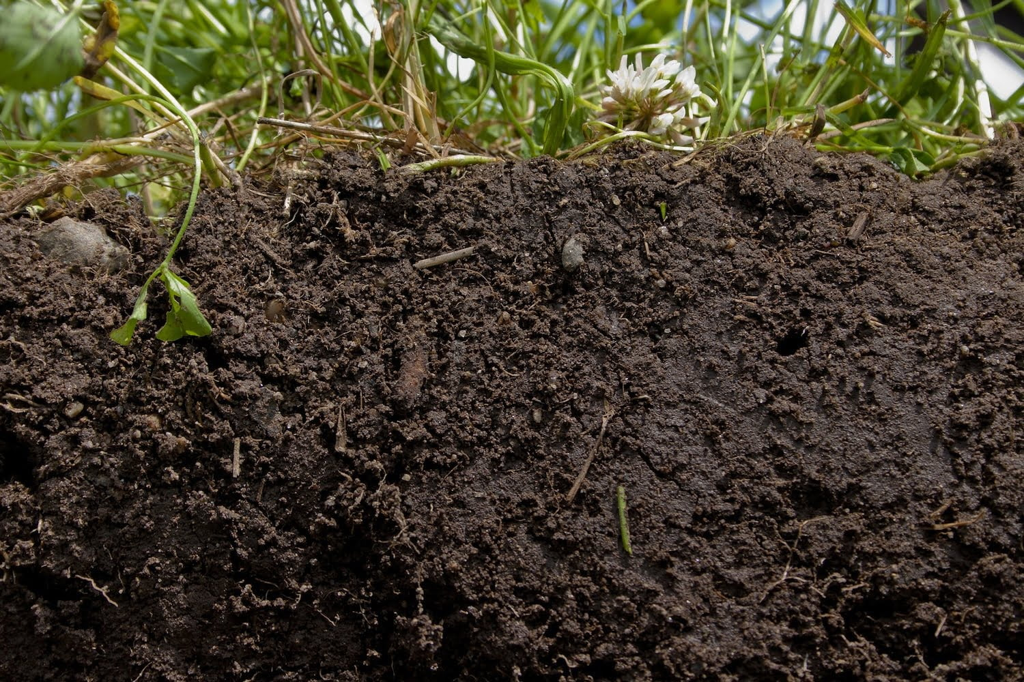
soil regeneration

Slide 17
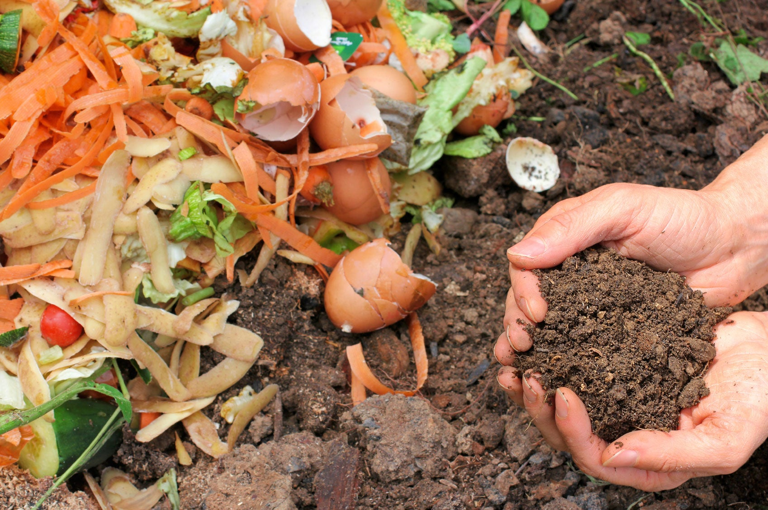
composting

Slide 18
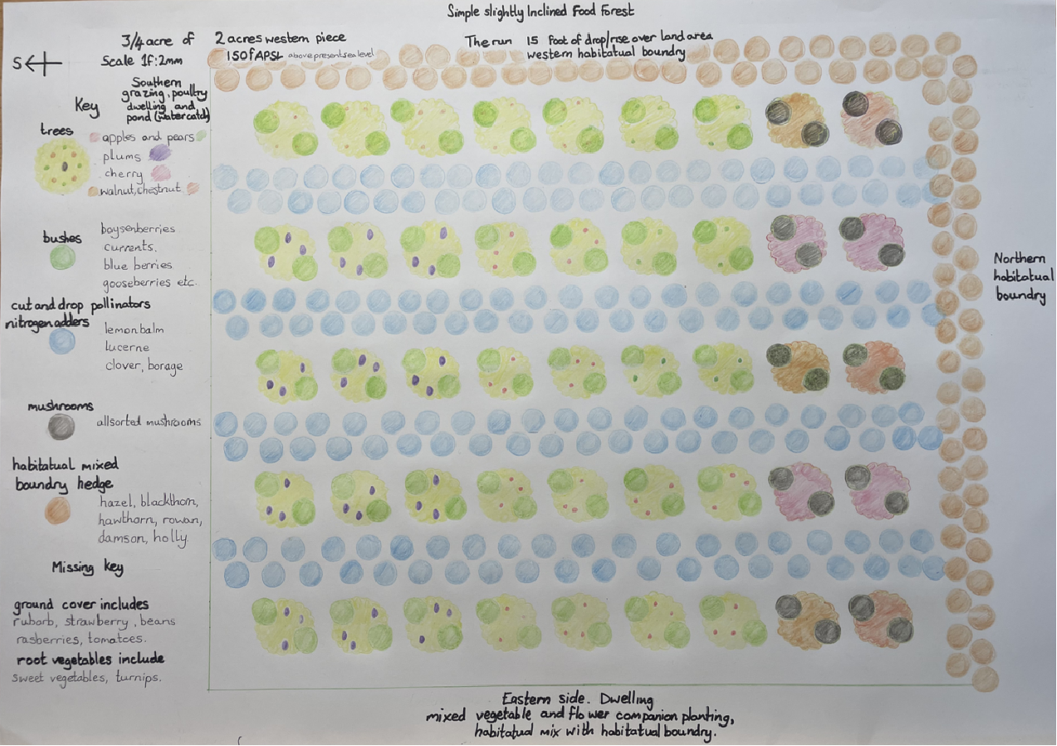
permaculture design

Slide 19
brewing
beer

Slide 20
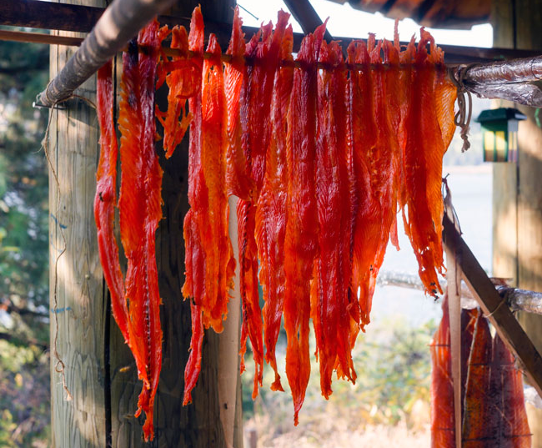
drying and smoking meats

Slide 21
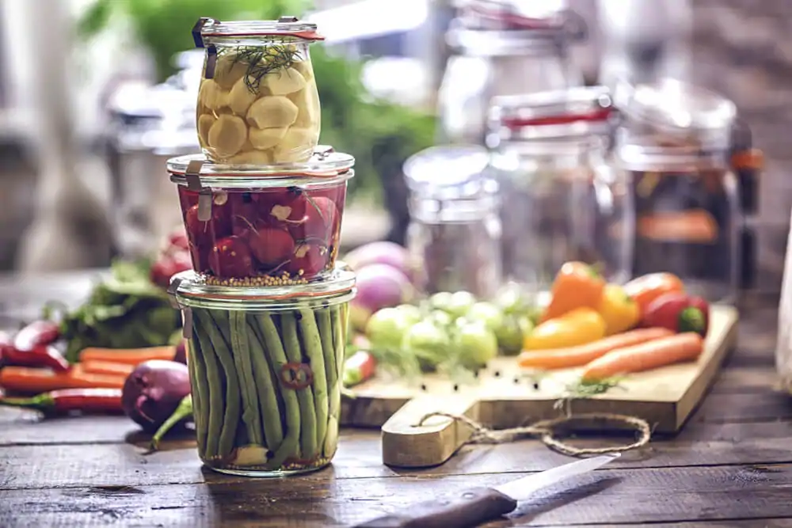
preserving vegetables

Slide 22
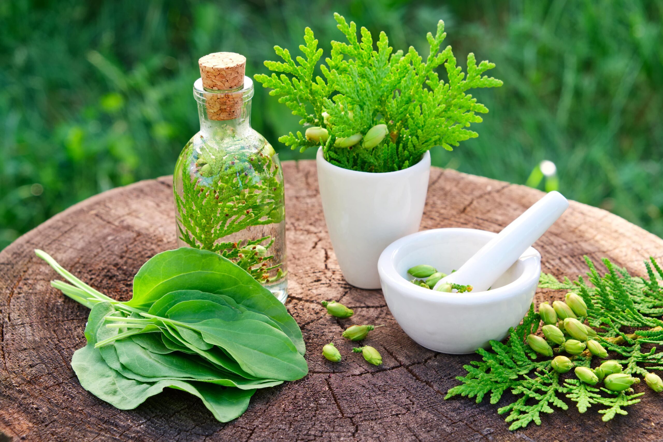
herbal remedies

Slide 23
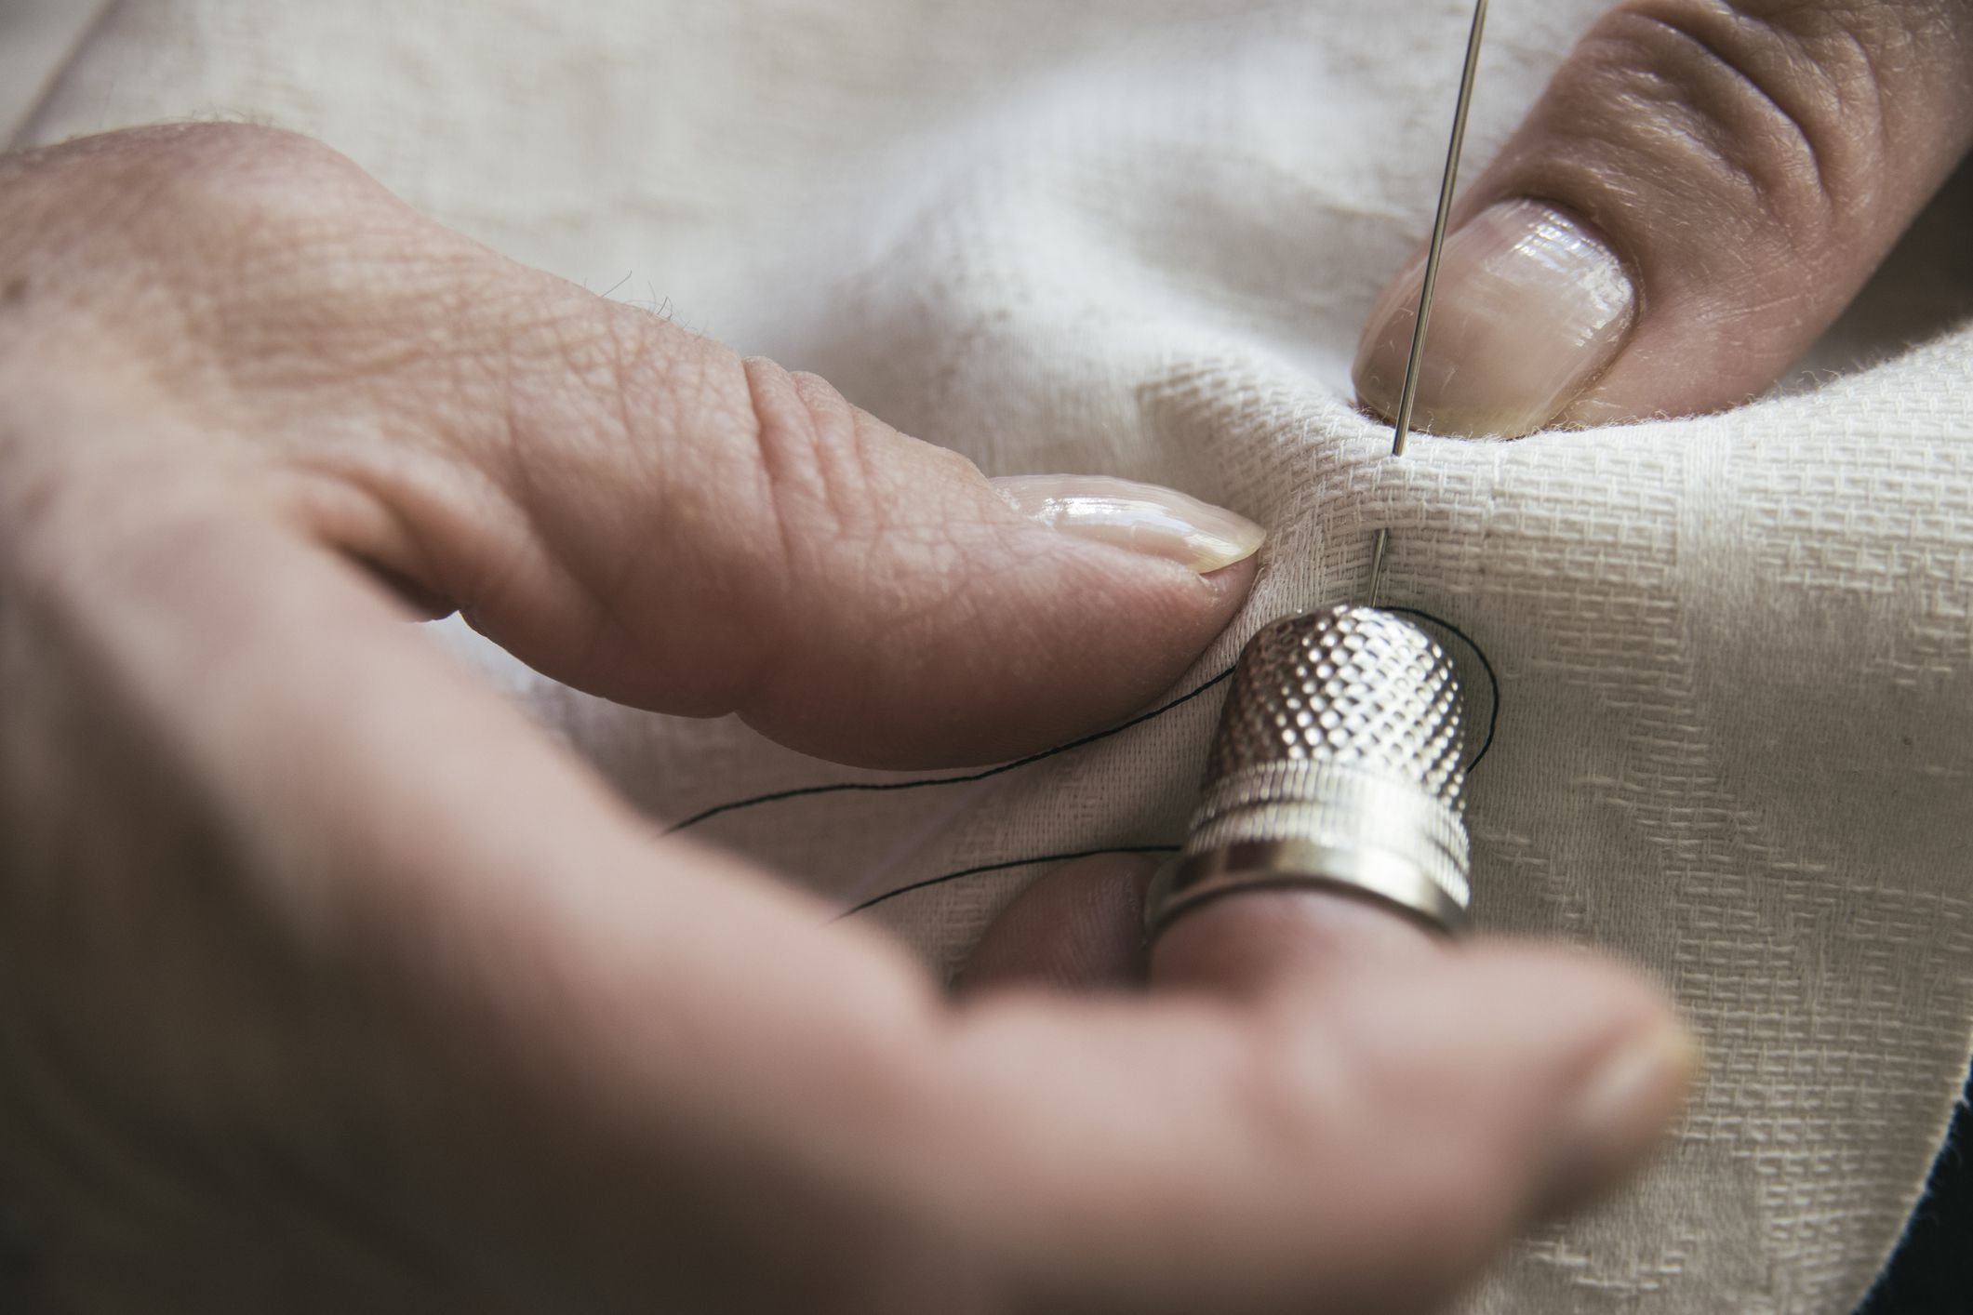
sewing and kitting

Slide 24
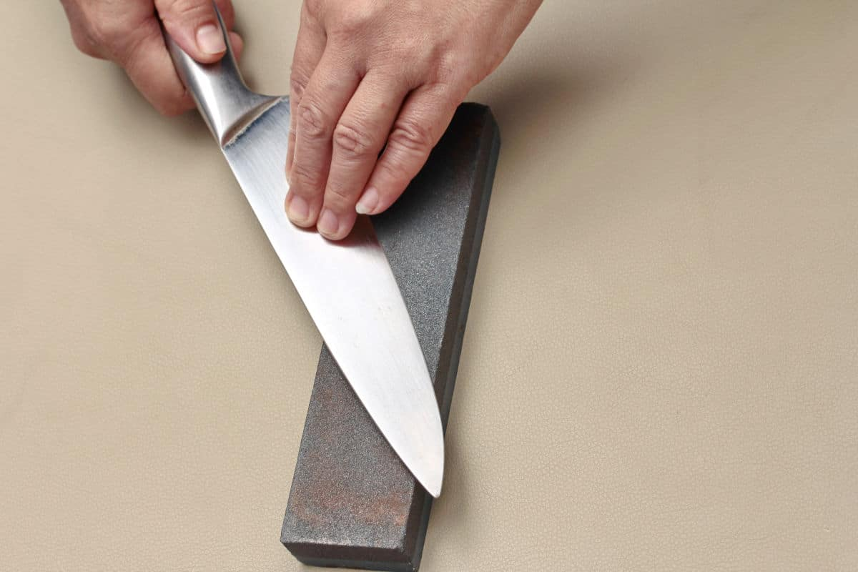
knife sharpening

Slide 25
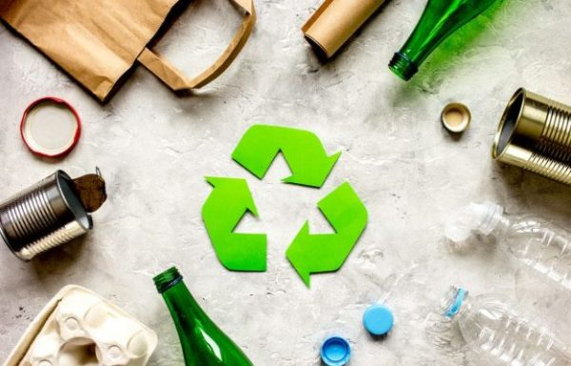
recycling

Slide 26
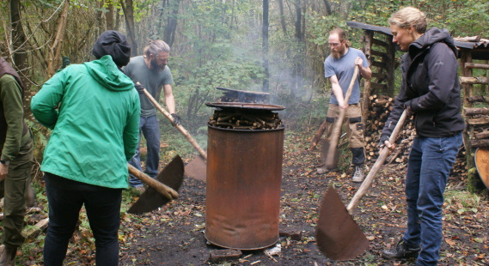
making charcoal

Slide 27
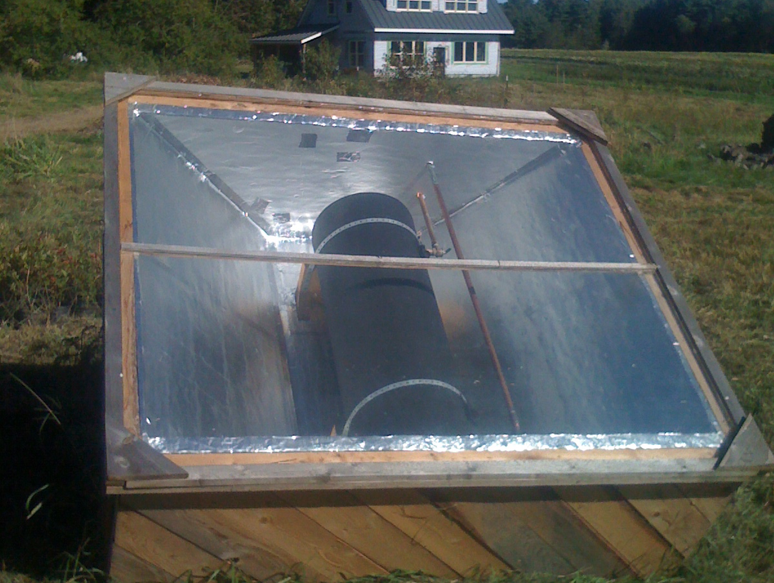
trapping the suns heat

Slide 28
tapography

Slide 29
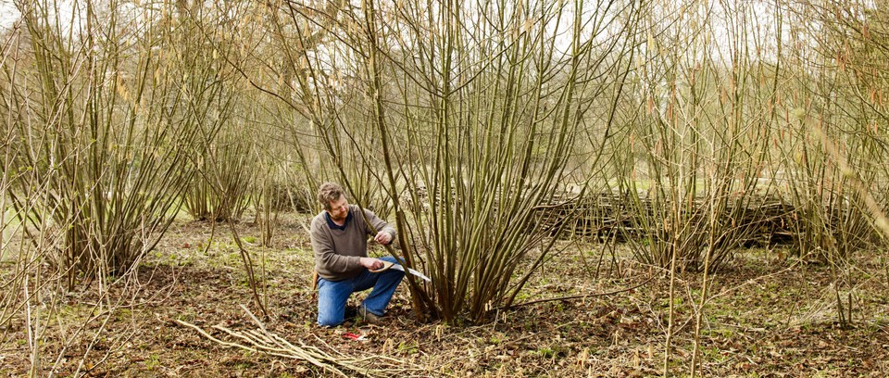
coppice hazel

Slide 30
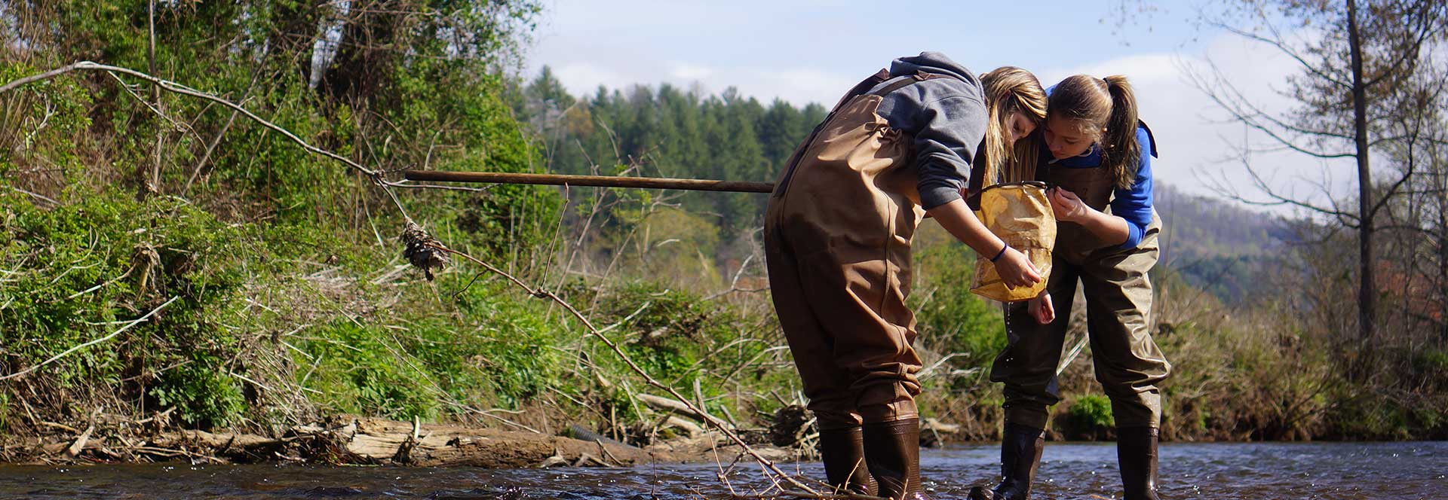
conservation

Slide 31
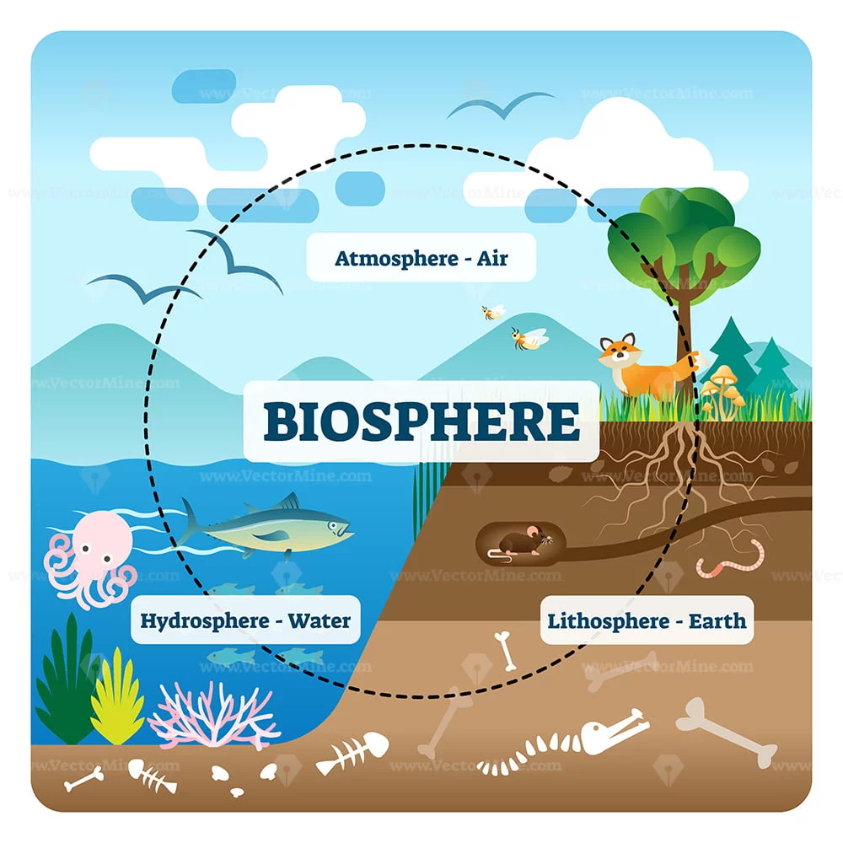
surveying the biosphere

Slide 32
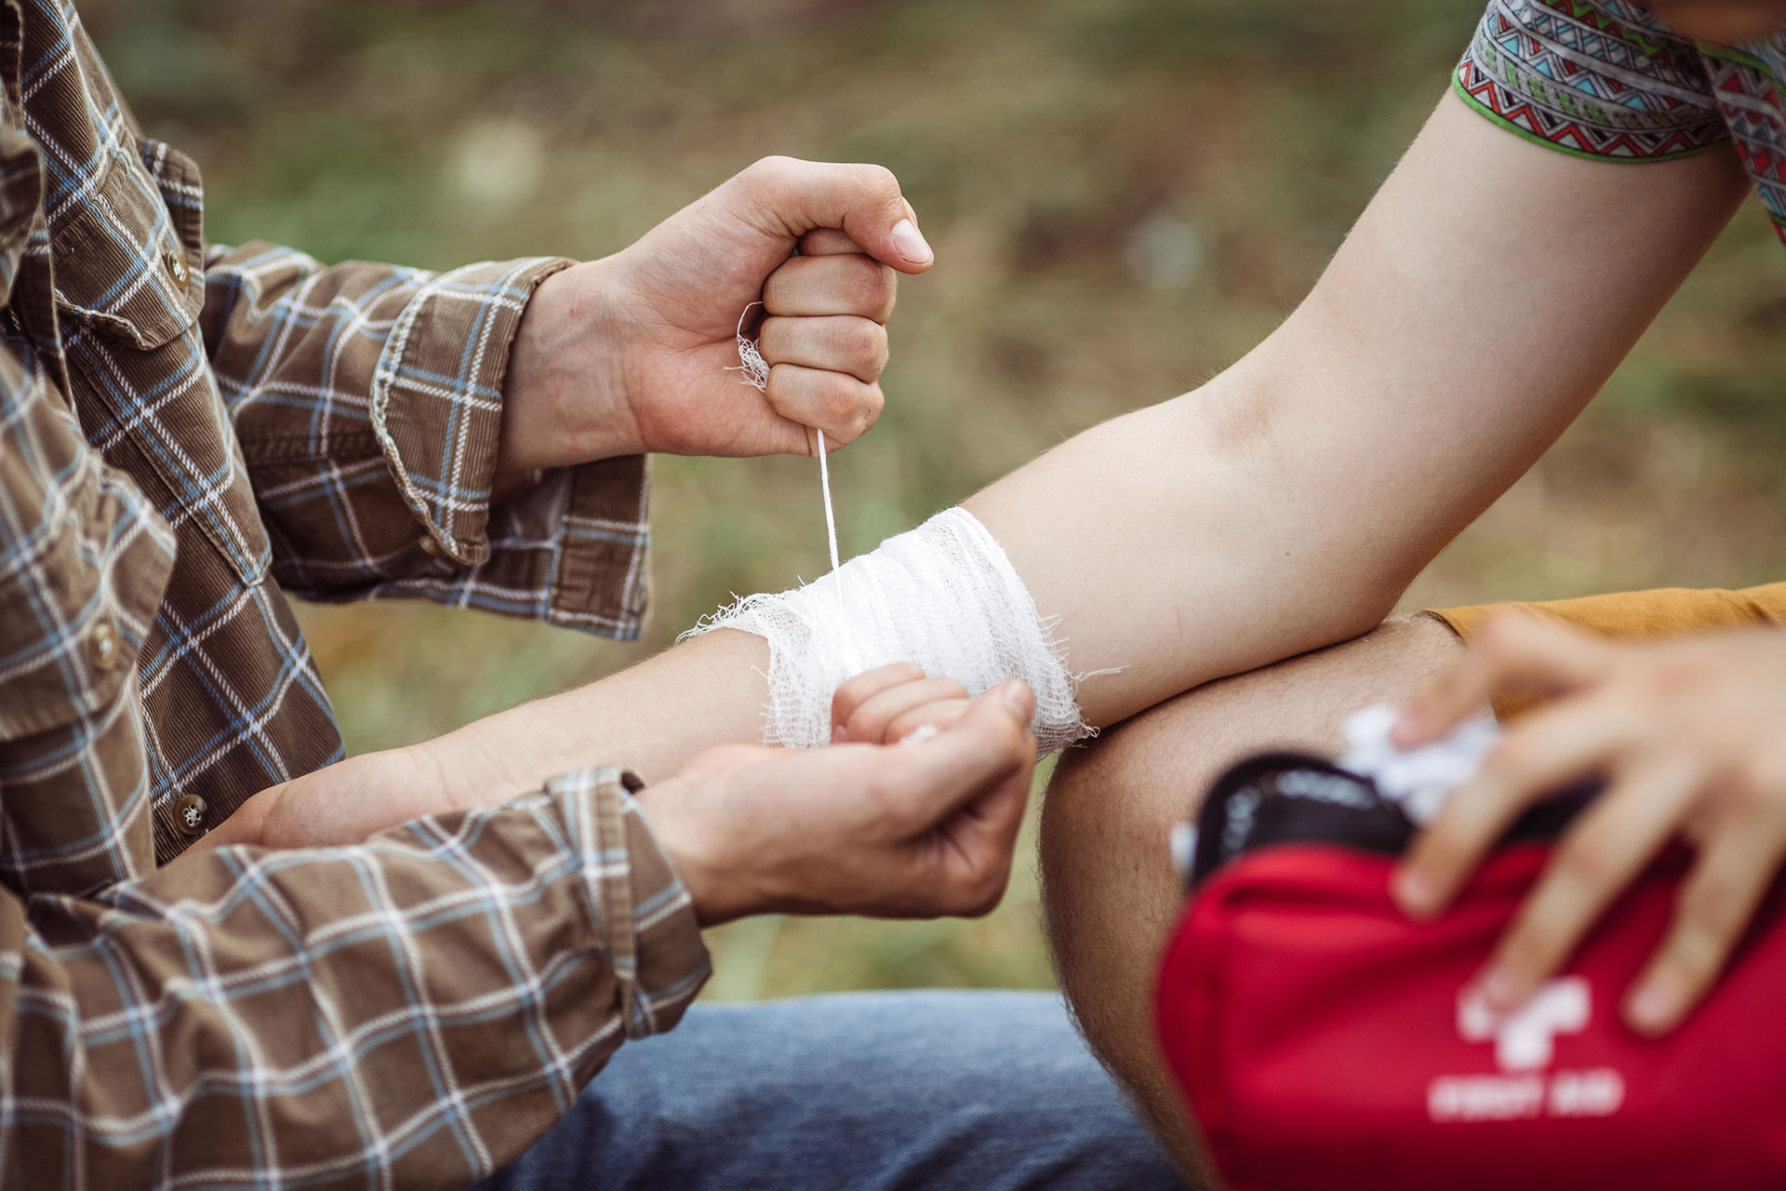
first aid

Slide 33
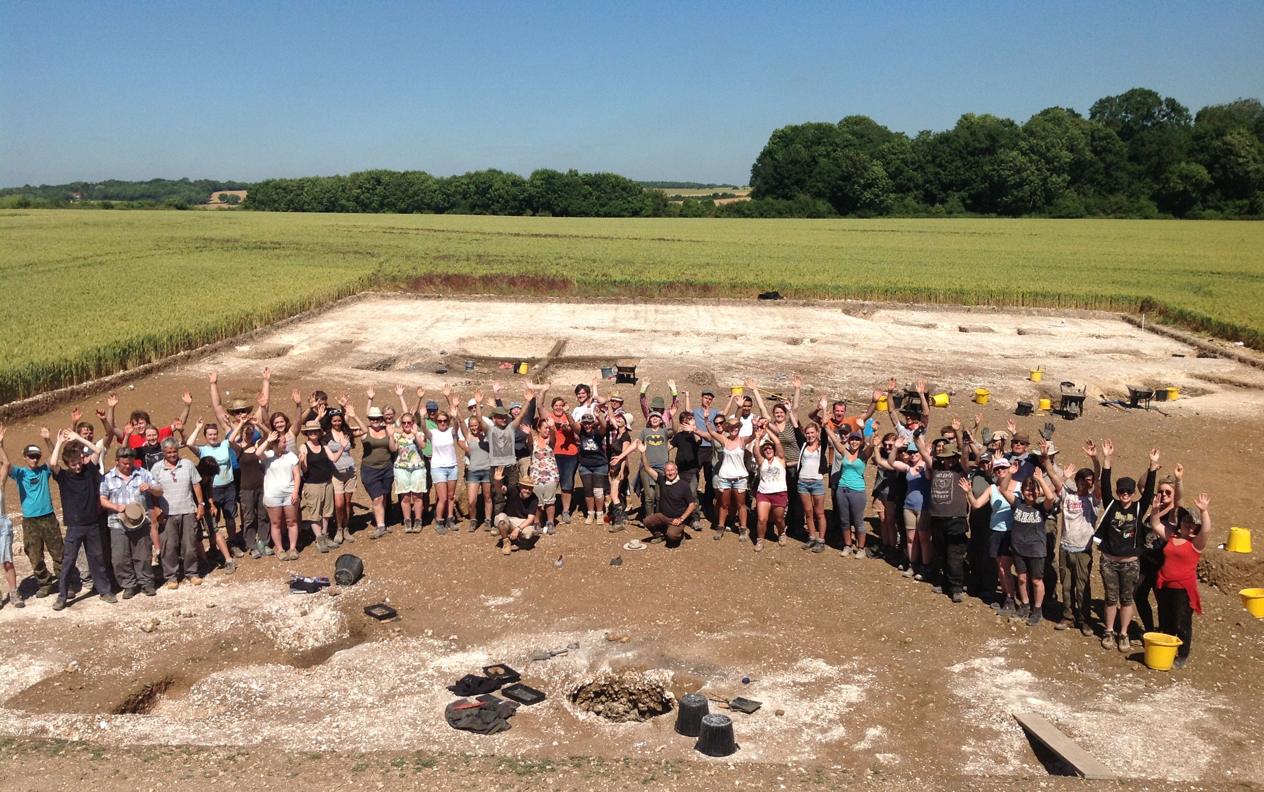
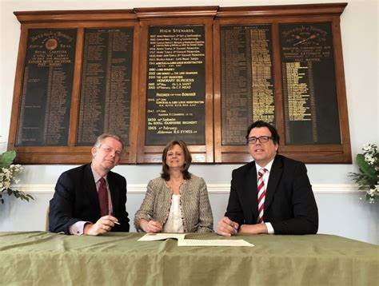
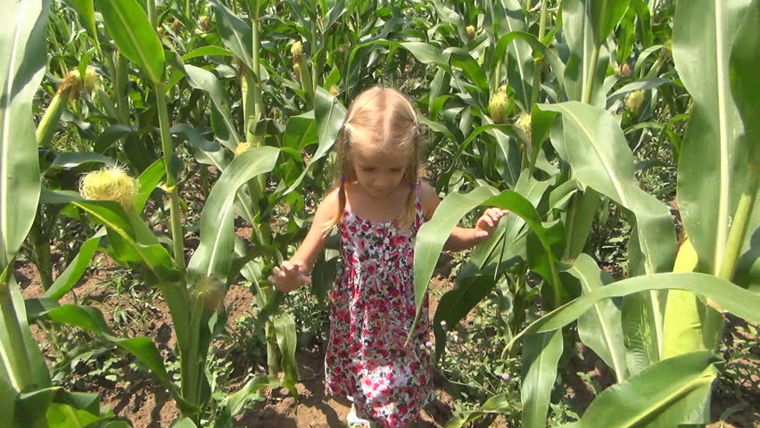
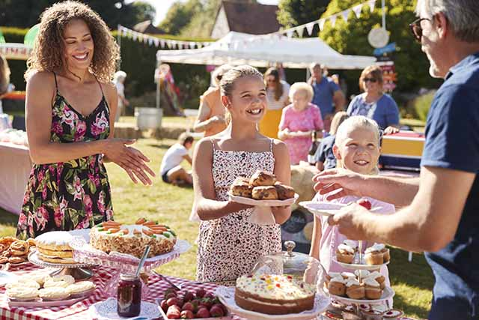
Hands on
Local volunteers
and partners
Connecting
with local councils
Wandering walks and activities
Fund raising

Slide 34
How to invest?

