Slide 1
EROI Analysis of Renewables and Hubbert Linearization
John Peach
Jan. 8 2024

Slide 2
Outline
1. Is it possible to divert enough fossil fuel energy into the production of renewables to maintain the same level of energy? (Nils Peterson)
EROI analysis of energy requirements
Energy for renewable development in declining oil age
Challenges beyond a simple EROI analysis
Evidence based philosophy and conclusions
2. ASPO France published a paper showing a modified Hubbert Linearization. Can you explain their results? (Rolland Sicario)
ASPO-France Hubbert linearization
World production and linearization
Discovery fit to logistic function
Updated discoveries, production and remaining curves

Slide 3
EROI of Oil and Renewables
EROI = Energy Returned over Input
Renewables have high initial energy input, low maintenance cost
Annual return for renewables = EROI / Operational lifespan
Conventional oil requires energy for
Initial drilling
Well to refinery transport
Refinery energy
Delivery to endpoint
Field pressure maintenance and water cut
Fracking has higher initial cost from drilling and completion
Oil EROI is returned over time from well to end use, renewables over lifetime

Slide 4
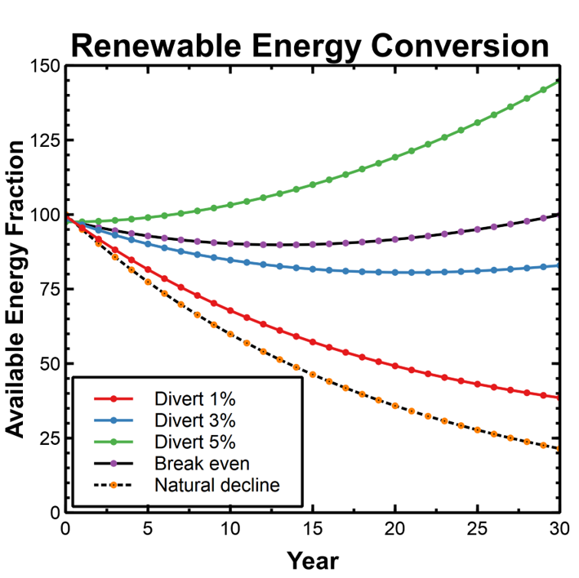
Peak Oil and Renewables EROI
Can renewables be built quickly enough to replace declining fossil fuel supplies?
Assume oil is post-peak, declining 5% per year.
RE annual production = EROI / lifetime (years)
Break-even ~ 3.5%
All scenarios begin with a net energy decline

Slide 5
Substituting Renewable Energy for Fossil Fuels is a Doomsday Stratagem – Art Berman
Focusing on only carbon emissions overlooks:
overconsumption,
air pollutants,
resource scarcity,
biodiversity loss,
ecotoxicity,
and eutrophication (algae blooms, dead zones).
Ref: https://energy.utexas.edu/events/substituting-renewable-energy-fossil-fuels-doomsday-stratagem#:~:text=Energy%20substitution%20is%20a%20doomsday,its%20consequence%20of%20no%20growth.

Slide 6
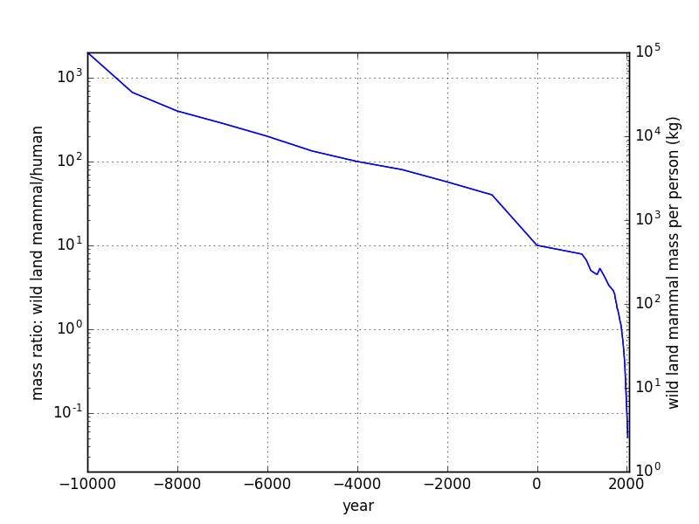
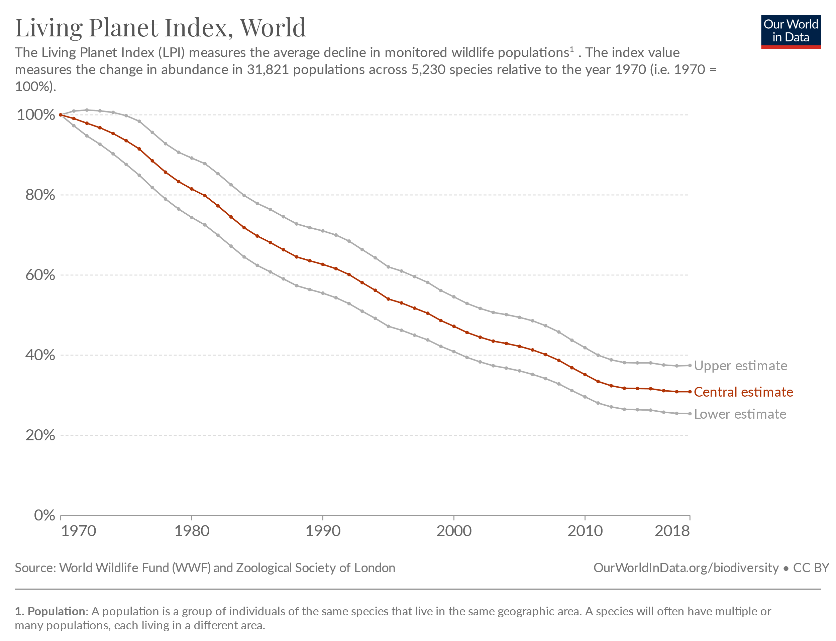
Biodiversity
“We have used it [energy] to expand the human enterprise and population, knock down forests, destroy and fragment habitats, drive extinctions, and generally threaten the vitality of the planet” – Tom Murphy, UCSD Astrophysics.

Slide 7
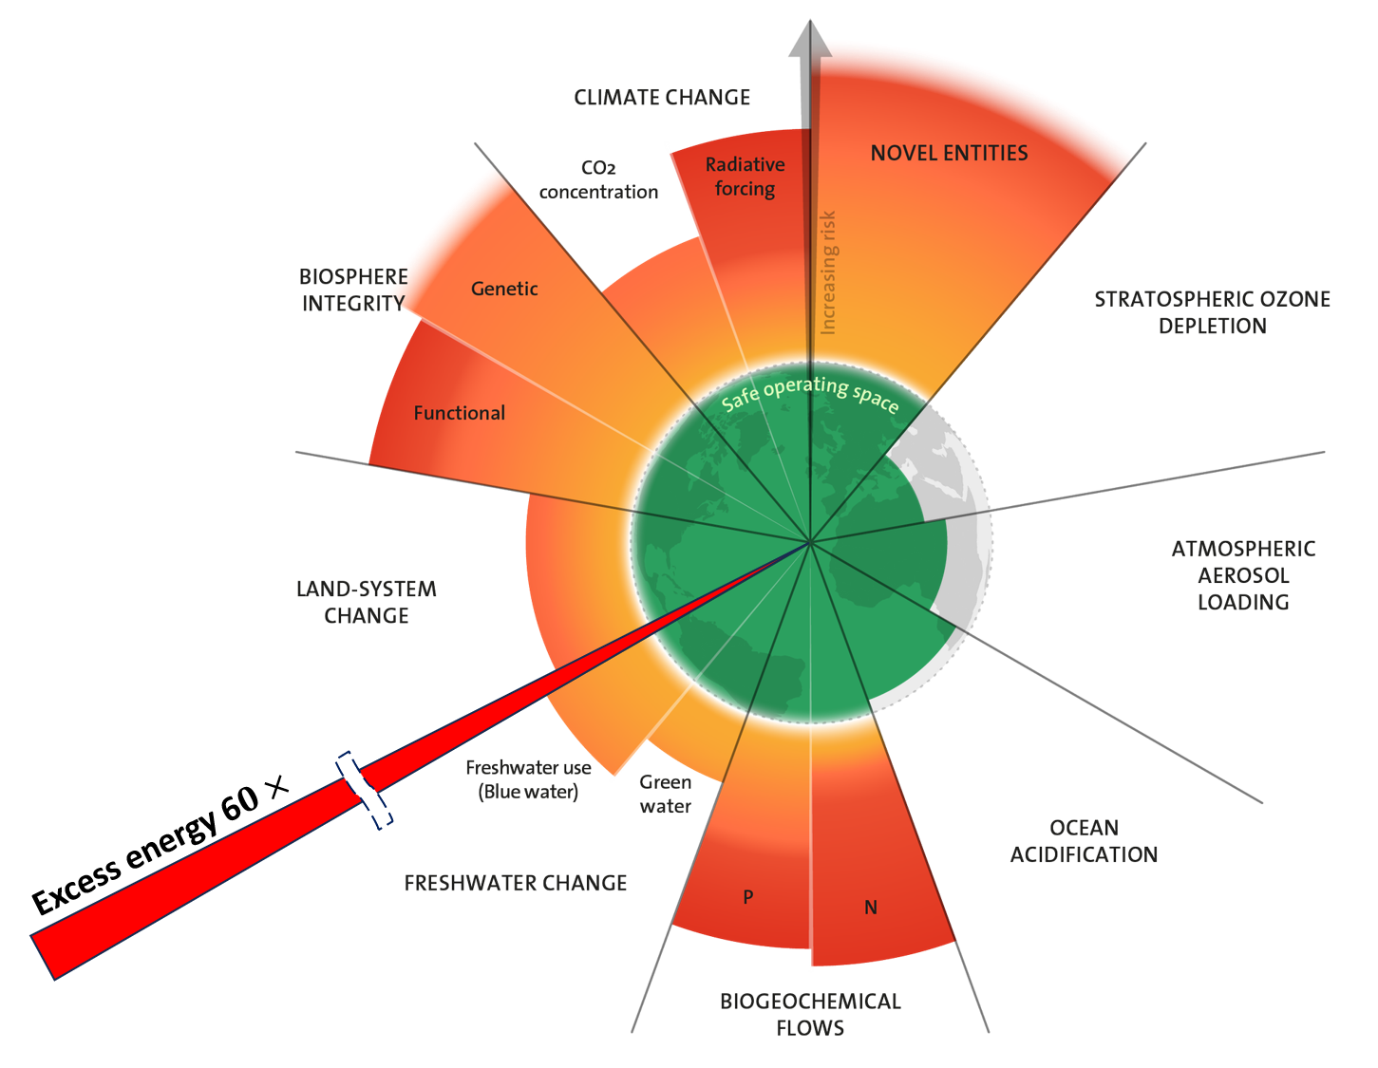
Earth Boundaries
It needs to be understood that renewable energy is not actually about saving the planet.
It’s really about preserving modernity in the face of CO2. Let’s be clear on the goal, here, and how ultimately narrow/misguided it is.
Which is more valuable—modernity or the ecological health of the planet? Which depends on which?
-Tom Murphy

Slide 8
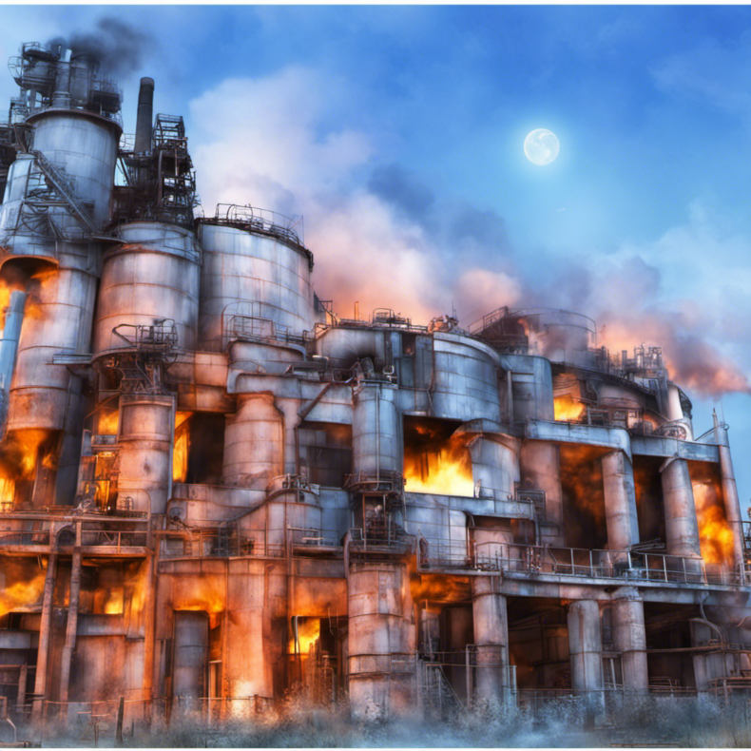
The Sagan Standard
Extraordinary claims require extraordinary evidence:
No evidence that renewables are self-sustaining
No evidence that society will substitute renewables for fossil fuels
No evidence that new energy sources wouldn’t cause increasing harm to nature
See: Wild Peaches, The Decline and Fall of the Petroleum Empire
https://wildpeaches.xyz/blog/the-decline-and-fall-of-the-petroleum-empire/

Slide 9
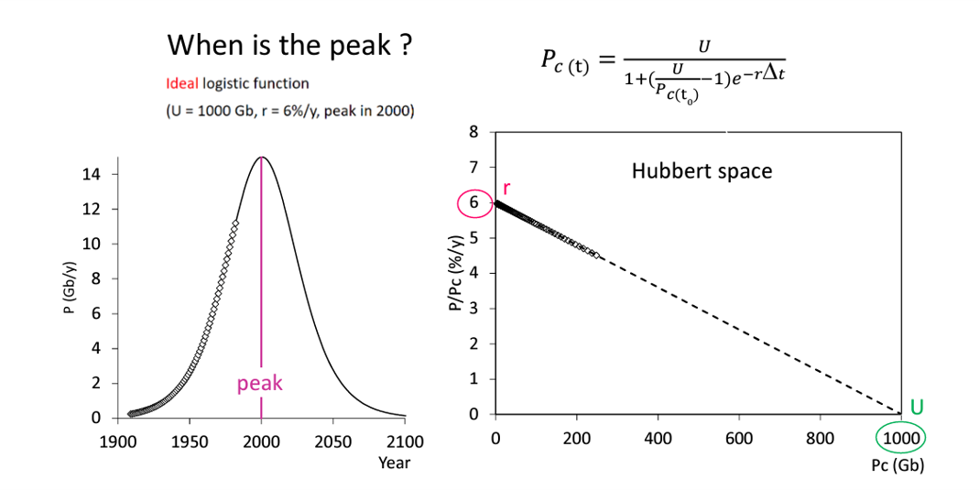
ASPO Hubbert Linearization
Hubbert Linearization converts bell shaped production to straight line.
$U$ (total produced) reaches max when $\frac{P}{P_{C}}=0.$
Growth rate $r$ is the highest point on the line.
Symmetry of production curve means peak is at midpoint.
Given $r, U$ date of peak can be forecast.
$P=$ Annual production
$P_{C}=$ Cumulative production
$U=$ Ultimate recoverable resource
$r=$ Intrinsic growth rate (%/year)
Ref: https://aspofrance.files.wordpress.com/2023/10/peak_oil_aspofrance_17oct2023.pdf

Slide 10
World Oil Production
Hubbert linearization assumes production is Gaussian, or bell-shaped curve
Hubbert model is invalid if production curve is not Gaussian.
No assumption can be made about URR
Peak cannot be assumed at halfway point
Linearization

Slide 11
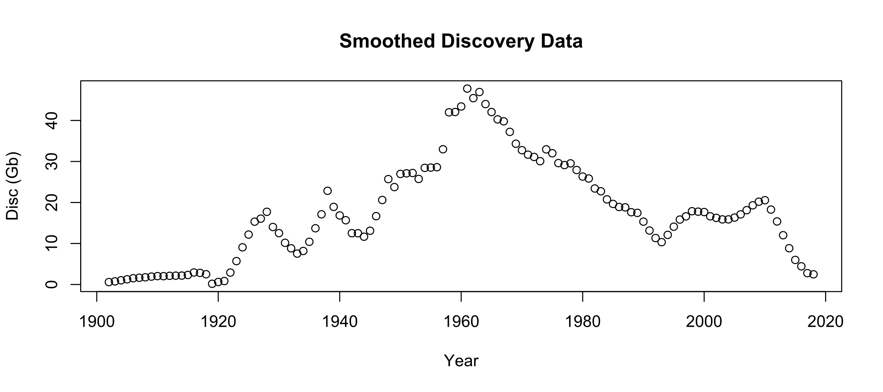
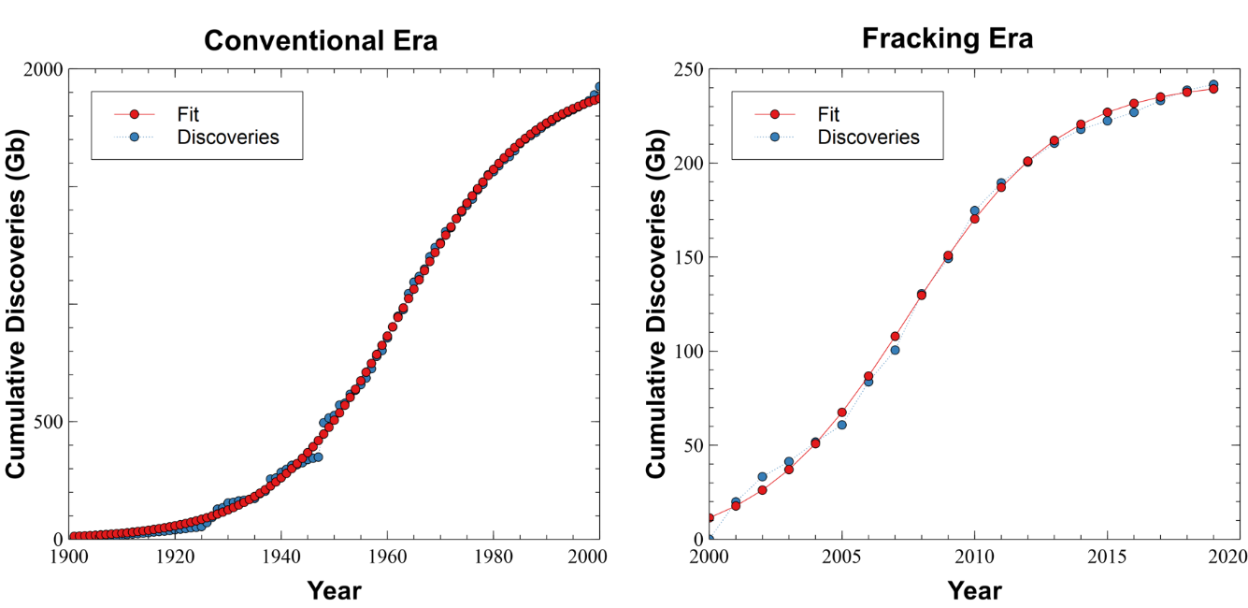
Hubbert fit to Discoveries
Conventional max = 1990 Gb
Fracking max = 250 Gb
Total max = 2240 Gb
Discovery data smoothed to show approximate peaks
Fitted cumulative data has not been smoothed
Logistic function
$t=$ Time (years)
$t_{m}=$ Time midpoint
$Q=$ Cumulative discoveries
$k=$ Slope at midpoint
$C=$Linear offset (years)

Slide 12
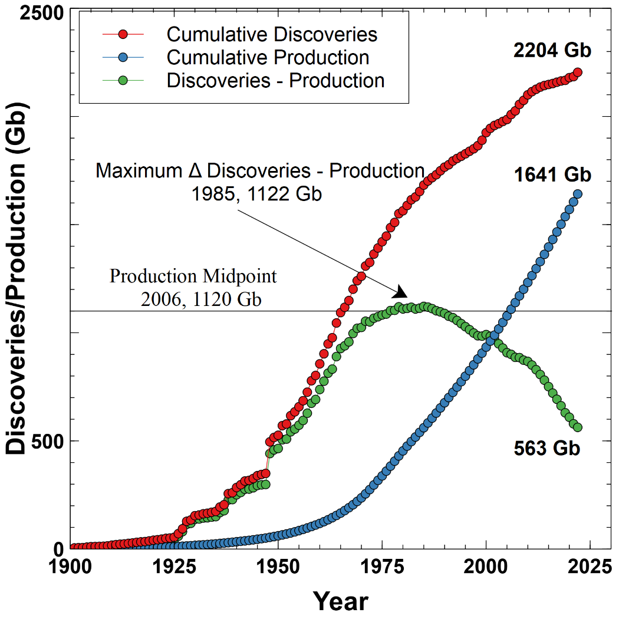
Discoveries, Production and Remaining
Total expected discoveries = 2240 Gb
Total discoveries to date = 2204 Gb
Production to date = 1641 Gb
Remaining = 563 Gb
Annual production ~ 36 Gb
Remaining time ~ 20 years
Half of all production since 2006
Peak is well past midpoint

