Slide 1
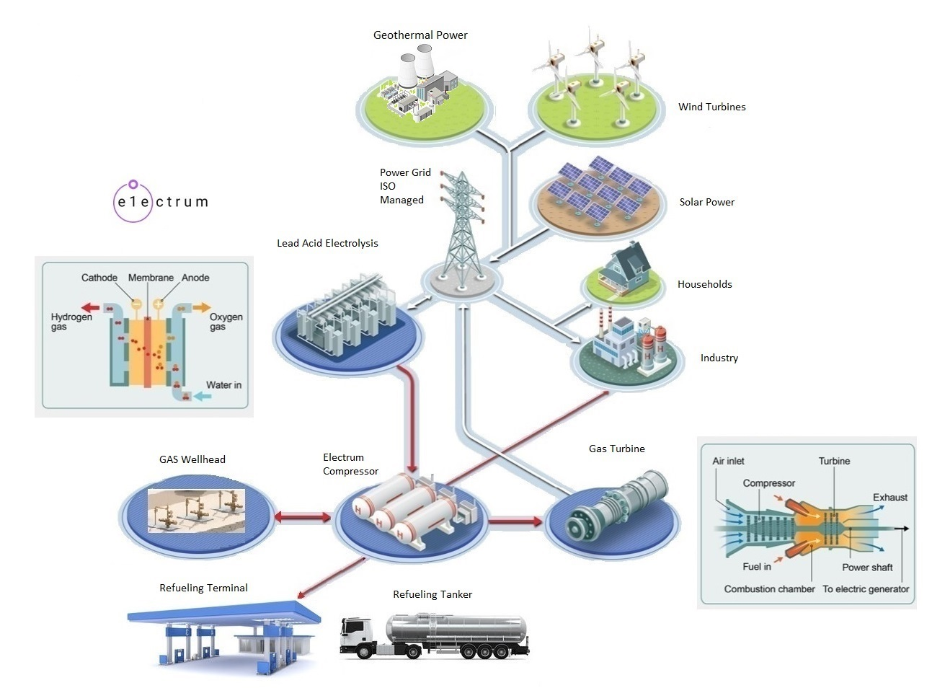
https://electrumpower.tech
Notes:
Dan Gowin
Copyright©, Electrum Power & Technology, All Rights Reserved.

Slide 2
Notice
Notes:
This is for educational purposes only.

Slide 3
More Braess Paradox

Slide 4
OPEC+ has promised 2 million barrel per day.
Notes:
Why is OPEC+ increasing production? Saudi Arabia’s National Debt will approach $97B by end of the year, with BRENT at $60 per Barrel.

Slide 5
By Q3 Shale production will drop by 10%
Notes:
Diamondback says U.S. oil production will fall by 10% by Q3.

Slide 6
The OPEC+ break will be consumed by Q4
Notes:
As per Kpler, OPEC+ extra barrels in the market, could be consumed by Shales rapid decline rate. Drilling must be maintained, to maintain level Shale oil production.

Slide 7
Lack of Qualified Investors
Notes:
The U.S. fall in credit rating from AAA to AA+ is affecting Smaller operators fund raising. Why invest in private enterprises when a greater yield can be had with U.S. Government bonds?

Slide 8
Refinery shutdowns
Notes:
"The US has already seen the closure of LyondellBasell’s Houston refinery, and two Californian refineries (Wilmington, Benicia) will follow suit, as the only way to counteract lower margins and weak demand growth seems to be capacity consolidation.“ This is the beginning of a global diesel shortage.

Slide 9
Narrative change

Slide 10
Oil depletion rates will accelerate

Slide 11
Questions?
Notes:
300 yards from the Raft River Binary Geothermal Power Plant. Drilled in 1973. 10, 383 meters deep. Temperature 320C.

