Slide 1
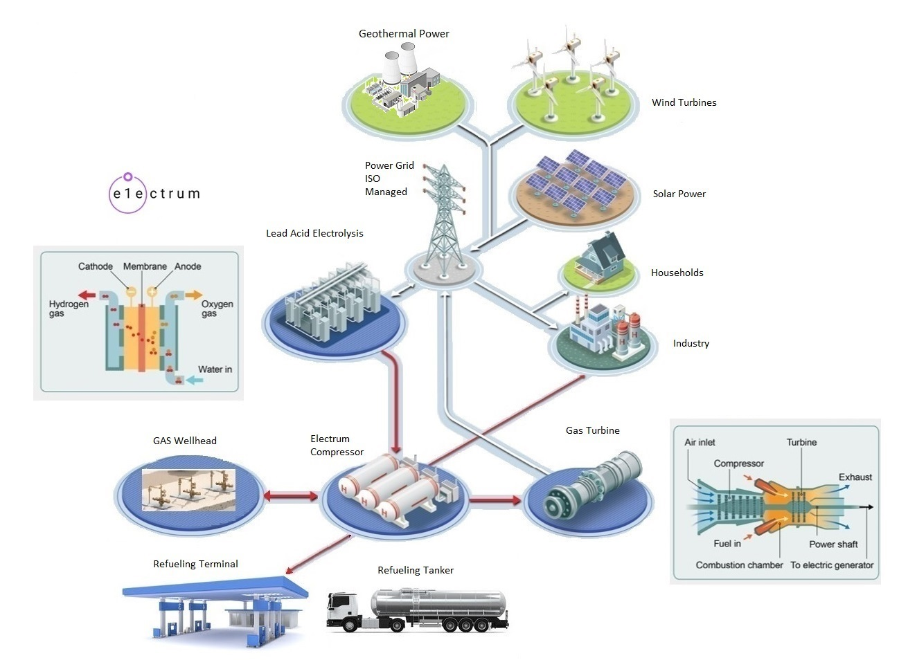
https://electrumpower.tech
Notes:
Dan Gowin
Copyright©, Electrum Power & Technology, All Rights Reserved.

Slide 2
Notice
Notes:
This is for educational purposes only.

Slide 3
Notes:
In order to understand how an energy transition might be possible, we first must understand the problem. We must understand energy storage. All Batteries are rated in Watts Hours per kg. And All Fuels are rated in BTUs per lbs. Converting to Joules per kg brings into focus these Energy Storage devices. Now we can understand how to substitute one energy storage device for another. The only fuel not on this chart is Nuclear Fuel. Which is rated at greater than 94,000,000 BTUs per lbs, Billions of Joules.

Slide 4
What is Coal Gas?
Coal gasification is a process that converts coal and water into a gaseous fuel called syngas, a mixture primarily of hydrogen and carbon monoxide. This process uses heat and chemical reactions, without combustion, to produce syngas, which can then be used for various applications like power generation, chemical production, and even as a feedstock for liquid fuels.
The gas is known as Town Gas, Water Gas and Synthesis gas
Notes:
1) Discovered in 1609 by Flemish scientist Jan Baptista van Helmont. Described as "wind Spirit".
2) In 1681, Johann Becker of Munich, discovered "Spirit of the Coal" Could destroy Iron Pipe upon prolonged contact.
3) In 1787, Lord Dundonald lit his house at Culross, Scotland. He discovered you could use copper tubing or bronze fittings to no ill effect when using the gas.
4) In 1792, William Murdoch (later known as Murdock), discovered by using a new device the bubbler, you facilitate new ways of making, purifying and storing the gas. By adding moisture to the gas, this would aid the cloth and leather fittings and gaskets used at the time. The cloth and leather would swell and thus seal the gas pipe works.
5) In France, Philippe le Bon patented a gas fire in 1799 and demonstrated street lighting in 1801.

Slide 5
What is Coal Gas?
Here's a more detailed breakdown:
1) Hydrogen: Around 50% of coal gas is composed of hydrogen.
2) Methane: Methane typically makes up about 35% of coal gas.
3) Carbon Monoxide: Carbon monoxide generally constitutes about 10% of coal gas.
4) Other Gases: Coal gas also contains trace amounts of other gases like ethylene, carbon dioxide, and ammonia.
Notes:
1) Other demonstrations followed in France and in the United States, but, it is generally recognized that the first commercial gas plant was built by the London and Westminster Gas Light and Coke Company in Great Peter Street in 1812 laying wooden pipes to illuminate Westminster Bridge with gas lights on New Year's Eve in 1813.
2) In 1816, Rembrandt Peale and four others established the Gas Light Company of Baltimore, the first manufactured gas company in America.
3) The first German gas plant was built in Hannover in 1825 and by 1870 there were 340 gas plants in Germany making town gas from coal, wood, peat and other materials.
4) In the 1850s every small to medium-sized town and city had a gas plant to provide for street lighting. Subscribing customers could also have piped lines to their houses. By this era, gas lighting became accepted. Gaslight trickled down to the middle class and later came gas cookers and stoves
5) The 1860s were the golden age of coal gas development. Scientists like Kekulé and Perkin cracked the secrets of organic chemistry to reveal how gas is made and its composition.
6) Every town in North America and Europe with a population greater than 10,000 had town gas by 1899.
7) George Westinghouse invented the Natural Gas System in 1890s. His intention was to save lives. A number of people used town gas to commit suicide. In addition to home poisonings.
8) The Natural Gas System was deployed in the U.S. in 1950.
9) By 1966 all of the Town Gas plants had been shutdown and converted to Natural Gas. Except for Indianapolis and Honolulu.
10) England had converted to Natural Gas in 1970, upon discovery of the North Sea Oil Field. The North Sea went into terminal decline over 20 years ago. Many in the British Parliament are rediscovering the old town gas system.

Slide 6
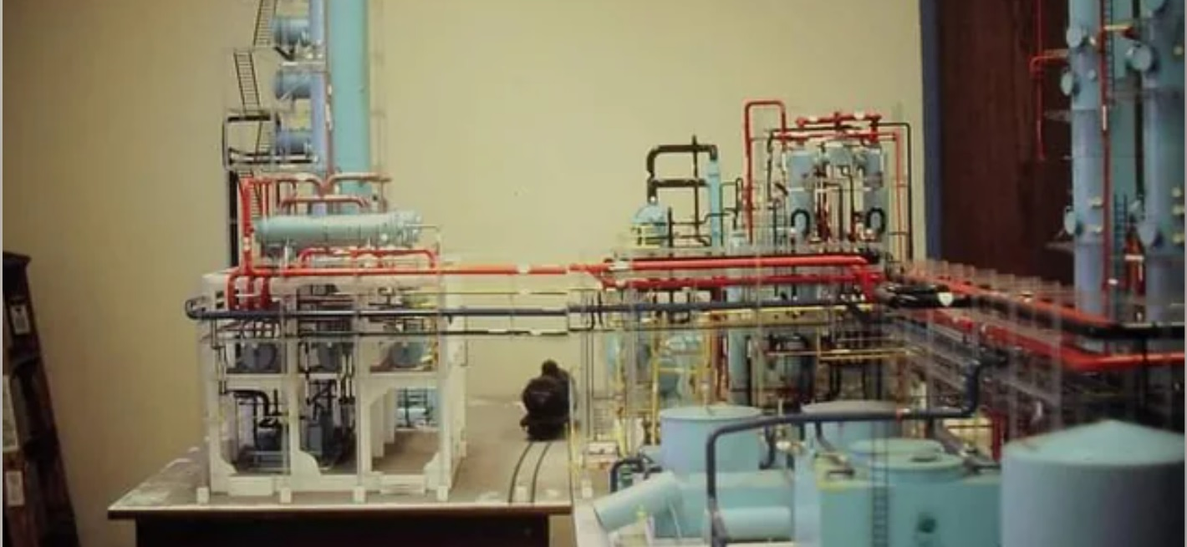
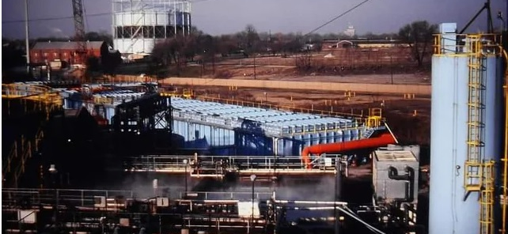
Citizens Gas & Coke Company
Notes:
Constructed in 1908 the Indianapolis Gas and Coke plant, on a 22 acre site along Prospect St, was a facility built to supply Indianapolis and the surrounding area with town gas. It also supplied coke, a product of coal burned in an oxygen-less ovens, to various steel plants around the country. At the time of it's construction, the state-of-the-art facility was the largest in the United States. It contained two massive coke batteries and a huge syn gas processing division, along with cooling and ammonia towers, power plant, and a gasometer.
The plant was shutdown in 2014. It had been supplying a hydrogen mixed gas to ~6M people in the Indianapolis Area for over a Century.
The Factors contributing to the shutdown were the quality of the coal. Producing Steel is all about the quality of the inputs. Most Steel Foundry's today use refinery coke.

Slide 7
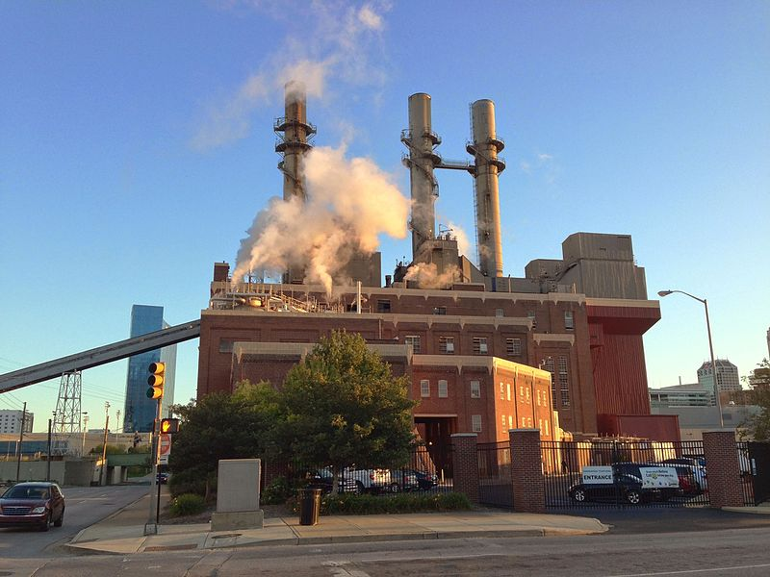
Perry K. Syn Gas Plant
Notes:
Perry K, a town gas plant built in 1870, in Indianapolis, produces syn gas for there primary customer Eli Lilly. The old town gas system was designed around the gasification of coal. By grinding coal and water together, then heat is introduced, Carbon and water is transformed into Carbon Monoxide and Hydrogen. Perry K’s, Syn Gas is 40% Carbon Monoxide and 60% Hydrogen. By 1873 this plant provided syn gas, water gas, to over 1200 Street lanterns in downtown Indianapolis. They also provided gas for 47,000 homes. As was the case in many towns and cities in the World at that time. In 2016 the plant was converted from gasification to steam reforming of natural gas. Eli Lilly uses the syn gas to polymerizes plastic coatings on pills, methanol and as the starting place for many drugs. Gasification of carbon is over 400 years old. When Eli Lilly’s production line is idle, the syn gas is stored underground, under downtown Indianapolis, in a water well. In addition, Perry K provides steam and chilled water to all the buildings in downtown Indianapolis.
This was my first power plant when I went to work for IPL in 1998.

Slide 8
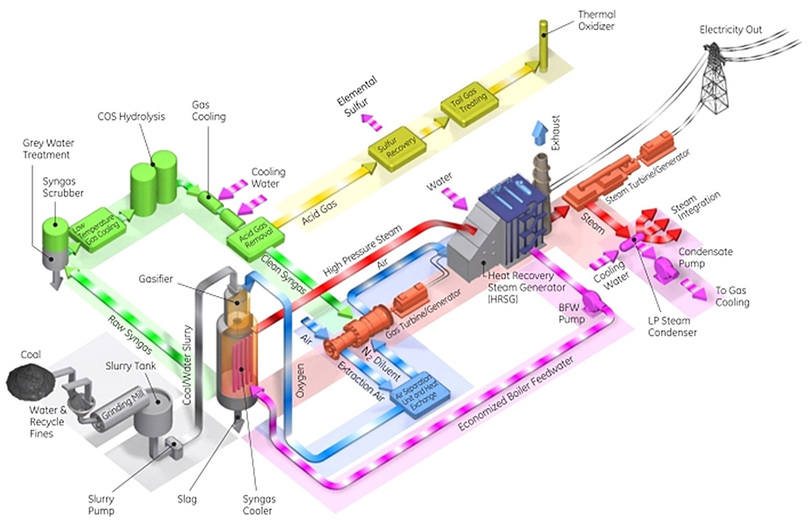
Wabash Valley Combined Cycle Coal Gasification Plant
Notes:
Wabash Valley power Plant was brought online in 1991. Wabash Valley turns anything with carbon into syn gas, which in turn is burned in four GE-7HA Gas Turbines. The Turbines in addition power three Steam Turbines, through a HERSOG, Heat Recovery Steam Generator. Wabash Valley uses garbage, farm waste, wood pellets and even Refinery Coke as source material for its gasifier. The plant currently is adding a Haber Ammonia plant to its capabilities. This plant requires greater than 500 tons of carbon material per day just to maintain its economics. The sorting of trash and other material is a main endeavor just to make sure bottles and cans don’t end up in the gasifier.

Slide 9
Notes:
Syn gas can be turned into many different types of plastic. This is a process for making most plastics before the age of oil. In fact, the Petrochemical Industry adopted most of its process from the old syn gas system. Unfortunately, the U.S. only produces enough Bio-Mass to make the equivalent of 2 million barrels per day of transportation fuel. If we use trash as the feed material for the gasification process, maybe we could produce 6 million barrels per day of transportation fuel.
Coal Gasification is where our modern chemical industry came from. The technology is 416 years old. The U.S. Consumes 2 million barrels per day of crude oil.

Slide 10
Notes:
The U.S. consumes on average 500 Gwe per hour. It oscillates between 400 Gwe to 540 Gwe. Remember the Braess Paradox? It will become very difficult to add more Generation or Load on the Power Grid.

Slide 11
Notes:
According to the DOE, the U.S. could replace all of its generating assets with EGS Geothermal Power Plants. EGS is Enhanced Geothermal System. Gwe stands for GigaWatt’s of Electricity. Great fact to know.

Slide 12
Every 2,000 feet you drill
Notes:
Every 1,000 Meters drilled into the Earth; the temperature increases 25.7C.
Or put another way, Every 2,000 feet you drill into the crust, the temperature increases by 30F.
The crust in the North America is 43 km Thick.
In the Pacific Ocean, off the coast of Hawaii, the crust is only 6 km thick.
Underneath that is a sea of molten rock. An infinite power source for all practical purposes.

Slide 13
Notes:
In 1890 a resident of Boise’s Warm Spring District, drilled a well and hit hot water. He started using the hot water to warm his home, for which the idea spread. Today there are over 300 home heated from the same set of hot water wells drilled in 1892. In 2023 a request was filed with the U.S. DOE for a grant to replace the piping that was last replaced in 1973. The response from the DOE was the neighborhood is too wealthy to warrant a grant. Funny thing is driving around the neighborhood, you are likely to see a Peterbilt or Kenworth semi-truck in one of the driveways. These are working people. They received a 50-year loan from the Idaho Water Board for $3M. Total cost of heating a home in this neighborhood? About $36 per month.

Slide 14
Notes:
After a serious energy crisis in the 1970s, The Mayor of Boise took the Governor of the State of Idaho down to WARM Springs Pump House and pointed out the obvious. By 1983 several wells had been drilled and thus started the conversion of Boise into a Geothermal City. Today all of the buildings in downtown Boise, including the Capital Building, are heated with Geothermal. The Geothermal Public Utility has been converting the surrounding neighborhoods, to Geothermal, at the request of its residents. Average of $38 per month, per home for heating. It’s a local energy source, locally controlled, Inexpensive and safe.
By taking towns off the gas grid, more resources can be made available for domestic and LNG exports.
I know NYC has banned the use of Natural Gas in buildings. ……………………

Slide 15
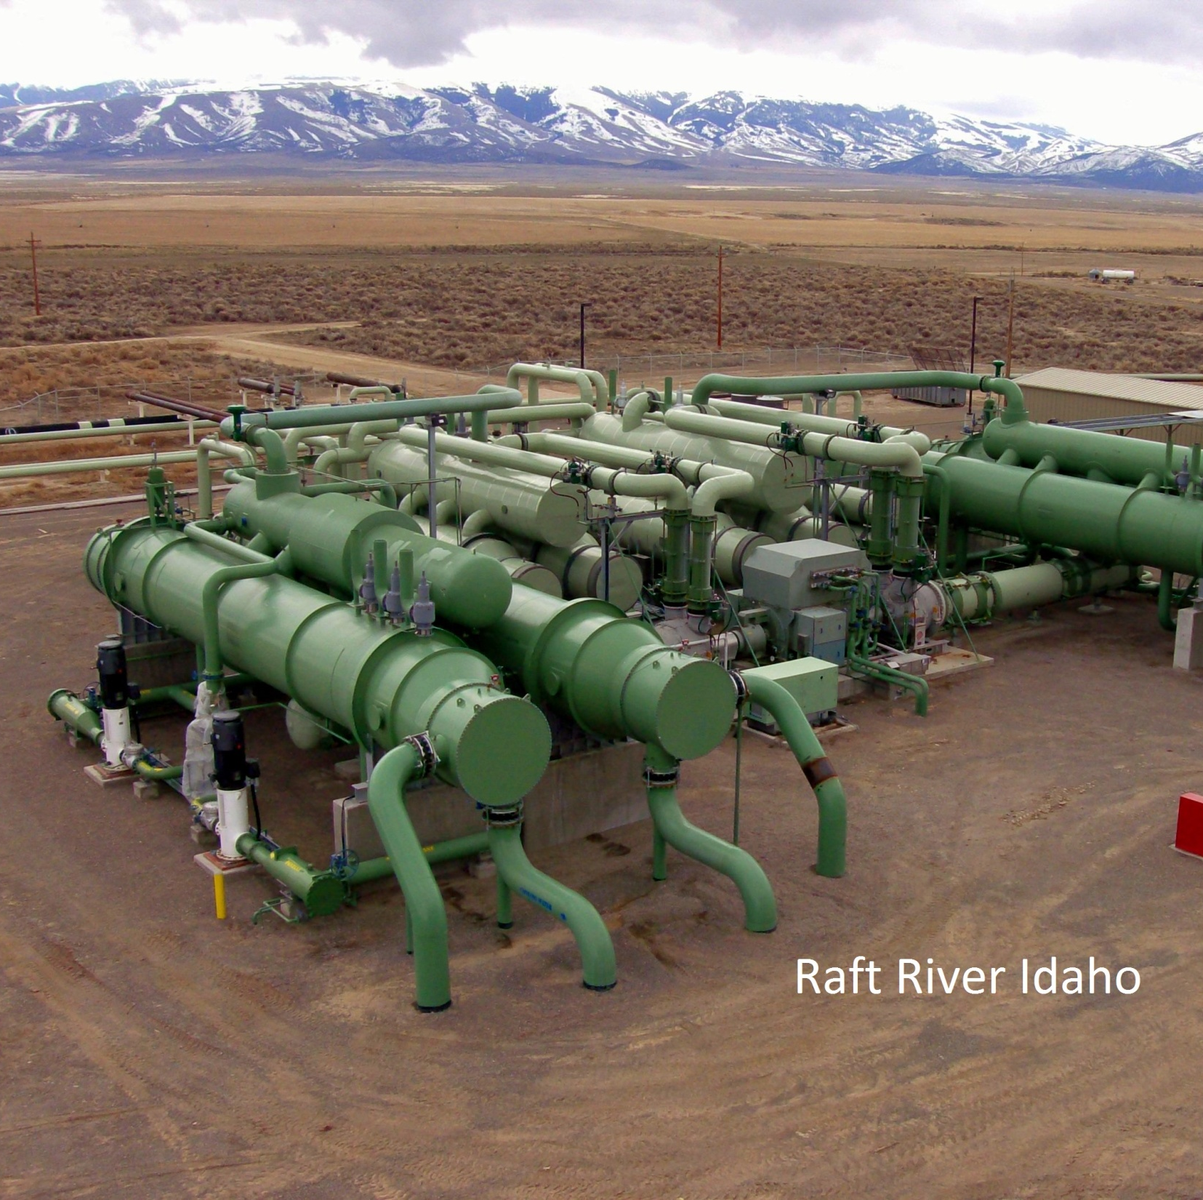
Raft River Geothermal Power Plant
Binary Geothermal Power Plant
Brought Online in 1980
Initially produced 140 MWh
Working fluid is Pentane
Pentane is Super Critical 198C
At 250C Produces 100 Bar of pressure
Bought by Oramat in 2000 and converted to 20 MWh
In operation for 45 Years
Notes:
The Raft River Geothermal Binary Power Plant was brought online in 1980 by my dad Donald Gowin and his submarine friends. The water comes out of the ground at 320C. The Power Plant is over 100 miles from the nearest geothermal source.
This all came about from DOE grant sent to the Idaho Engineering Laboratory (INL), during the 1970s energy crisis.

Slide 16
Notes:
If some if this looks like it came out of a nuclear power play book, you would be right. This power plant design came out of the U.S. Navy’s Nuclear Fleet. The second loop, after the heat exchanger, is comprised of pentane, a liquid with low temperature characteristics.
The first Geothermal Power Plants allowed live steam, from the ground, to drive turbines directly. The minerals dissolved in the hydrothermal water deposited on the equipment until failure. Todays, Geothermal Binary power Plants have the same capacity factor as Nuclear Power Plants. Safe reliable Base Load.
A secondary Heat Exchanger can be added to provide Geothermal Heating for a town.

Slide 17
Notes:
This Geothermal technology is based on Horizontal drilling and fracking. Fracking had been known in the Oil & gas Industry since before the 1940s. Horizontal drilling had been invented in the 1950s. The primary water loop under ground is pressurized for multiple reasons. One is to maintain the fracture network underground. The other is to keep the minerals dissolved in the water, so that equipment deposits are prevented.
The above depicts two geothermal resources driving two Pentane driven (Steam) Turbines, each equal to 110 MWh each. Total 220 MWh of electric power generation. Each side has two Horizontally drilled Injection wells and one Horizontally drilled production well. The rock is fracked between the wells and 8 million to 10 million gallons of water is pumped in. The two Geothermal Reservoir's, at 11,000 Meters deep, will maintain a temperature ~282.778 C (~541.33 F). Only 1% to 2% of the water is cycled through the reservoirs. The Steel casing is 16” in diameter.

Slide 18
Notes:
The following Turbine design is for load following. When attached to the Power Grid your always balancing the load to the generation. If there is not enough generation on the Power Grid you will get frequency drag. If your generating more power than necessary, your wasting fuel. Looking to the left of the Generator, on the diagram, is the Turbine. There are 5 bleed off valves, attached to the turbine, that recirculate steam back to the boiler. This maintains the temperature and allows less fuel usage. 110 MWh steam turbine..

Slide 19
Notes:
This might be a better option, considering the Braess Paradox. Remove towns off the Power Grid to make energy more resilient. Since a Geothermal Power Plant is attached to an infinite Power Source, removing all the bleed off valve would allow full power operation. There would be lees wear and tear on the turbine. This Power Plant would have a lot of spinning reserve. Full Power, 110 MWh, NOT on the Power Grid. Adjusted for inflation, CAPEX, M&O, would be $6 per MWh, amortized over 50 years.

Slide 20
Notes:
A 110 MWh (Steam) Turbine. The blades are made from Stainless Steel. The rust is caused by steam. If Pentane was used the blades would be nice and shiny.

Slide 21
Notes:
The left column is the capacity factor of a given power grid energy source. The far-right column is the inflation adjusted price per megawatt hour, coming online in 2040. Geothermal is the least expensive baseload we have, as per the U.S. Department of Energy. The second most affordable power source is home solar panels. Renewable energy delivered directly to your home.
In this chart is a hidden secret. A knockout combination.

Slide 22
PEM Electrolysis
Notes:
Invented in 1959 by General Electric, the PEM Electrolzyer turns water and electricity into hydrogen and oxygen. The U.S. Navy uses it to convert Sea Water into Oxygen onboard Nuclear Powered Submarines. Originally called Polymer Exchange Membrane Electrolyzer. Today we call it the Proton Exchange Membrane Electrolyzer. What passes through the membrane is a proton. Truly a quantum device. In one format this device turns electricity and water into hydrogen & oxygen. In a separate format it turns hydrogen & oxygen into electricity and water. The PEM fuel cell was born. Both devices have efficiencies in the 80% to 90% area.

Slide 23
Fuel Cells Power Torpedo’s
Notes:
The U.S. Navy found a us for that hydrogen byproduct. A submarine powered by 100 MW nuclear reactor turns electricity and water into a valuable fuel, hydrogen, for fuel cell powered torpedo's.

Slide 24
Flying Torpedo drone
Notes:
The latest, a flying Torpedo Drone. It can stay aloft for 3 weeks, on a fuel cell, hydrogen, air and an induction motor..

Slide 25
Notes:
Hydrogen Fuel cell powered vehicles. The upper left is the 2017 Toyota Marai Fuel Cell vehicle. Top middle depicts the partnership with Kenworth and Toyota. A drop in Fuel Cell kit for Kenworth Class 8 Trucks. Upper Right corner, Hyundai Panel Truck. Middle Left Chevy Colorado ZS2. The Military has done extensive testing with this vehicle. Fuel Cells turn 80% to 90% chemical energy into electricity. This vehicle has very little thermal signature. The U.S. Military uses UV and FLIR Cameras to measure the amount of CO2 our enemy's vehicle belches out. The Middle bottom vehicle is the GM SURUS. Named after Hannibal's war elephant. This vehicle looks like a skateboard. SURUS is a Robot Truck with a 200 KW Fuel Cell. A PlayStation Controller with a USB port can be used to control SURUS. SURUS came out of the Autonomous Ammunition Handler Program. The Right Middle image is some of JCB Heavy equipment. Lord Bamfords Family Company, JCB, was founded in 1850. Originally, they made water pumps powered by syn gas. Today Hydrogen Powered Diesel’s, bring this family-owned company back to its roots. The Bottom Left image is the SURUS carrying a 40’ Cargo Container. The Bottom Right image is the Toyota Hilo. A Four-Wheel Drive, Hydrogen Fuel Cell Truck for the inner child in all of us.

Slide 26
Notes:
Koenigsegg Gamera sports car. It uses Four Quark Radial Induction Motors. One behind each tire with disc brake. 0 to 60 mph in 1.9 seconds. Top Speed 325 mph. Hybrid Electric Car, powered by a 3- cylinder ICE driving a 500 KW generator. The system uses Ultra Capacitors for a buffer. The engine can use Nitro Methane, DME or Hydrogen as the fuel. The model shown is capable of producing 1340 hp.

Slide 27
Notes:
This was announced last year.

Slide 28
Carbon Fiber
Notes:
The Type 4 tank shown above was developed in 2000. Top pressure in the Toyota Marai’s fuel tanks is 700 Bar (10,000 psi). Yes, its 25 years old.

Slide 29
Notes:
For the longest time we knew what materials were impervious to hydrogen. Impervious to embrittlement. In 2010 Fermi National Labs, in collaboration with Eli Lilly figured out the mystery. The above image is X-Ray Diffraction of 316 Astenic Stainless Steel. All the Atom’s are connected in triangles. Not enough space for a Hydrogen Molecule to intercalate between crystalline layers. No way for Brownian Motion to destroy atomic bonds. All the materials listed above are impervious to hydrogen.
Imagine if you will you're at the Beach. And you want to build a retaining wall to hold sand. Let's say you build your retaining wall with Bowling Balls. You connect your bowling balls with bolts, epoxy or something. You start placing sand behind it. The Bowling Balls are Iron Atoms. And the sand is the hydrogen molecules. The sand slips right through.
But if you place nickel and chrome between the Iron atams, your steel is locked tight. Stainless Steel.

Slide 30
Notes:
High Pressure Equipment Inc. has been in business since 1960. Most of there customers are the Military. They make a variety of High-Pressure Hydrogen Equipment upon demand.

Slide 31
Notes:
There is a Storge and Compressor problem with hydrogen. It’s a challenge compressing the Universe’s smallest Molecule. Even after we solved embrittlement, we still had problems compressing it and storing it. One kilogram of hydrogen at room pressure occupies 12,000 liters of volume. Even the above state of the art Industrial Compressor, with 16” diameter pistons is too small for the task. In addition, due to the size of the hydrogen molecule, vast quantities of the gas simply pass its compression rings, due to the Bernulli Effect. Essentially the compressors burn themselves up compressing the gas. The reason California’s service stations are down 50% of the time, is due to compressor issues.
The compressors at oil refineries use lubricating oil. Even still they must be replaced every 2.5 years. The compressors at the Hydrogen Services stations can’t use lubricating oil. It would contaminate the hydrogen being placed in fuel cell vehicles.

Slide 32
How to store vast quantities of hydrogen
Notes:
In 2010 Sandia National Labs published this white paper, among researchers, detailing solutions to the hydrogen storage problem. It was declassified in 2011.

Slide 33
Notes:
The solution detailed the use of various underground storage techniques. Horizontally drilled and fracked dry wells are considered Depleted Gas Reservoirs.

Slide 34
Notes:
Remember the old Perry K, Syn Gas Plant? The Old Town Gas System is depicted on this map by the red triangles.
1) The Natural Gas system was invented by George Westinghouse in 1890s.
2) Any town with a population greater than 10,000 has a town gas plant. Baltimore Gas Light Company was built in 1817. And Honolulu Gas Company was authorized by the Hawaiian legislature in 1859.
3) Natural Gas system was deployed in the U.S. in 1950.
4) By 1966 all of the town gas systems had been converted to Natural Gas. Except Indianapolis and Honolulu.

Slide 35
Notes:
This is from a driller's safety course. Why the Blow Out Preventor (BOP) is so important. This graph depicts how its possible to store hydrogen gas at pressures greater than 1000 Bar (15,000 psi). You already have geological structures able to store gasses as high as 1400 BAR (20,000 psi). It also details the wells must be pressurized with drill mud to keep the well bore from collapsing. Drill mud is pushed down through the drill string, through the cutting head to pick up rock chips. The mud and chips are pumped to the surface to be collected and analyzed by the geologist. When the cap rock is pierced by the cutting head, it usually bangs the drill string. Someone hits the big red button to activate the BOP, which clamps around the drill string and holds the pressure in there. Until it can be safely released.

Slide 36
Notes:
Energy Storage. How to store Wind Energy without the use of batteries. At 800 MW per hour of curtailed Wind Power, times 24 hours, times 365 days, for a total of over 7 TWe.

Slide 37
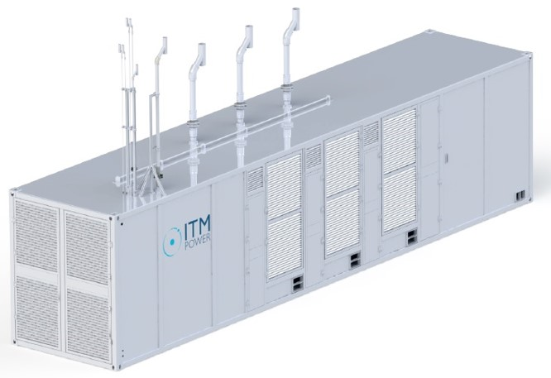
PEM Electrolyzer, One MWh, 22 kg h2, @20 Bar, 13200 Liters of volume.
Notes:
Using Megawatt Grid Scale Electrolyzers, 7 TW of curtailed wind power could be converted into 154,000 Metric tons of hydrogen, that could be stored underground. The GE LM6000 Multi Fueled 50 MWh Gas Turbine would be the perfect choice for converting stored energy back into the electrical grid.
One thing missing was how to solved the hydrogen compression problem.

Slide 38
Fluidic Compression
Notes:
Why use Fluidic Compression? Non-Mechanical form of compression that uses the boundary between Super Critical Fluids too achive even higher pressures. Molecularly tight at the quantum level. It’s a form of compression that uses the laws of quantum mechanics to your advantage.

Slide 39
Notes:
A Big Difference. Mechanically compressing hydrogen to 350 Bar (5,000 psi) consumes over 1.2 Million Joules per kg. But, Fluidic compression of hydrogen, to 350 Bar (5,000 psi), consumes only 32 Joules per kg.

Slide 40
Electrum Hydrodynamic Compressor
Notes:
Above to the right is the Prototype Electrum Hydrodynamic Compressor Power Supply using a 3,000 Liter Tank on the left. On June 17, 2021, I blew out a coupling at 3970 Bar (57579.96 psi). The Cracker Unit (image below) depicted here has a storage Capacity of 15,000 Liters. I was allowed to verify its ASME rating. Both tanks are ASME rated at 5100 Bar (73,000 psi) with 316 Stainless Steel liner. The Electrum Hydrodynamic Compressor was built under a DARPA project. All the IP is owned by Electrum Power & Technology Inc.

Slide 41
Notes:
Why would you pursue higher pressures? The above depicted a 2021 Toyota Marai car. Toyota publishes an instruction manual, on how to remove the Type 4 Carbon Fiber Tanks from the car, with details on how to order all prescribed tools. So, in theory by replacing the Toyota Carbin Fiber Tanks with higher capacity tanks, greater refueling capabilities could be obtained.
By using average gas storage well, containing 440,000 kg of hydrogen, at 1000 Bar, an Electrum Hydrodynamic Compressor, using 15,000 Liter Tank, could be filled to 1000 Bar. At 1000 Bar the tank would contain 1200 kg of hydrogen. The tank would then be pressurized from 1000 Bar to 3000 Bar, within 5 minutes. Over 50 Toyota Marai’s could be refueled, to 2800 Bar, within 30 minutes.

Slide 42
Becoming Ubiquitous
Notes:
Pushing the boundaries of pressure and size. These high-pressure carbon fiber tanks are almost bullet proof. To rupture a carbon fiber tank with a armour piercing military round requires the shot to be perfectly flat. Other wise the flexibility of the carbon fiber will repel the round.

Slide 43
Notes:
The above system is designed to replace the energy infrastructure for a county. The system plans on using Secondary Heat Exchanger from the Geothermal Power Plant. District heating is intended to remove counties off the gas grid. The system allows towns to be removed from the Power Grid, also, by providing a 110 MWh to 220 MWh Geothermal Power Plant (50,000 to 100,000 houses) with Hydrogen Park providing transportation refueling and backup power via gas turbine. Minimum cost per county (2025) is $130M. There are 4,063 counties in the U.S.. It's been calculated than only 720 counties are critical for maintaining the economic viability of the country as a whole.. The 720 counties would be next to major freeways and thorough fairs within the country. For 720 counties, total cost of $93B. If all 4,063 counties were converted the cost would be over $580B. This is a distributed energy system.
Remember they’re planning on spending $5T on the CO2 Oil Field Recovery System.

Slide 44
Prof. Fritz Haber
5.2.2 Die Ammoniaksynthese
Page 151
English translation on how to produce ammonia.
“The process prefers higher pressures and lower temperatures, in the presence of an Iron Based Catalysts”.

Slide 45
Ultra Pressure Haber Process
Notes:
The Haber process prefers higher pressures and lower temperatures. At 1000 Bar, the Haber Ammonia reaction occurs at 23C (70F), and 90% of the nitrogen and hydrogen transform into Ammonia. The reaction is exothermic and therefore requires a heat exchanger to maintain lower temperatures.
https://www.ptgchemical.com/iron-catalyst-for-ammonia-syn

Slide 46
Notes:
Since the iron-based pellet catalyst, for the Haber Reaction, is inexpensive ($1 per lbs) and easily available, an Electrum Hydrogen Park with Haber mod could be deployed in Farmland. The source for the nitrogen would be a Mechanical Compressor with desiccator. The mechanical compressor would compress air to 550 psi. Nitrogen turns into a Super Critical Fluid at 495 psi. This would allow the farmers to produce only the required amount of anhydrous ammonia needed for crop planting. It is estimated 80% of the year the Electrum Haber equipment would remain idol. This would reduce, if not eliminate the risk of transporting Anhydrous Ammonia via rail or ship.

Slide 47
Notes:
This is from a tool Sandia National Labs developed for implementation of the Geothermal Hydrogen System for cities. Market Penetration of Hydrogen Enabled Equipment.

Slide 48
Notes:
The cost driver is the wells. Deeper wells store more kg of hydrogen. Which leads to lower number of wells. Less cost per kg delivered. CAPEX with M&O is 40.5 cents per kg. With 40.5 cents profit per kg. Taxes projected to be 18 cents per kg. Total $1 per kg hydrogen delivered.

Slide 49
Questions
Notes:
Baltimore converted their street lanterns over to electric in 1970. The Baltimore Gas Light Company was providing Town Gas to the City of Baltimore for over 150 years. 1200 Gas Street Lights. 427,000 homes in 1969. This Gas Lantern is on the National Historic Landmark Registry. The city has installed security cameras all around the lantern. Its just as important as the Washington Monument or Mt. Rushmore. They conduct a gas lantern holiday every year on February 7th. The Baltimore Gas Light Company was founded on February 7th, 1817. The still burn town gas in this lantern. They’ve been burning a hydrogen mixed gas in this lantern for over Two Centuries.
What are the issues with the Oil and Gas Industry. When it comes to Oil Fields, the last thing that passes through the well head is natural gas. Saudi Aramco currently has this hydrogen project where they are trying to transport hydrogen from the Middle East to Japan. First they perform Steam Reforming. They take a pipe full of nickel ball bearings and heat it to 500C. Then introduce Steam and Natural Gas to produce SYN Gas. They then use Water Shift Reaction to remove the CO. Carbon Monoxide, Water and Iron Chrome catalyst are converted to CO2 in water and hydrogen. The Hydrogen is then cryogenically frozen down to -250C. Until the Hydrogen is a liquid and room pressure. This cryogenic hydrogen is then transported from Saudi Arabia to Japan.
The project id absurd on three levels.
1) The cost is $150 per kg.
2) Japan is surrounded by an ocean of hydrogen. And you wouldn’t believe how much rainfall they get.
3) Why would you transport a substance that cover 70% of the planet?
The Oil & Gas industry is an Industry that takes a finite substance, only found in certain places of our World. Refine it into some great products like Diesel and gasoline. And ship it to the other side of the planet? Why would you try to ship a substance as ubiquities as hydrogen?

