Slide 1
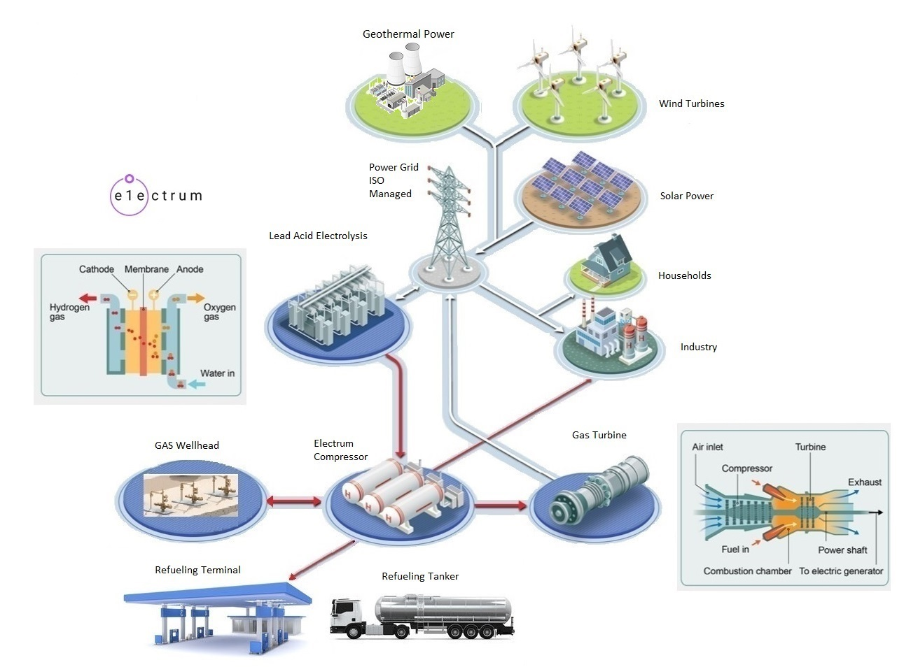
https://electrumpower.tech
Notes:
Dan Gowin
Copyright©, Electrum Power & Technology, All Rights Reserved.

Slide 2
Notice
Notes:
This information is for educational purposes only.

Slide 3
Let’s review what has been going on with Energy in the U.S.

Slide 4
Coal Fired Power Plants
Anthracite
Over 80% Carbon
Great coal from Pennsylvania
Bitumen
From 40% to 80% Carbon
Why use scrubbers?
Half the Power of the Turbine
Lignite
Less than 40% carbon
Burning dirt
Notes:
Anthricite, the Power Plants haven’t seen this coal in over 50 years.
Bitumen. When burning a fuel that is over 40% NOT carbon, you must use a scrubber. If Not, Your first problem will be your employees. Most of your employees will live within 60 miles of your Power Plant. Every morning when starting out for work, your employees, will scrape ¼” of ash off there pickup truck. Eventually they have a very human reaction “My God what am I breathing?”. Your second problem will be Farmers. Farmers spend million of dollars on fertilizer and pesticides. Soil testing is a large part of there operation. If you're raining down Mercury and Cadmium on Farmland, eventually your will be in court. Downside of running a scrubber, half the Power of your Turbine will be consumed by THE scrubber.
Lignite. The U.S. has over 300 years' worth of lignite. When your Power Plant burns Lignite, you have to remember half the energy of your fuel is consumed by the scrubber. And then you mix in Grid Losses of 4%, you have a total of only 16% of the energy of a fuel that is mined and transported by the ton arriving at your customer. Not to mention over 60% of this fuel is NOT carbon. Where do you store the ash?
What puts a coal fired power plant out of business?
Diesel. The Front Loader, Dump Truck and Locomotive all run on Diesel.
Loading the coal. Disposing of the Ash.

Slide 5
Why convert to Combined Cycle?
Notes:
Per the USGS, Bitumen, in the U.S., will for all practical purposes be gone by 2032.
I’ve converted 4 coal fired power plants to combined cycle in my career. Because of the Coal.
Note: When replacing a energy source on the Power Grid, you first must repay the original loan and then depreciate the value of the plant. Only then will you qualify for a new loan to replace the power source.

Slide 6
Braess Paradox
Notes:
Braess's paradox is the observation that adding one or more roads to a road network can slow down overall traffic flow through it. The paradox was first discovered by Arthur Pigou in 1920,^{[1]} and later named after the German mathematician Dietrich Braess in 1968.^{[2]}
The paradox has analogies in electrical power grids and biological systems. It has been suggested that, in theory, the improvement of a malfunctioning network could be accomplished by removing certain parts of it.
Adding new generation can cause the power grid to become unstable. Adding load like Housing subdivisions or even Tesla’s can cause the power grid to become unstable.

Slide 7
Whiting Oil Refinery
Notes:
Whiting Refinery - Whiting, Indiana
Built in 1889 by Standard Oil of Indiana.
Refines 400,000 barrels per day (64,000 m3/d) of crude oil.
IN 2012 BP undertook a $14B modernization project to convert from American crude to Heavy Western Canadian crude.
I’ve installed four LM6000 Gas Turbines at the Whiting Refinery.
There are 155 Oil Refineries in the U.S., for a total financed cost of $2.33 Trillion.
By the end of 2025 there will be 153 refineries in the U.S.. Tight margins.

Slide 8
Notes:
Currently (2025) Over 70% of the World Hydrogen is produced at oil Refineries.
The Primary purpose is to remove Sulfur from the product.

Slide 9
Hydrogen Storage at the Refinery
Notes:
There are three storage wells at the Whiting refinery. One for Propylene. Another for Ethylene. And the last for Hydrogen.
The volumetrics of hydrogen make it difficult to transport or store. One Kilogram of hydrogen, at room pressure, occupies 12,000 Liters of volume.
The safest way to store hydrogen is in a gas well. It is also the most economical way to store the gas.
Hydrogen is a gas that is lighter than air and will expand to the point it won’t burn. Hydrogen must be compressed to be used.

Slide 10
U.S. Natural Gas System
Notes:
Almost 25% of the Natural Gas in the pipeline system is consumed just powering the pumps. Whether you use the gas or not.
There are multiple Oil & Gas pipelines that Criss cross North America. Trillions of dollars in investment.
Note: In the Permian they say they don’t have enough Natural Gas Pipeline Capacity to bring all of the shale oil to market.

Slide 11
Notes:
Most Americans don’t recognize the scale of the Oil & Gas Industry. A Natural Gas Pump Station. Behind the cylinder painted blue are pistons over 12” in diameter. This Compressor has 6 cylinders, with a crankshaft between them. There is a Natural Gas fired diesel engine to the right, powering the pump. The pumps here in the Mid-West are housed in buildings, to protect from the creation of Methane Hydrate, a mixture of methane and water that freeze in the pipes when is gets cold.

Slide 12
Notes:
Down at Cheniere’s Sabine Pass LNG facility they use Gas Turbines to power the Pumps. At the facility they use chains of compressors and Fractionating columns to separate Natural Gas into separate gas streams. The first stage compresses to 50 psi because Butane becomes a Super Critical Fluid at 25 psi. Then to 150 psi, to separate Propane. Then 220 psi, to separate Hydrogen. Then 550 psi, to separate nitrogen, Then 650 psi, to seperate any oxygen. Then 750 psi, to separate ethane. Then 950 psi, to separate methane. And last 2,000 psi, to push CO2 into pipeline systems. They compress multiple gases into Super Critical Fluids that can be separated. The process of compressing gases generates lots of heat. Each one of the trains have many cooling fans.

Slide 13
Haber Bach Ammonia process
Notes:
The Haber Bach process is plagued by too low pressure. The process for making Ammonia favors higher pressure at lower temperatures. At 200 BAR (2900 psi) the main reactor must be heated to 450c (842F), just to get the iron catalysts to react with the Nitrogen and Hydrogen. The efficiency of the processes, at 200 BAR, is only 19%. The above process uses massive amounts of Natural Gas, due to the need to bringing the Steam Reformer up to 500C and the Haber Reactor up to 450C.
Note: At 1000 BAR (15,000 psi) the Haber reaction occurs at 21C (70F) and is 90% efficient. Just by increasing the main process loop pressure can yield a large increase in efficiency and safety.

Slide 14
Notes:
IMO 2020 Fuel Standard.
The International Maritime Organization 2020 Fuel Stand took effect in January of 2020. The Shipping Industry had a choice of changing from Bunker Fuel to Natural Gas, LSFO or installing a scrubber on all of the Worlds Commercial Ships. Most chose the path of least resistance. Burn a fuel comprised of #2 Diesel. Low Sulphur Fuel Oil (LSFO) is 2 parts #2 Diesel and 1 part Fuel Oil.

Slide 15
Diesel Shortage since 2020
Notes:
Ships order fuel by the ton. Truckers purchase fuel by the gallon. Nobody made changes to the Refineries.

Slide 16
Notes:
The Oil & Gas Industry is truly global. It has supply chains that stretch around the planet.
From the Oil Field, by truck, train, pipe or ship to the Refinery.
From the refinery, by truck, train, pipe or ship, to the customer.
This global supply system allows the Oil & Gas Industry to Normalize the cost of producing fuel across the entire planet. This allows economies of scale to reduce the cost of fuels for vast parts of the Worlds populations.

Slide 17
Notes:
On Monday, March 10th, 2025. The Stena Immaculate Oil Tanker, while anchored awaiting to be unloaded, off the Coast of Scotland, was struct by a Cargo Container Vessel. The Stena Immaculate was carrying 220,000 barrels of Jet Fuel, for the U.S. Military Sealift Command. This fuel was destined for U.S. Military assets in the European Theatre.

Slide 18
Notes:
Unfortunately, one man is missing. All the rest were safely rescued. But this incident highlights a vulnerability the U.S. Military has and has been working to reduce or eliminate since WW2. The Bad guys know the same thing that we do, you don’t have to take on the M1 Abrahm's Main Battle Tank. You just have to destroy the fuel truck. You just have to destroy the fuel chain.
The Oil & Gas Industries supply chain is a tactical nightmare for the U.S. Military.

Slide 19
U.S. Oil & Gas Industries Future Plans.

Slide 20
Notes:
Back in 2022, Saudi Arabia came out with a similar report stating they needed $10T of investment over five years just to maintain oil production. They site the lack of new oil field discovery as the underlying issue. August of 2024 Exxon published the above report stating the same issues.
Unfortunately, the Public has concluded that the Oil & Gas Industry is trying to extort the rest of the World.

Slide 21
Notes:
My backyard is New Albany and Marcellius gas fields.
BTW – Michigan has 16,000 depleted Oil & gas wells.
I spent some teenage summers in Sinclair Wyoming, helping my cousins on various projects.

Slide 22
Notes:
Geologists hate M. King Hubbert Oil Production Curve. Hubbert based his curve on empirical data. Its not a geologic theory, its based on the interaction between human beings and geology. Unfortunately, that means the production of any oil field is unpredictable, due to human interactions. Barnettt and Fayetteville shale fields are in terminal decline. Bakken and Eagle Ford are still up in the air. The Bakken and Eagle Ford Graph’s clearly show the interactions of humans. The graphs are from Goehring & Rozencwjg.

Slide 23
Notes:
In 2017 Citizens Energy (Formerly Indiana Gas of Evansville), sold this Oil & Gas Field to Center Point Energy, of Houston, and I was given the operations contract. I have a few engineers in Louisville that visit the facility a few times a year. I’ve subcontracted out the Well and Pump House services to Royal Oil Field Services, of Odessa, TX. My staff maintains the SCADA devices for feeding data into the State DNR system.
Every spring, we pump natural gas up from Texas and store it in our gas storage wells for Winter heating and electricity. Evansville oil & gas field is in terminal decline. The other asset I manage is Shelbyville Gas Field, of Shelbyville, IN. Most of the Oil & gas fields I manage were discovered in the 1890s.
In the past I made predictions about the Petersburg Coal Fired Power Plant being converted to Combined Cycle Gas Turbine. The Conversion started this year. It is projected to be completed the Spring of 2026. The cause for conversion, the coal in Indiana has been mined out.

Slide 24
Notes:
The system I manage extends into Marcellas Shale in Eastern Ohio.
The Devonian Shale in Eastern Ohio is over 20,000 ft. deep. That’s over 6 km.
At these depths, the temperatures and pressures are high enough to crack large hydrocarbon molecules, into small ones like Methane and Ethane. Its mother Natures cracker Unit. The Marcellas mostly yields gas. Some condensates.
There are 22 documented cases where the horizontally dilled wells were too close together, and during fracking, the secondary well heads were blown off. With water shooting out of the ground over 148C (300F).
It’s becoming more expensive to produce shale gas. Ten years ago, the laterals were only 4,000 ft. That’s 20,000 ft of Vertical casing pipe and 4,000 ft. of Horizontal, for a total of 24,000 of Steel pipe in the ground. Today laterals are over 25,000 ft., with 20,000 Vertical. For a total of 45,000 ft. of Steel Pipe in the ground. Life of the wells is expected to be only 3 years. We’re getting only 2/3 as much gas as we did 10 years ago, as rated per foot drilled.

Slide 25
Notes:
Liquid CO2 is Super Critical CO2. When CO2 is compressed to 1055 psi it turns into a Super Critical Fluid.
These CO2 pipelines are pressurized to 2,000 psi. This CO2 pipeline System is advertised as a CO2 Sequestration System.
At these pressures, CO2 is used as a solvent. For example, Super Critical CO2 is used to removed Caffeine from coffee beans.
I’m going to talk about Wyoming. I’m going to talk about what I know about.
The Salt Creek Oil Field was discovered in 1889. And by 1935 it had run dry. Since 2004, Haliburton Oil Field Services has been attempting to resurrect production from this Oil Field. The Oil field is located 20 miles North of Casper, WY.
The pipeline system in Wyoming is designed to pump Super Critical CO2 in the Salt Creek Oil Field.
Its known as, Enhanced Oil Recovery with CO_{2.} The CO₂ is captured in a natural gas facility in the nearby LaBarge field.
In 2016, CO₂ was leaking from an abandoned well in the field and led to its temporary closure.

Slide 26
Notes:
I was notified 3 years ago that the Heartland Greenway pipeline, by Navigator CO2 would be extended down to the Evansville Oil & Gas field for Enhanced Oil Recovery with CO₂.

Slide 27
Notes:
They plan to leach the hydrocarbons out of the already fracked Shale Fields, with Super Critical CO2.
Enhanced Oil Recovery with CO2. Source of the CO2 are Ethanol Plants, Power Plants and Oil Refineries. Projected cost $5T. Projected completion 2030.

Slide 28
Notes:
Many of the CO2 Pipeline Projects have been canceled.

Slide 29
Notes:
The area in green was supposed to be two new offshore oil fields to come online this year and next.
Both have been delayed until 2026 and 2027 respectively. Total forecast production 250,000 barrels per day.
Can they bring the costs down? Can the price of oil rise up to the break even?

Slide 30
Notes:
Alpine is supposed to come online in 2030. Projected 80,000 barrels per day.
The Future of Kodiak, Ahpun East and Ahpun West is uncertain. For Pantheon to drill each well is $25M. A field requires minimum of 9 wells to be drilled. Drillers charge by the Meter. Total capital to start Kodiak, Ahpun East and Ahpun West is $225M each. Odds are most of these wells will be dry. What is the break even for this oil?

Slide 31
Questions
Notes:
Peak Oil was a topic of March 13th CERA/Week conference.

