Slide 1
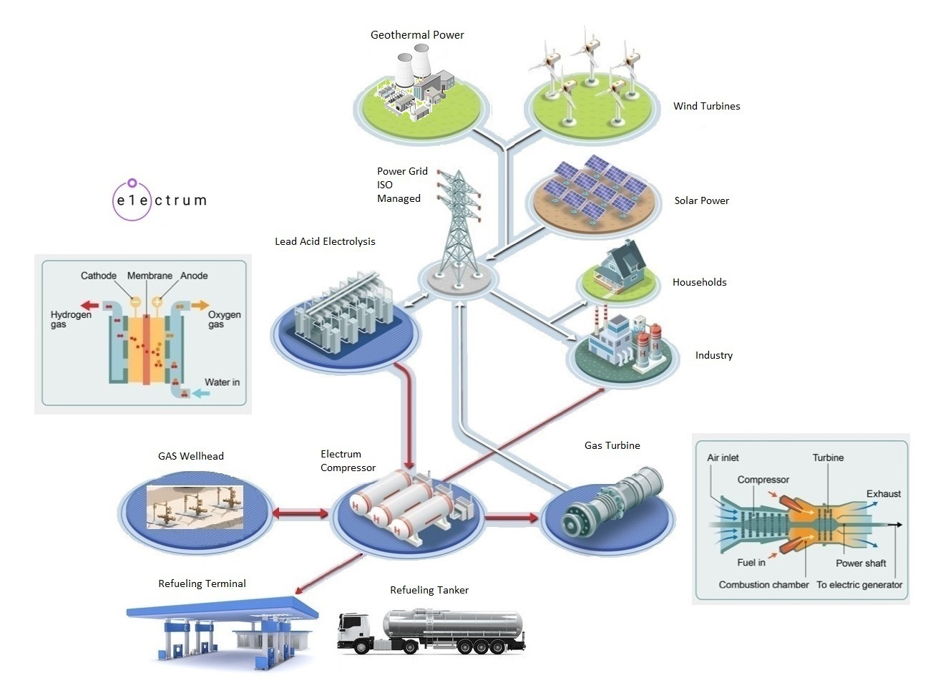
https://electrumpower.tech
Notes:
Dan Gowin
Copyright©, Electrum Power & Technology, All Rights Reserved.

Slide 2
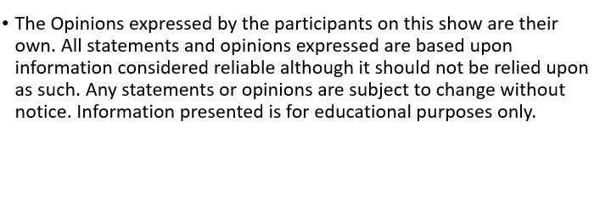
Notice
Notes:
This is for educational purposes only.

Slide 3
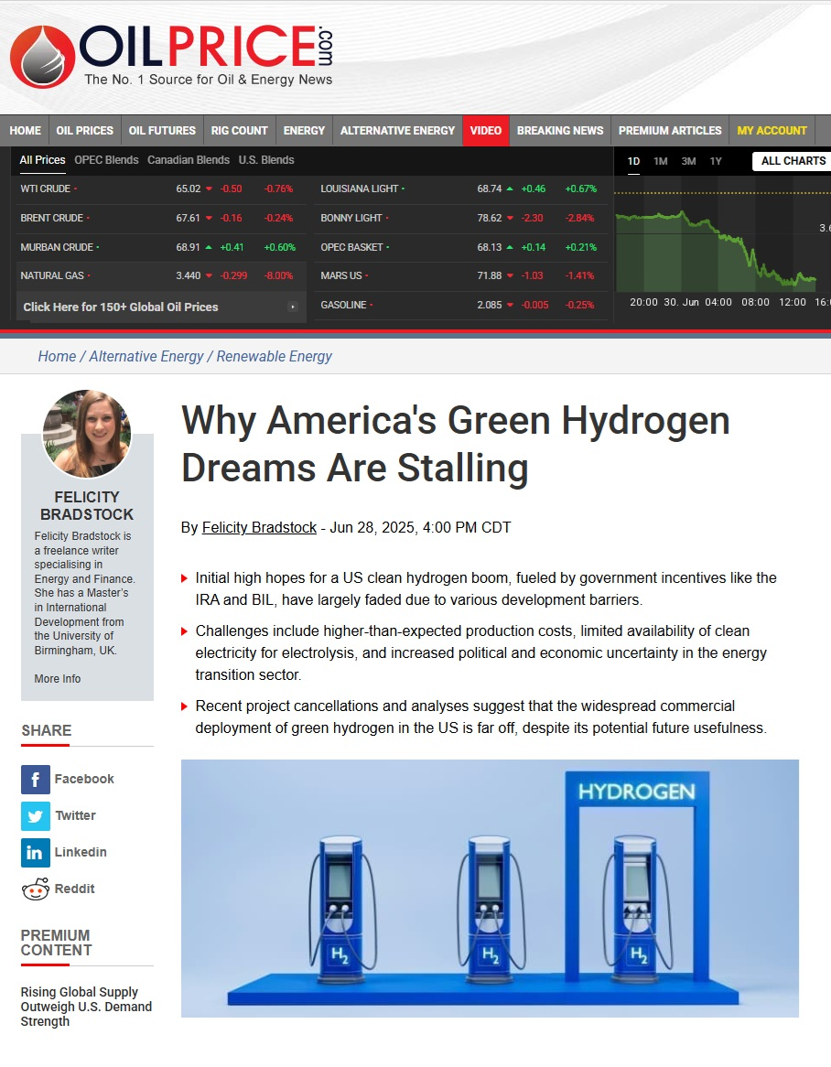
Hydrogen Dreams in America
Notes:
A number of Hydrogen HUBs around the country have been suspended indefinitely. Interesting most of these HUBs are centered around Oil Refineries. The IRS release hydrogen taxing rules one week before Donald Trump became President of the U.S.. Presidents Trumps first task was to suspend the previous administrations Hydrogen tax credits.

Slide 4
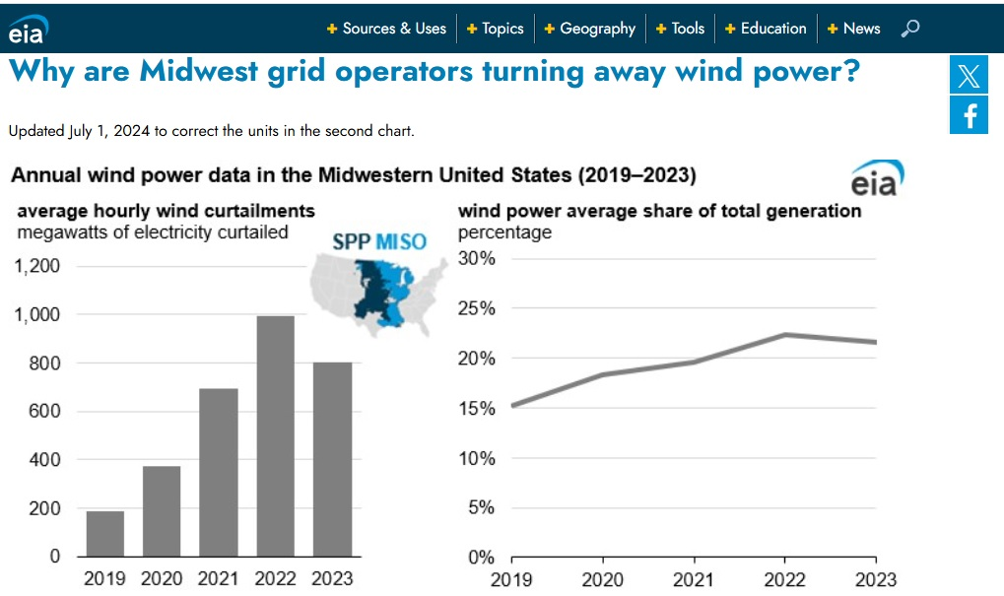
Notes:
The Oil & Gas industry claims Green Hydrogen Production from Wind and Solar is too expensive. I guess nobody told them about all the Wind and Solar Power that is curtailed. Trillions of watts of wasted electricity. Hydrogen that could be produced for the cost of the equipment.

Slide 5
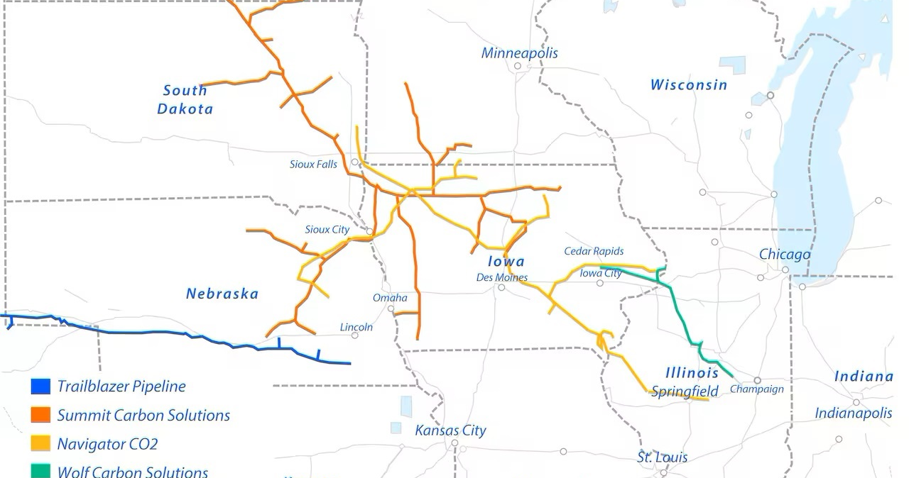
Notes:
The Truth. The BP Whiting Refinery, in Indiana, Hydrogen HUB was suspended indefinitely, due to its real purpose being suspended or delayed in construction. The United States Continental CO2 Pipeline.

Slide 6
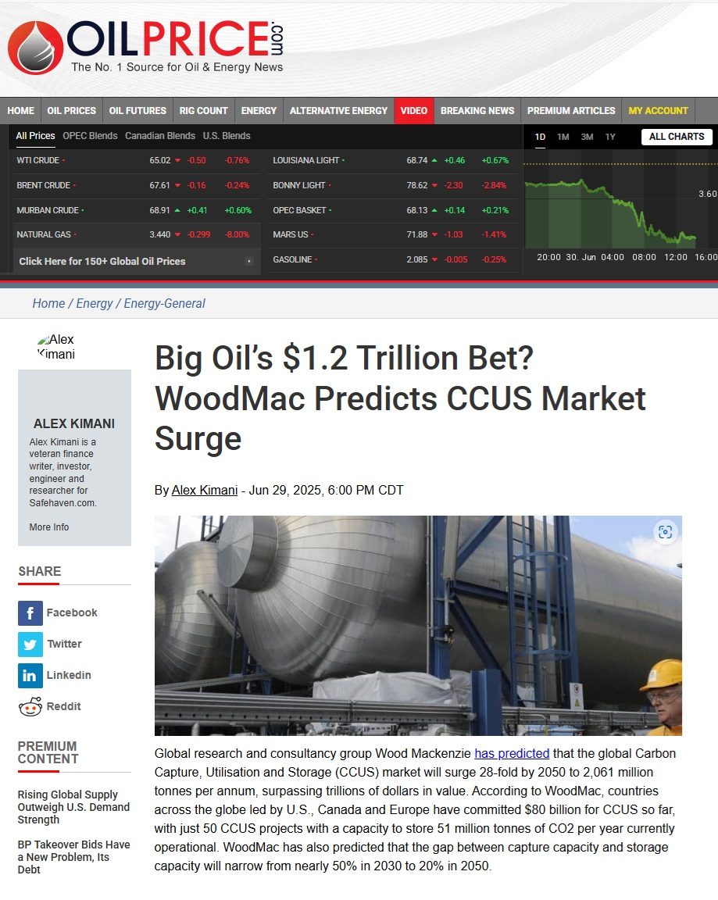
Carbon Capture for Blue Oil Recovery
Notes:
They’re datacenters for AI springing up all over the United States. The Oil & Gas Industry is building Gas Turbine Power plants, right next to the New Data Centers. To clean it up, they’re offering carbon capture right in the Continental CO2 Pipeline system.

Slide 7
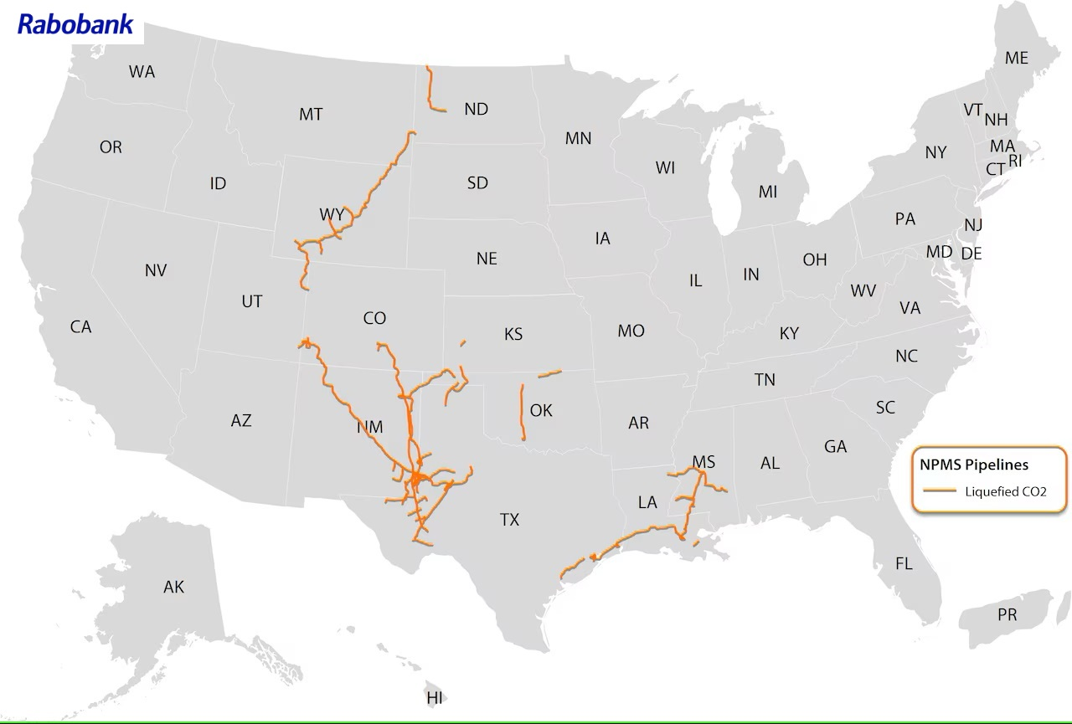
Notes:
Last year, Exxon acquired CCUS specialist Denbury Inc. Denbury recycles CO2 through its Enhanced Oil Recovery (EOR) operations and uses it to produce environmentally-friendly, carbon-negative Blue Oil.

Slide 8
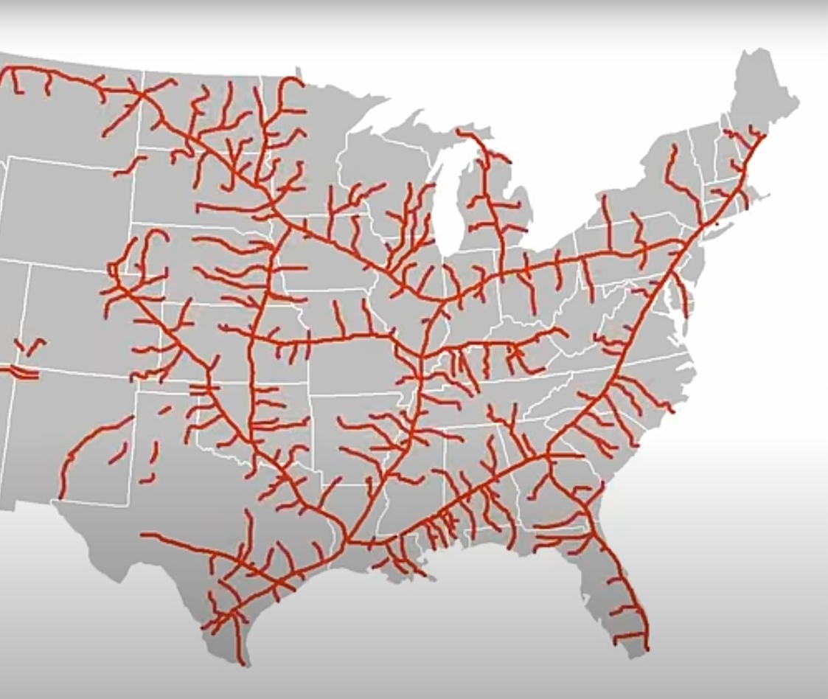
Questions?

