Slide 1
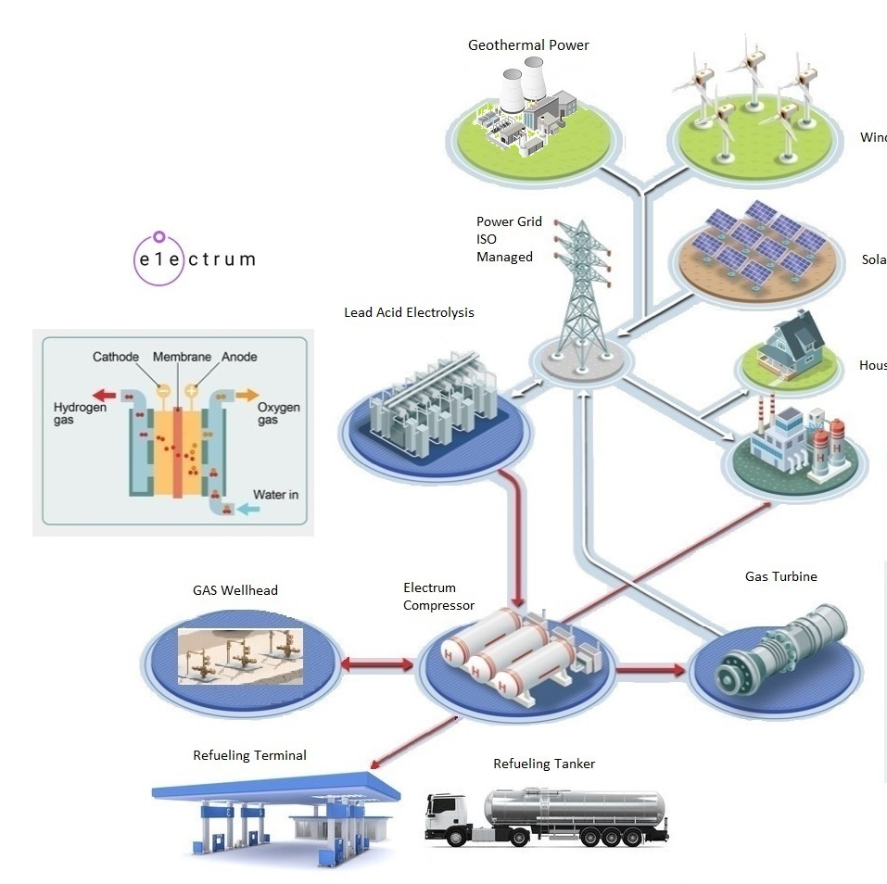
https://electrumpower.tech
Notes:
Dan Gowin
Copyright©, 2 026, Electrum Power & Technology, All Rights Reserved.

Slide 2
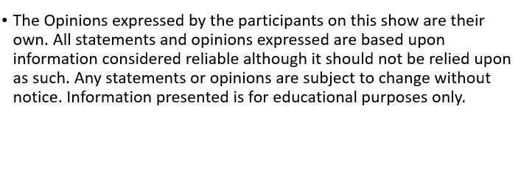
Notice
Notes:
This information is for educational purposes only.

Slide 3
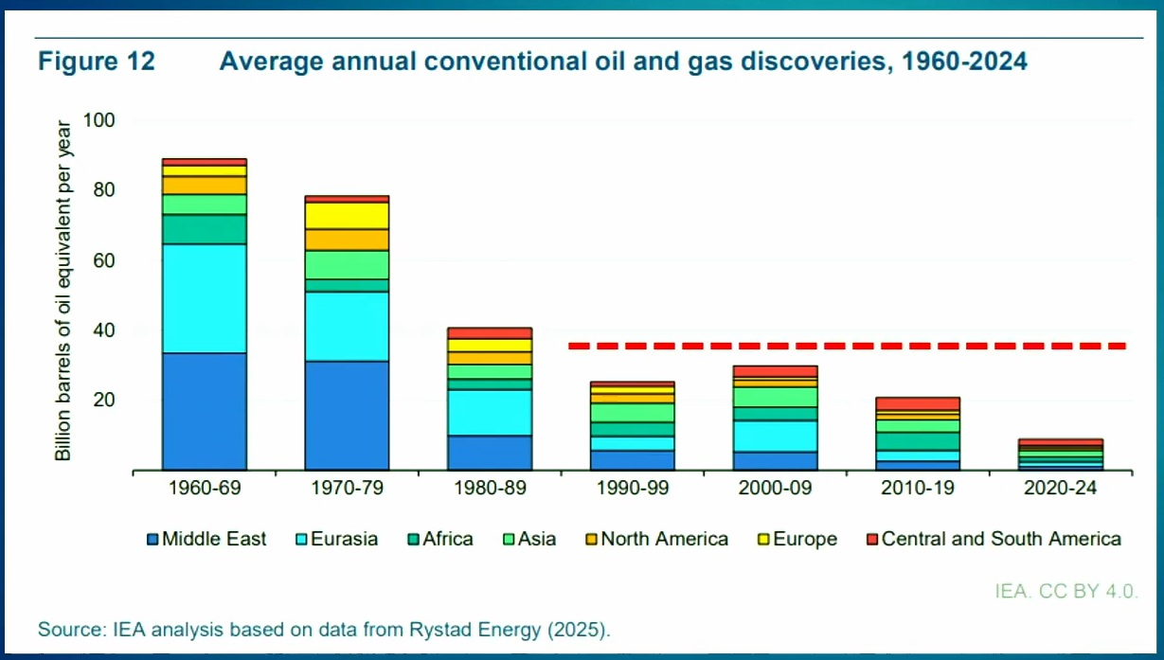

Slide 4
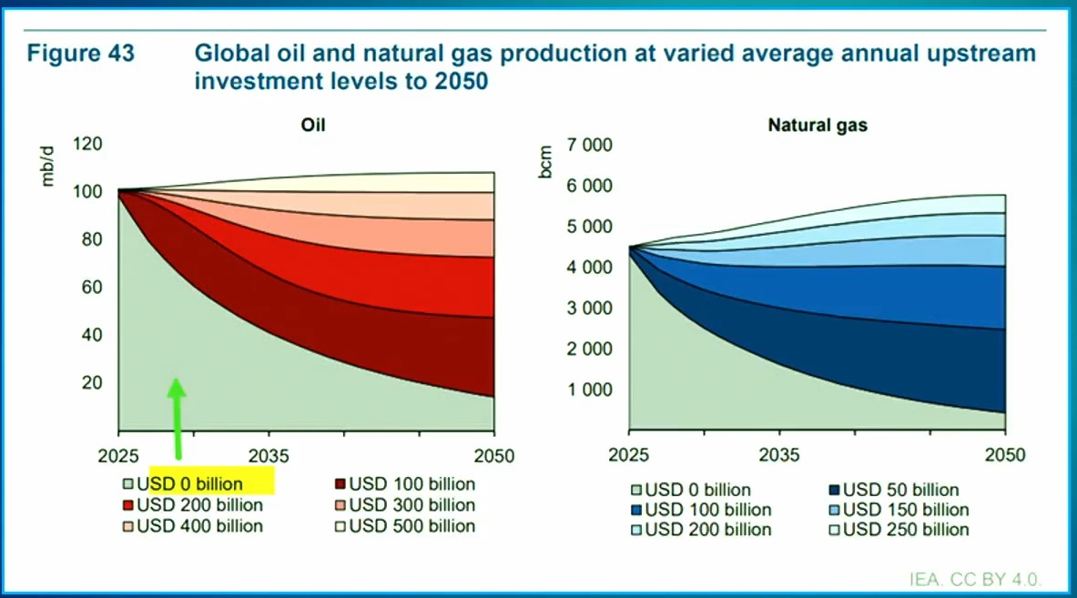
Notes:
Just to keep production flat.

Slide 5
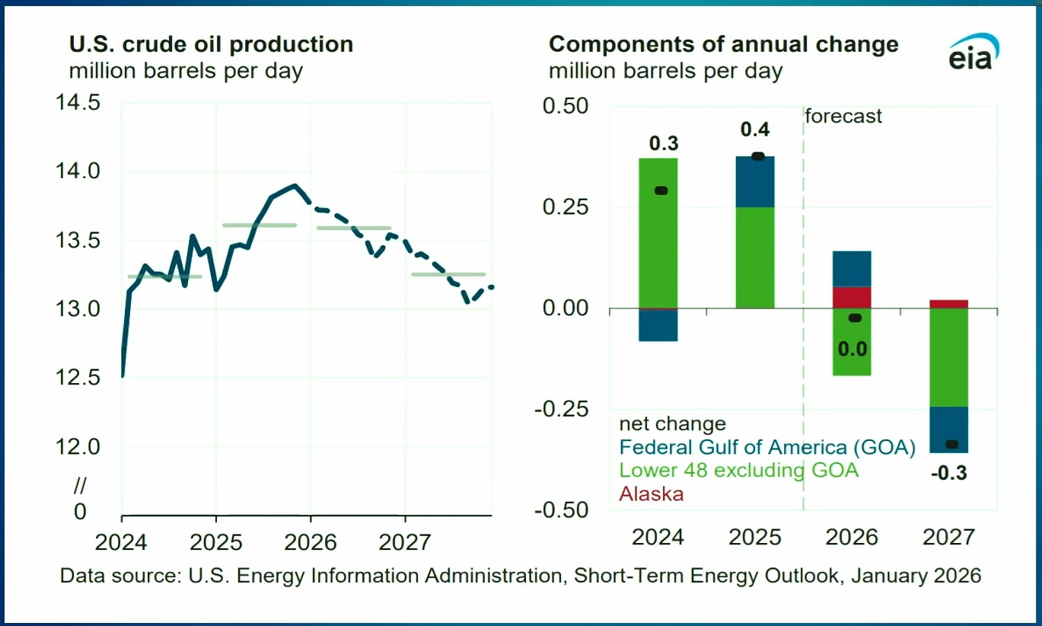

Slide 6
Shale Production
Production falls 74% the first year.
Production falls 47% the second year.
Production falls another 47% the third year.
By the fourth year steel pipe is canabalized.
The CEO’s of Diamondback, Occidental, Cheveron and ConicoPhilips have stated in SEC filing to investors, U.S. Shale production has peaked.

Slide 7
U.S. Oil reserves Proven and Probable
ExxonMobile has 11 years.
Chevron 8.5 years.
BP 7.9 years.
Royal Dutch Shell 7 years.
Gulf of America maximum production 2 mbd by 2030.
Note: due to costs production will end ~2037.
Brazil, Guyana, Venezuela 4 mbd.

Slide 8
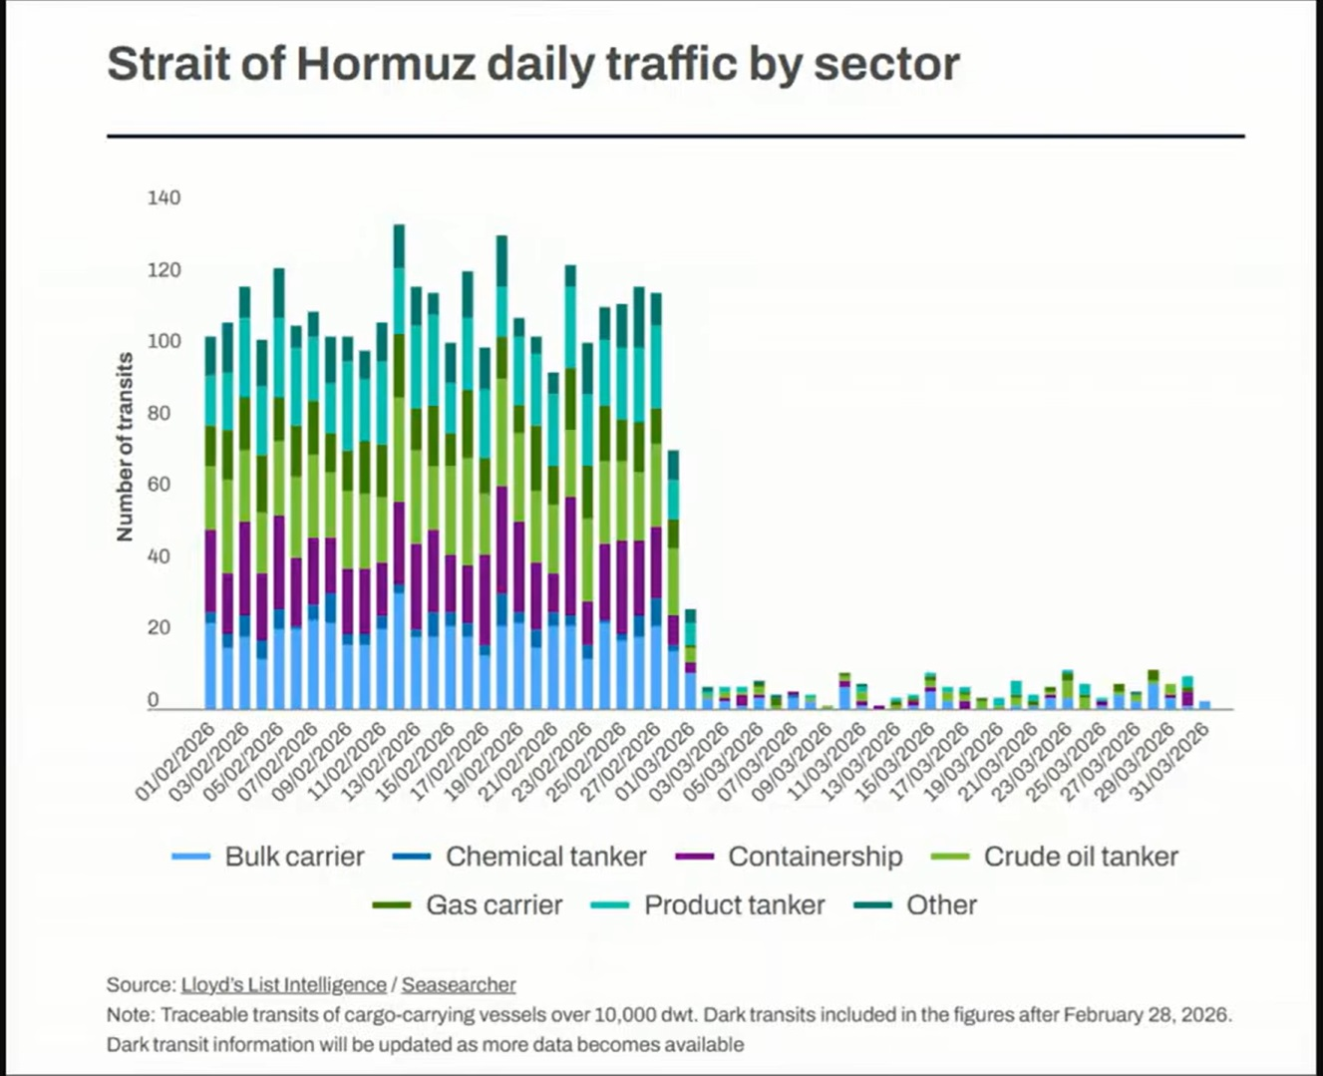

Slide 9
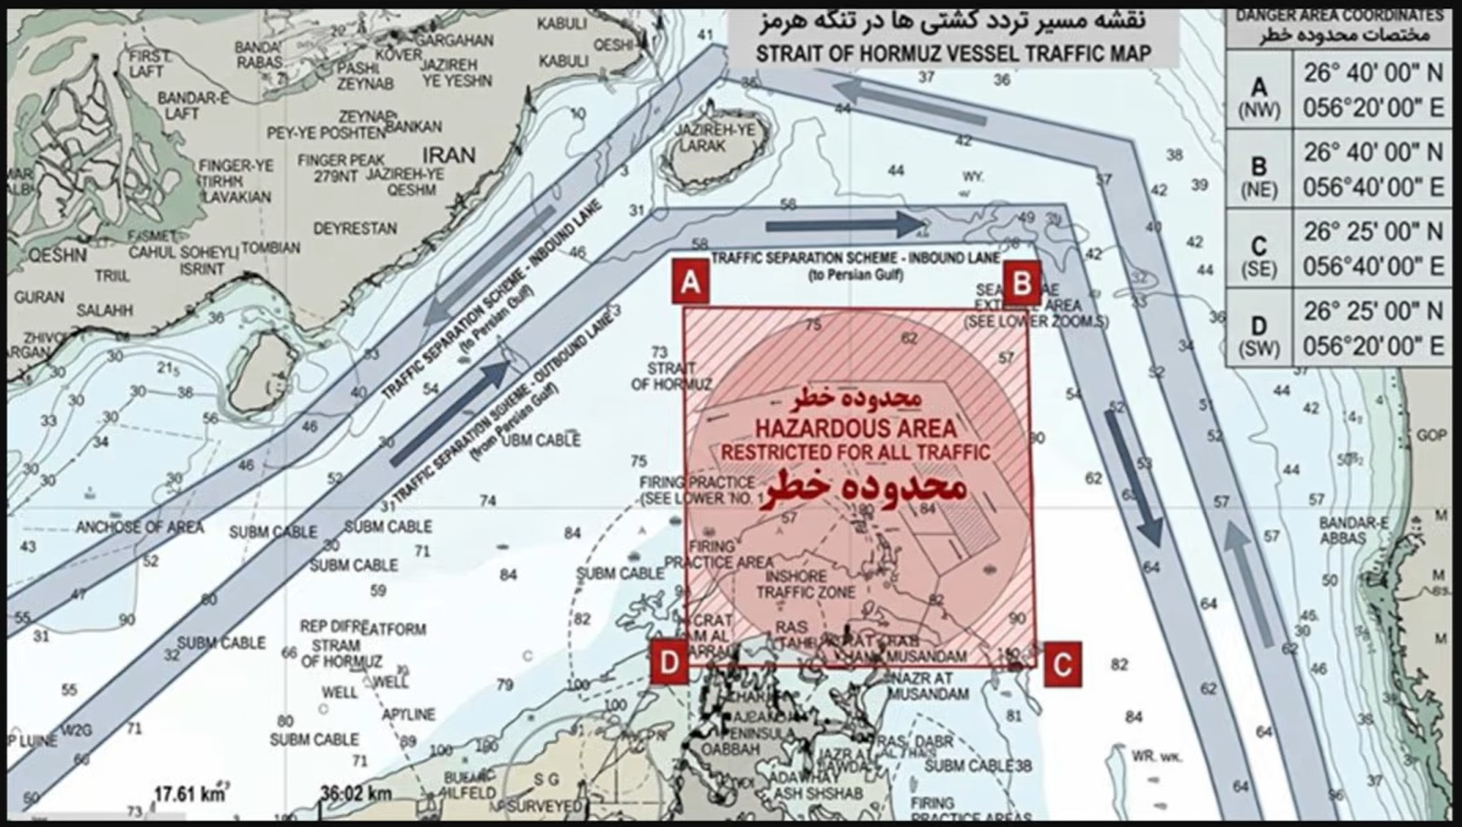
Notes:
On April 9th, 2026, the government of Iran announced the Straights of Hormuz were deemed a hazard to navigation due to the presence of anti-ship mines.

Slide 10
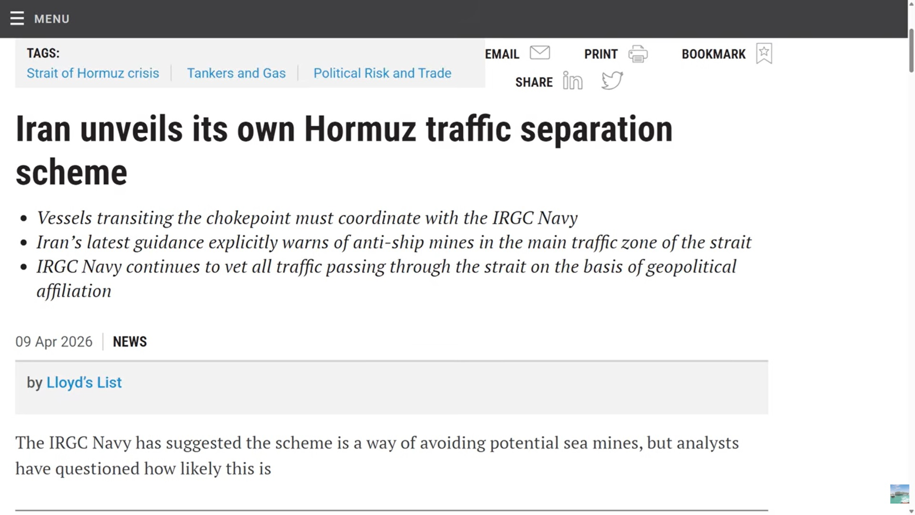
Notes:
This is from Lloyds of London. As long as the U.S. Military is in the Persian Gulf, shipping is uninsurable. Reasoning is the Country of Iran is not a movable object.

Slide 11
Analysis
About 20.6 mbd transit the Straights of Hormuz.
Traffic has collapsed by 92%.
Larger than the 1973 disruption by 3 to 5 Times.
Oil Tankers trapped in and outside the Persian Gulf.
~30 VLCCs trapped in the Persian Gulf.
~90 VLCCs trapped outside the Persian Gulf by contract law.

Slide 12
Bypass only changing the risks
Saudi Arabia East West pipeline to Yanbu.
Theory 7 mbd.
Designed for temporary service 4 mbd.
UAE to Oman pipeline.
Theory 1.8 mbd.
Actual 1.7 mbd.
Iraq North pipeline.
Destroyed.
Total disruption per day.
15.9 mbd.

Slide 13

Reservoir Revenge
Wells are shutin when storage is at 90%.
Steps to restart.
Remove sub pump
Chemical Treatment
Clean accumulated water
Replace Pump
Sediment Clog
Parrafin
Pressure Damage
Time to restart.
Up to 2 years before production is back to 80%.
Personel and equipment shortage.
Asian manufacturing
Damaged facilities.
Over 1 mbd refinery damage.
Qater LNG Facility damaged for 3 to 5 years.
UAE Gas Field is on fire.
Saudi Arabia Petrochemical park is on fire.
Notes:
Kharg Island, South Pars, Fujairah port, Ruwais oil refinery, Ras Tanura refinery and Samref refinery coast Red Sea have been damaged. Iraq has shut in its oil fields.

Slide 14

Strategic Petroleum Reserve
United States
411 Million Barrels
125 days supply
Japan
350 Million Barrels
170 days supply
IEA
400 Million Barrels
One time
China
1.2 Billion Barrels
108 days supply
Kazakhstan

Slide 15

Metabolic collapse of byproducts
Helium (Source Qater LNG)
Cooling applications this was 33% of world supply
EUV Lithography (Semi Conductors)
Silicon crystal growth
NASA, MRI for medical
Sulfur
Over 45% of world trade gone
EV Battery Processing
Phospate Fertilizer
Copper processing
Nitrogen Fertilizer
Over 30% of world trade
Urea & Anhydrous Ammonia
In 40 days, crop planting will become critical
Aluminum & Methanol
Aerospace
Automotive
Plastics of all kinds

Slide 16
Global South
As of April 2026
Power Plant Usage 23%.
Garment Sector down by 70%.
Diesel in Storage down by 70%.
LNG Imports are suspended
Social Unrest
Industrial Collapse due to diesel shortage
Military guarding what is in storage

Slide 17
Risk to World GDP
Short
Up to 2 weeks Straight of Hormuz Closed
$330B GDP Loss
Medium
From 4 to 6 weeks Straight of Hormuz Closed
$770B GDP Loss
Prolonged
From 3 to 6 months Straight of Hormuz Closed
$2.2T GDP Loss
Notes:
Stagflation

Slide 18
Fossil Fuel Addiction
Nations Most Exposed
Those nations without renewables
Economics
Stagflation
Cracker economics
Plastics Industry starved of feed stock for plastic
The world is short Over 7 million metric tons of ethylene

Slide 19
A Ripple of 2 to 5 years
Phase 1
Phase 1
Hormuz Shock
Iran become a world energy risk
Phase 2
Phase 2
From 2027 to 2028
Refinery capacity moved from Middle East
North America, Brazil, Argentina and Guyana considered safe as an energy source
Iran has become a permanent security risk
Phase 3
Phase 3
From 2029 to 2030
Rise of Electric Transportation in Japan and EU
China center of world supply chain
End of just in Time manufacturing
Replaced with Just in Case manufacturing
Corporate costs rise

Slide 20
Summary
Permanent Hormuz Risk Premium
Cost embedded into World Manufacturing
Permanent rise in prices Worldwide
Western hemisphere safe haven
U.S., Canada, Brazil, and Guyana
New investments at the expense of Persian Gulf States
Status of Venezuala in unknown
World Food shortages
Caused by fertilizer shortage
World wide crop yields will reduce from 2027 to 2028
Political Issue for decades
Starvation
Straights of Hormuz not opened by July 2026
Persian Gulf Countries will become a Legacy Asset by 2030

Slide 21
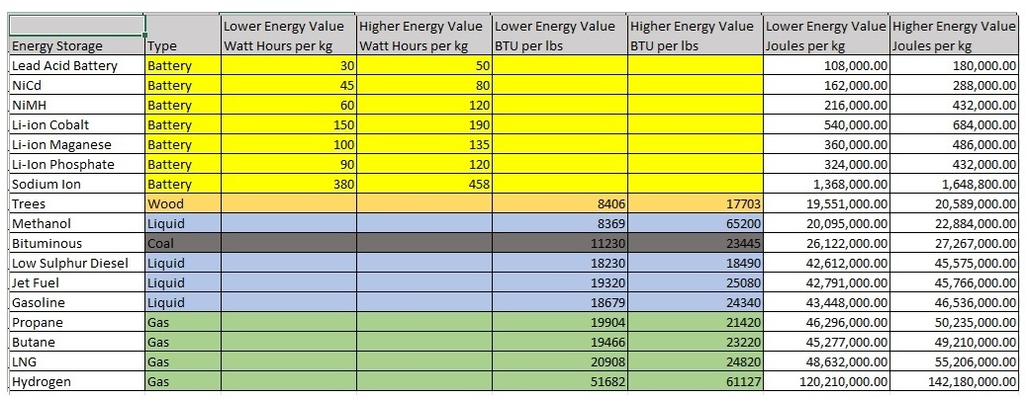

Slide 22
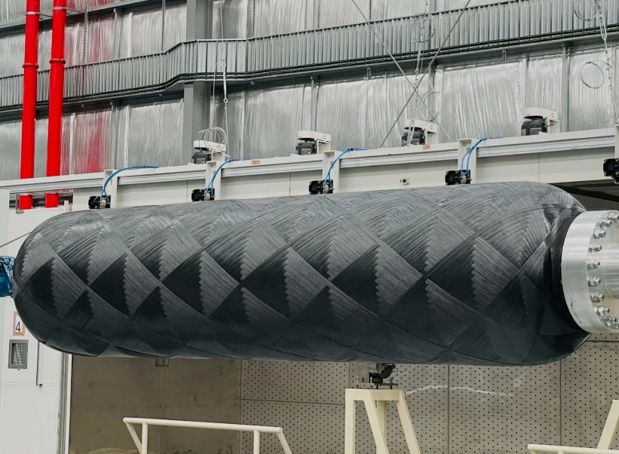
Questions
Notes:
Type 7 Carbon Fiber Tank, 56 kg hydrogen, @2800 Bar. Total weight with fuel 105 kg.
It is theorized that a Toyota Hilux could be driven over 4,000 miles with this tank in the bed of the truck.

